Slide 1

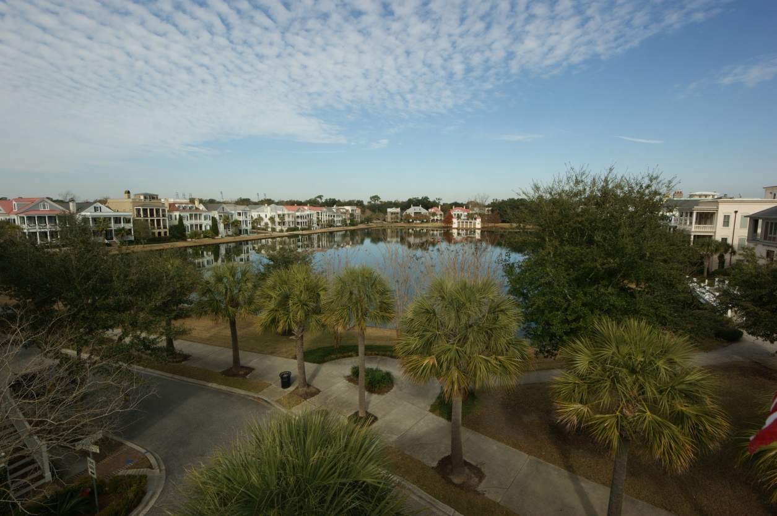
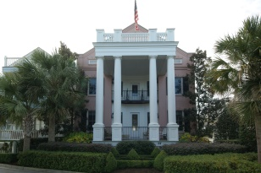
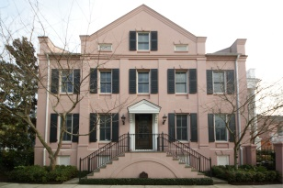
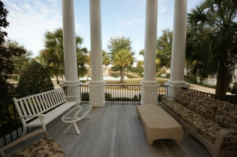
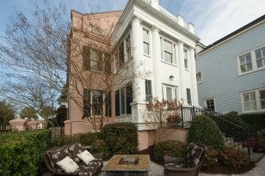
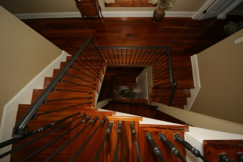
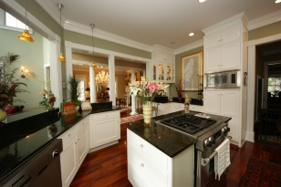
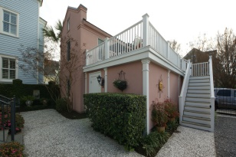
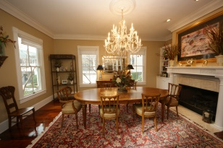
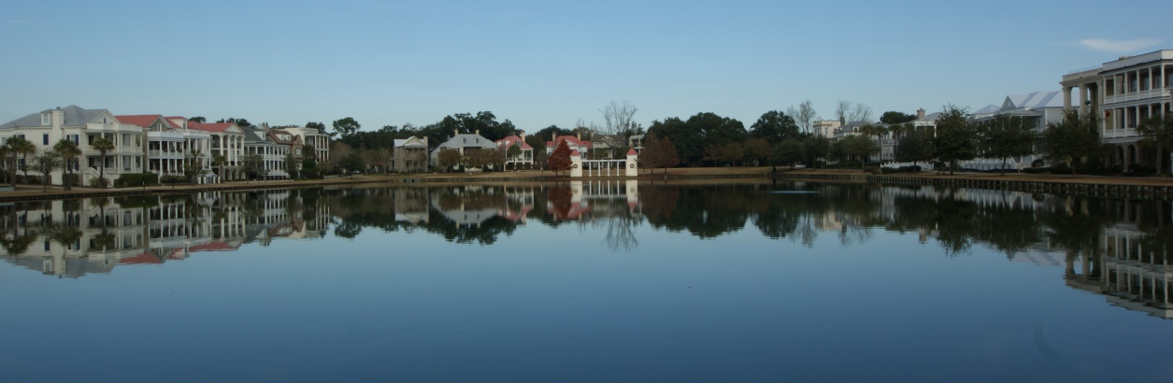
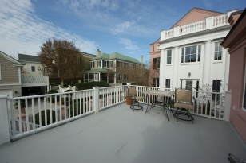
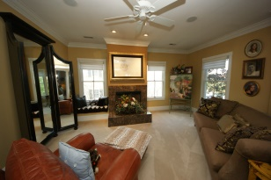
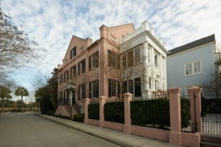


I’ON LAKEVIEW LUXURY
W/ GARAGE APARTMENT
Voted Best Smart Growth Community and Best Community in the Nation, I'On is proof that a village can be both neighborly and private. Few communities offer festivals in the village square, farmers' markets, lively concerts at the outdoor amphitheater alongside the pristine silence of the lakes (this property is lakefront), marshes and rookery. This property is just the retreat and larger lot size you need for both privacy and prestige. Scrupulously maintained since 2003, this property offers options for families and empty nesters alike with flexibility and function. There are plenty of photos and a tour attached that more than tell the story of this home which is ready for you. Click the photos to read additional comments that will make you ready to contact me for a showing. Brazilian Tiger Wood flooring throughout the home make it both contemporary and traditional. The flooring is so durable and beautiful, it has not even been stained, but simply glossed. Two elevator positions are available to the second floor for those that would like to add an elevator and I can put you in touch with the elevator professionals so you can ask your questions. A front piazza with sound system is perfect for a morning cup of coffee or afternoon cocktails or entertaining. The well connected lighting system has programmed mood lighting and safety features. The Master Bedroom is much more as an actual Master Suite with built in laundry and a huge Master Bathroom with his/hers areas, closets, shoe closets and plenty of room. Laundry is also available on the third floor where the kids may live or simply to keep it out of the way. Your guests can have privacy on the third floor if the kids are grown and private porches off the front and the back provide amazing views of the neighborhood or sit down in a chair and no one will even know you are up there. Your guests and family will appreciate hot water on demand recirculating hotel style and your lot is bigger than most, but organized in a way that is private and perfect for entertaining or even housing dogs and the smaller ones can't fit through the fence, which will allow you to rest easy. You will have irrigation to keep everything growing well but zero grass to maintain, which makes life easier. If you need a home office, art studio, small apartment or man/poker or even bunko room, the room over the stand alone garage is more than you can imagine. This property is a must see so contact me now and let's get you in tomorrow.
Address: 87 Latitude Lane
Subdivision: Ion
Area: 42 - Mt Pleasant S of IOP Connector
City: Mount Pleasant
County: Charleston
Listing ID: 14031678
Listing Price: $1,525,000
Sq Feet: 4,653
Bedrooms: 4
Bathrooms: 3½
Acres: 0.13
Stories: 3

