Slide 1
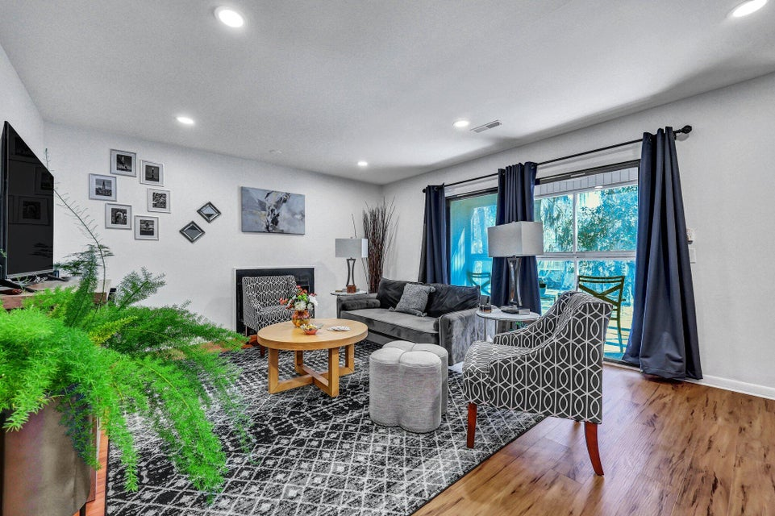
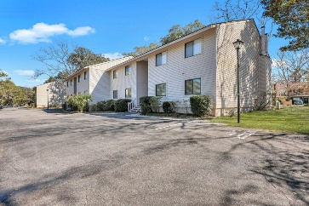
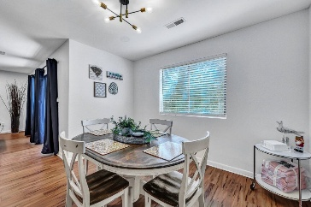
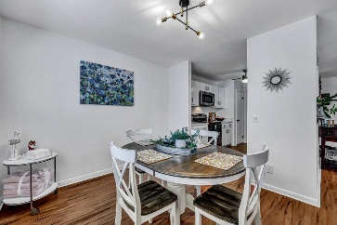
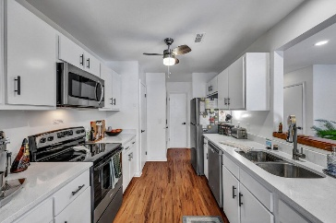
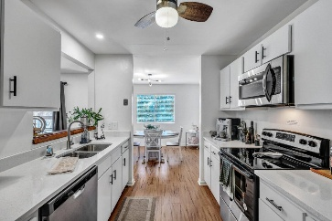
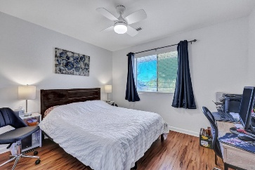
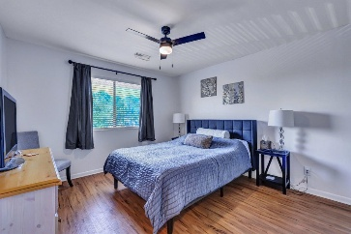
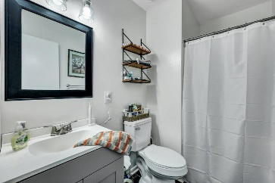
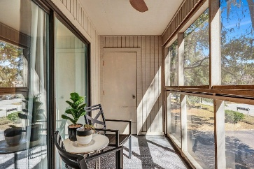
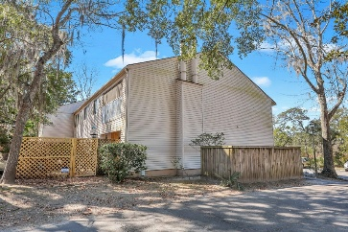



Just Listed! Renovated West Ashley Condo
87 Ashley Hall Plantation Rd #108
Ricefield
Charleston, SC 29407
MLS# 25005473
$325,000
2 Beds | 2 Baths | 1,056 SF
This beautifully updated 2-bedroom, 2-bath condo offers modern upgrades, stylish finishes, and a low HOA fee of just $250/month—all in a sought-after West Ashley location! Will sell furnished with acceptable offer! Enjoy the fresh 2024 renovations, including new luxury vinyl flooring throughout, new tile flooring in both baths, and a freshly painted interior with popcorn ceilings removed for a sleek, contemporary look. The kitchen has been completely refreshed with new quartz/granite countertops, an undermount sink and faucet, newly painted cabinets with updated hardware, and brand-new stainless steel appliances, including a refrigerator, electric range, microwave, dishwasher.
New recessed lighting, ceiling fans, and light fixtures throughout. Stay warm during the cold months with your own fireplace which easily heats up this cozy condo! Additional upgrades include new interior doors and hardware, new 2" blinds and curtain rods, and modernized bathroom fixtures, including new toilets, sinks, and lighting. Step outside to your screened-in porch, the perfect spot to relax and enjoy the outdoors without the bugs! A new HVAC system (air handler & exterior unit) installed in 08/2024 ensures year-round comfort. With thoughtful updates throughout and a prime location near shopping, dining, and easy access to downtown Charleston, this move-in-ready condo is a must-see!
Nick Mazzilli
843-640-5575
nick@themazzilliteam.com
themazzilliteam.com
The Mazzilli Team
3427 W Montague Ave
Suite 6
North Charleston, SC 29418

