Slide 1
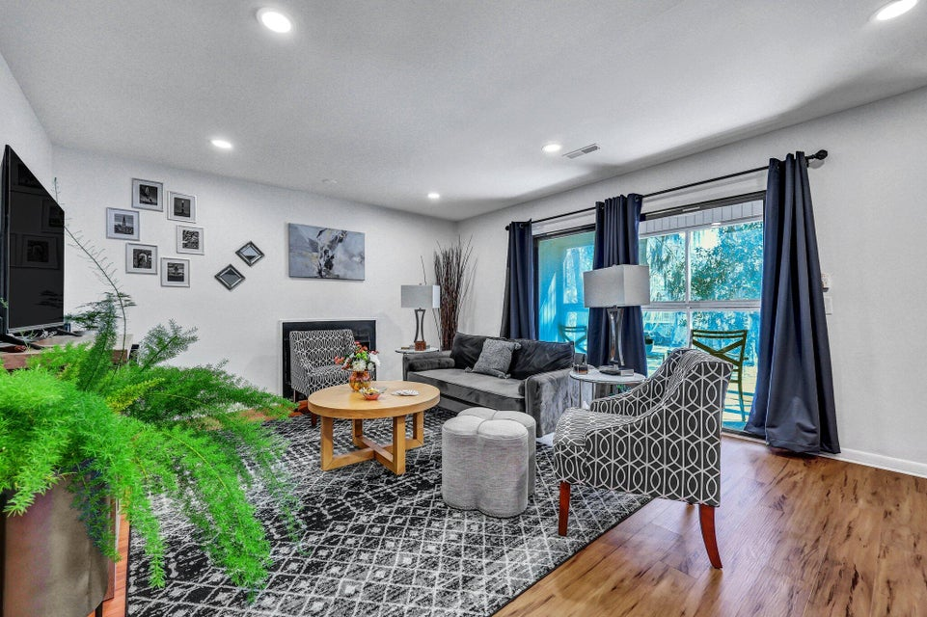
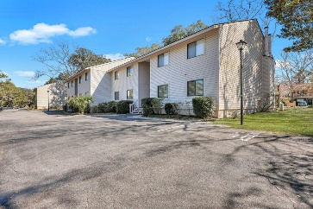
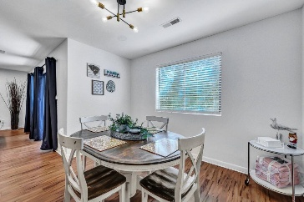
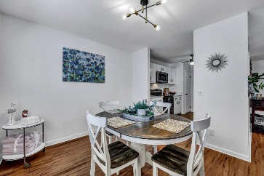
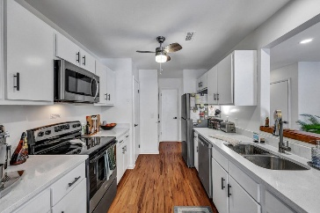
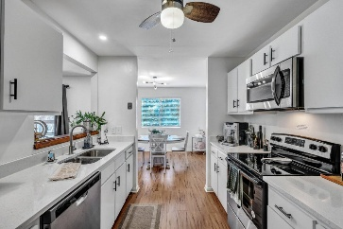
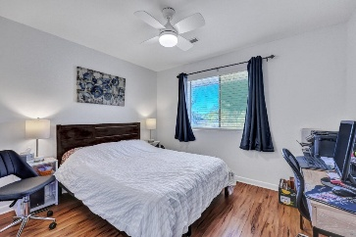
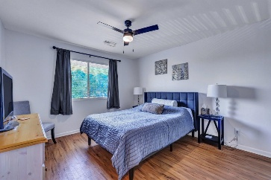
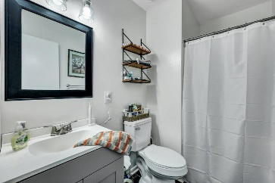
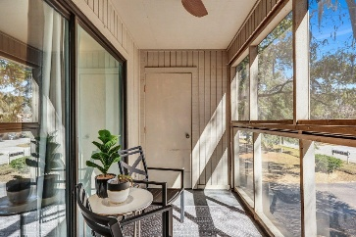
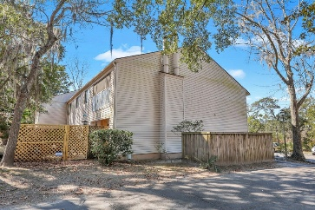



Renovated West Ashley Condo
87 Ashley Hall Plantation Rd #108
Ricefield
Charleston, SC 29407
MLS# 25005473
$298,500
2 Beds | 2 Baths | 1,056 SF
Welcome to effortless living in this beautifully updated 2-bedroom, 2-bath condo, ideally located in one of West Ashley's most desirable areas. Renovated in 2024, this move-in-ready home offers modern comfort, thoughtful upgrades, and a low HOA of just $250/month. Inside, you'll find brand-new luxury vinyl plank flooring that flows throughout, fresh paint, and smooth ceilings that instantly elevate the space. The open layout is both functional and inviting, with a cozy fireplace anchoring the living area and adding warmth during cooler months. The primary suite features a completely remodeled en-suite bathroom, offering a private retreat with stylish finishes. The kitchen has been fully refreshed with quartz or granite countertops, an undermount sink and modern faucet, newly painted cabinetry with updated hardware, and a complete set of brand-new stainless steel appliances - including a refrigerator, electric range, microwave, and dishwasher. Recessed lighting, ceiling fans, and updated light fixtures brighten every corner of the home, while new interior doors, modern hardware, and two-inch blinds add a crisp, clean feel. Both bathrooms have been upgraded with new tile flooring, contemporary sinks and vanities, updated toilets, and sleek lighting. The in-unit washer and dryer add extra convenience, and the screened-in porch is the perfect place to enjoy your morning coffee or unwind at the end of the day - all without pesky bugs. A brand-new HVAC system, installed in August 2024, ensures year-round comfort. With all the heavy lifting done and a prime location close to shopping, dining, and just a short drive to downtown Charleston, this home blends modern living with everyday ease. Come see it for yourself - your West Ashley lifestyle starts here.
VIDEO TOUR
Nick Mazzilli
843-640-5575
nick@themazzilliteam.com
sellmyhousecharlestonsc.com
The Mazzilli Team
3427 W Montague Ave
Suite 6
North Charleston, SC 29418

