Slide 1
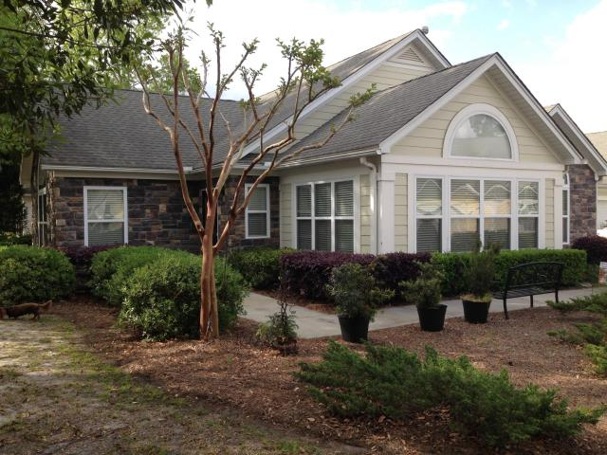
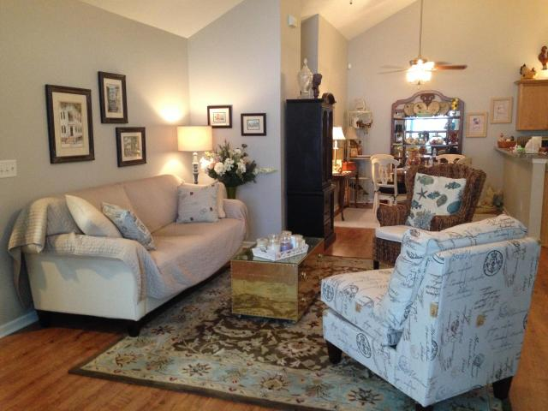
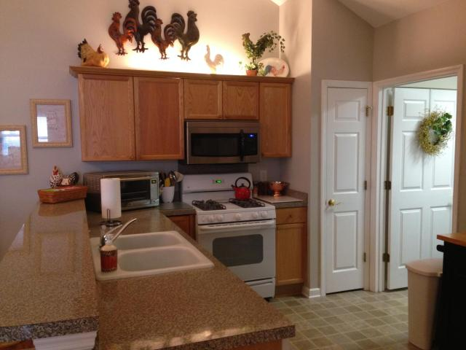
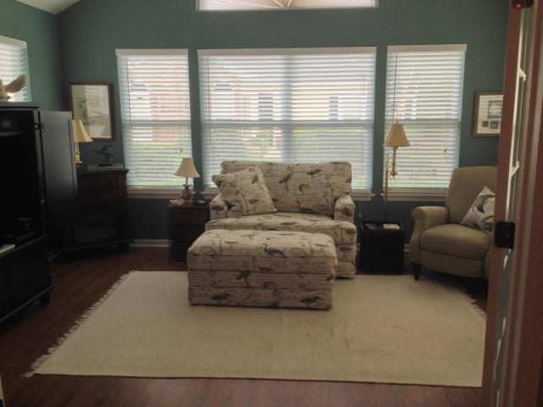
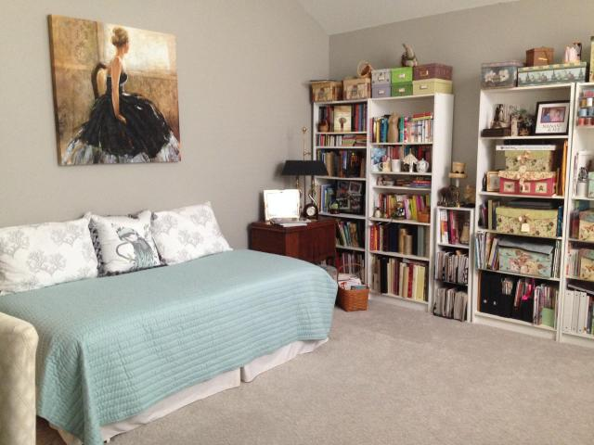
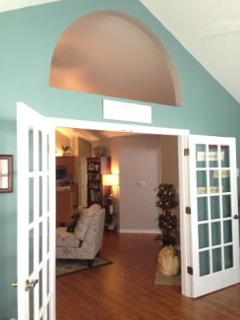
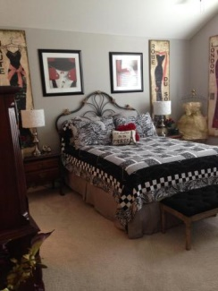
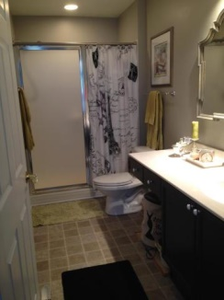
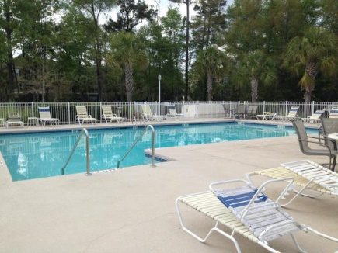
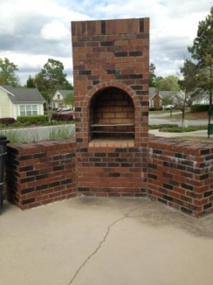

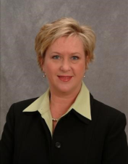

Villas at Charleston Park 8800 Dorchester Rd #304 North Charleston, SC 29420 MLS# 15009138 Just Reduced to $185,000 2 Bedrooms ▪ 2 Baths ▪ 1,579 sf.
Open House :: Sunday, July 12th from 2-5
Lovely one story patio style home in the Villas at Charleston Park is a must see! Renovated with wood flooring and upgraded carpeting, cathedral ceilings, living room with fireplace, a sun room, dual masters, freshly painted, new ceiling fans, new storm door and a 2 car garage. Low maintenance living with lawn care and exterior maintenance covered by HOA. Neighborhood club house, fitness center and pool. Located near shopping and golfing.
Jennifer Nipper, Realtor®
(843) 478-1800 | jen@AgentOwned.com
www.AgentOwned.com
The AgentOwned Realty Co | 824 Johnnie Dodds Blvd | Mt. Pleasant, SC 29464
Real Estate • Mortgage • Insurance

