Slide 1
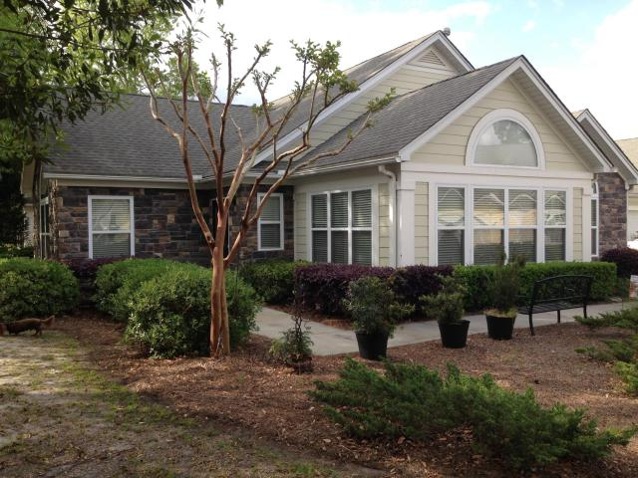
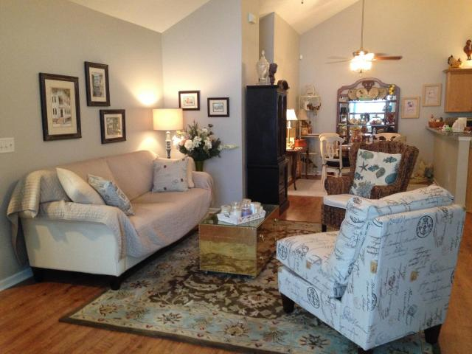
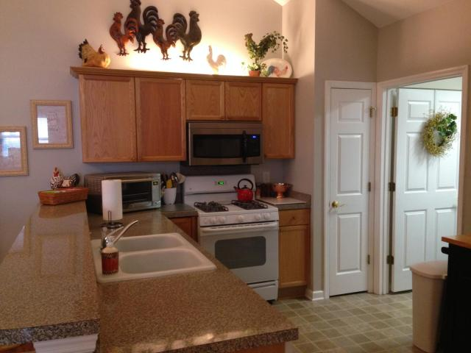
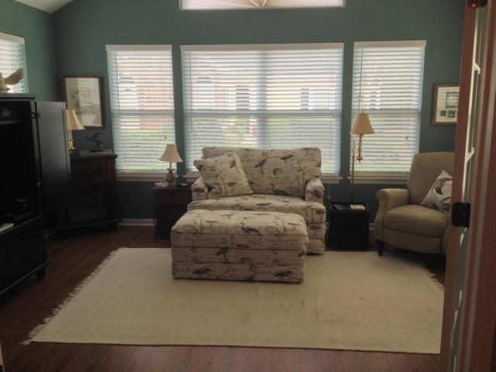
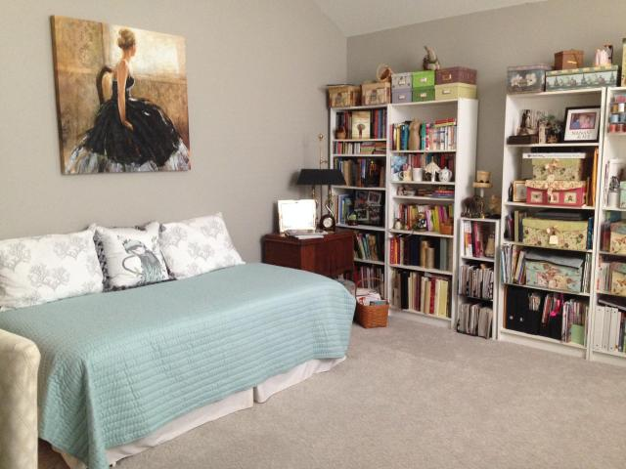
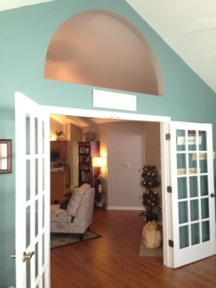
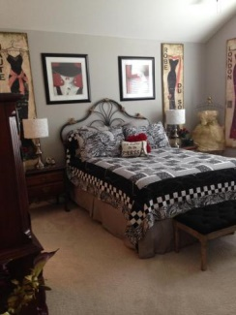
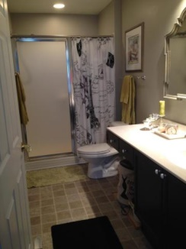
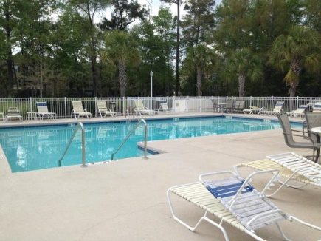
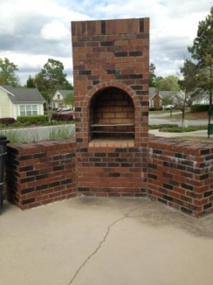

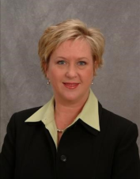

8800 Dorchester Rd #304 North Charleston, SC 29420 MLS# 15009138 Just Reduced to $189,000 2 Bdrm ▪ 2 Ba. ▪ 1,579 sf.
Luxury Villa in Villas at Charleston Park
Luxury ground floor condo with open floor plan and cathedral ceilings. New wood floors in living room, dining room and sunroom. Two large bedrooms with two large baths, and a sunroom. Interior freshly painted, new ceiling fans, new upgraded carpet in bedrooms, new built-in microwave, updated vanities in baths, new vanity lights, new closet organizers, new storm door and a two car garage. Community has a Clubhouse with pool, fitness center and pool table. Located near Bosch, Boeing, Airport and all interstates.
Jennifer Nipper, Realtor®
(843) 478-1800 | jen@AgentOwned.com
www.AgentOwned.com
The AgentOwned Realty Co | 824 Johnnie Dodds Blvd | Mt. Pleasant, SC 29464
Real Estate • Mortgage • Insurance

