Slide 1
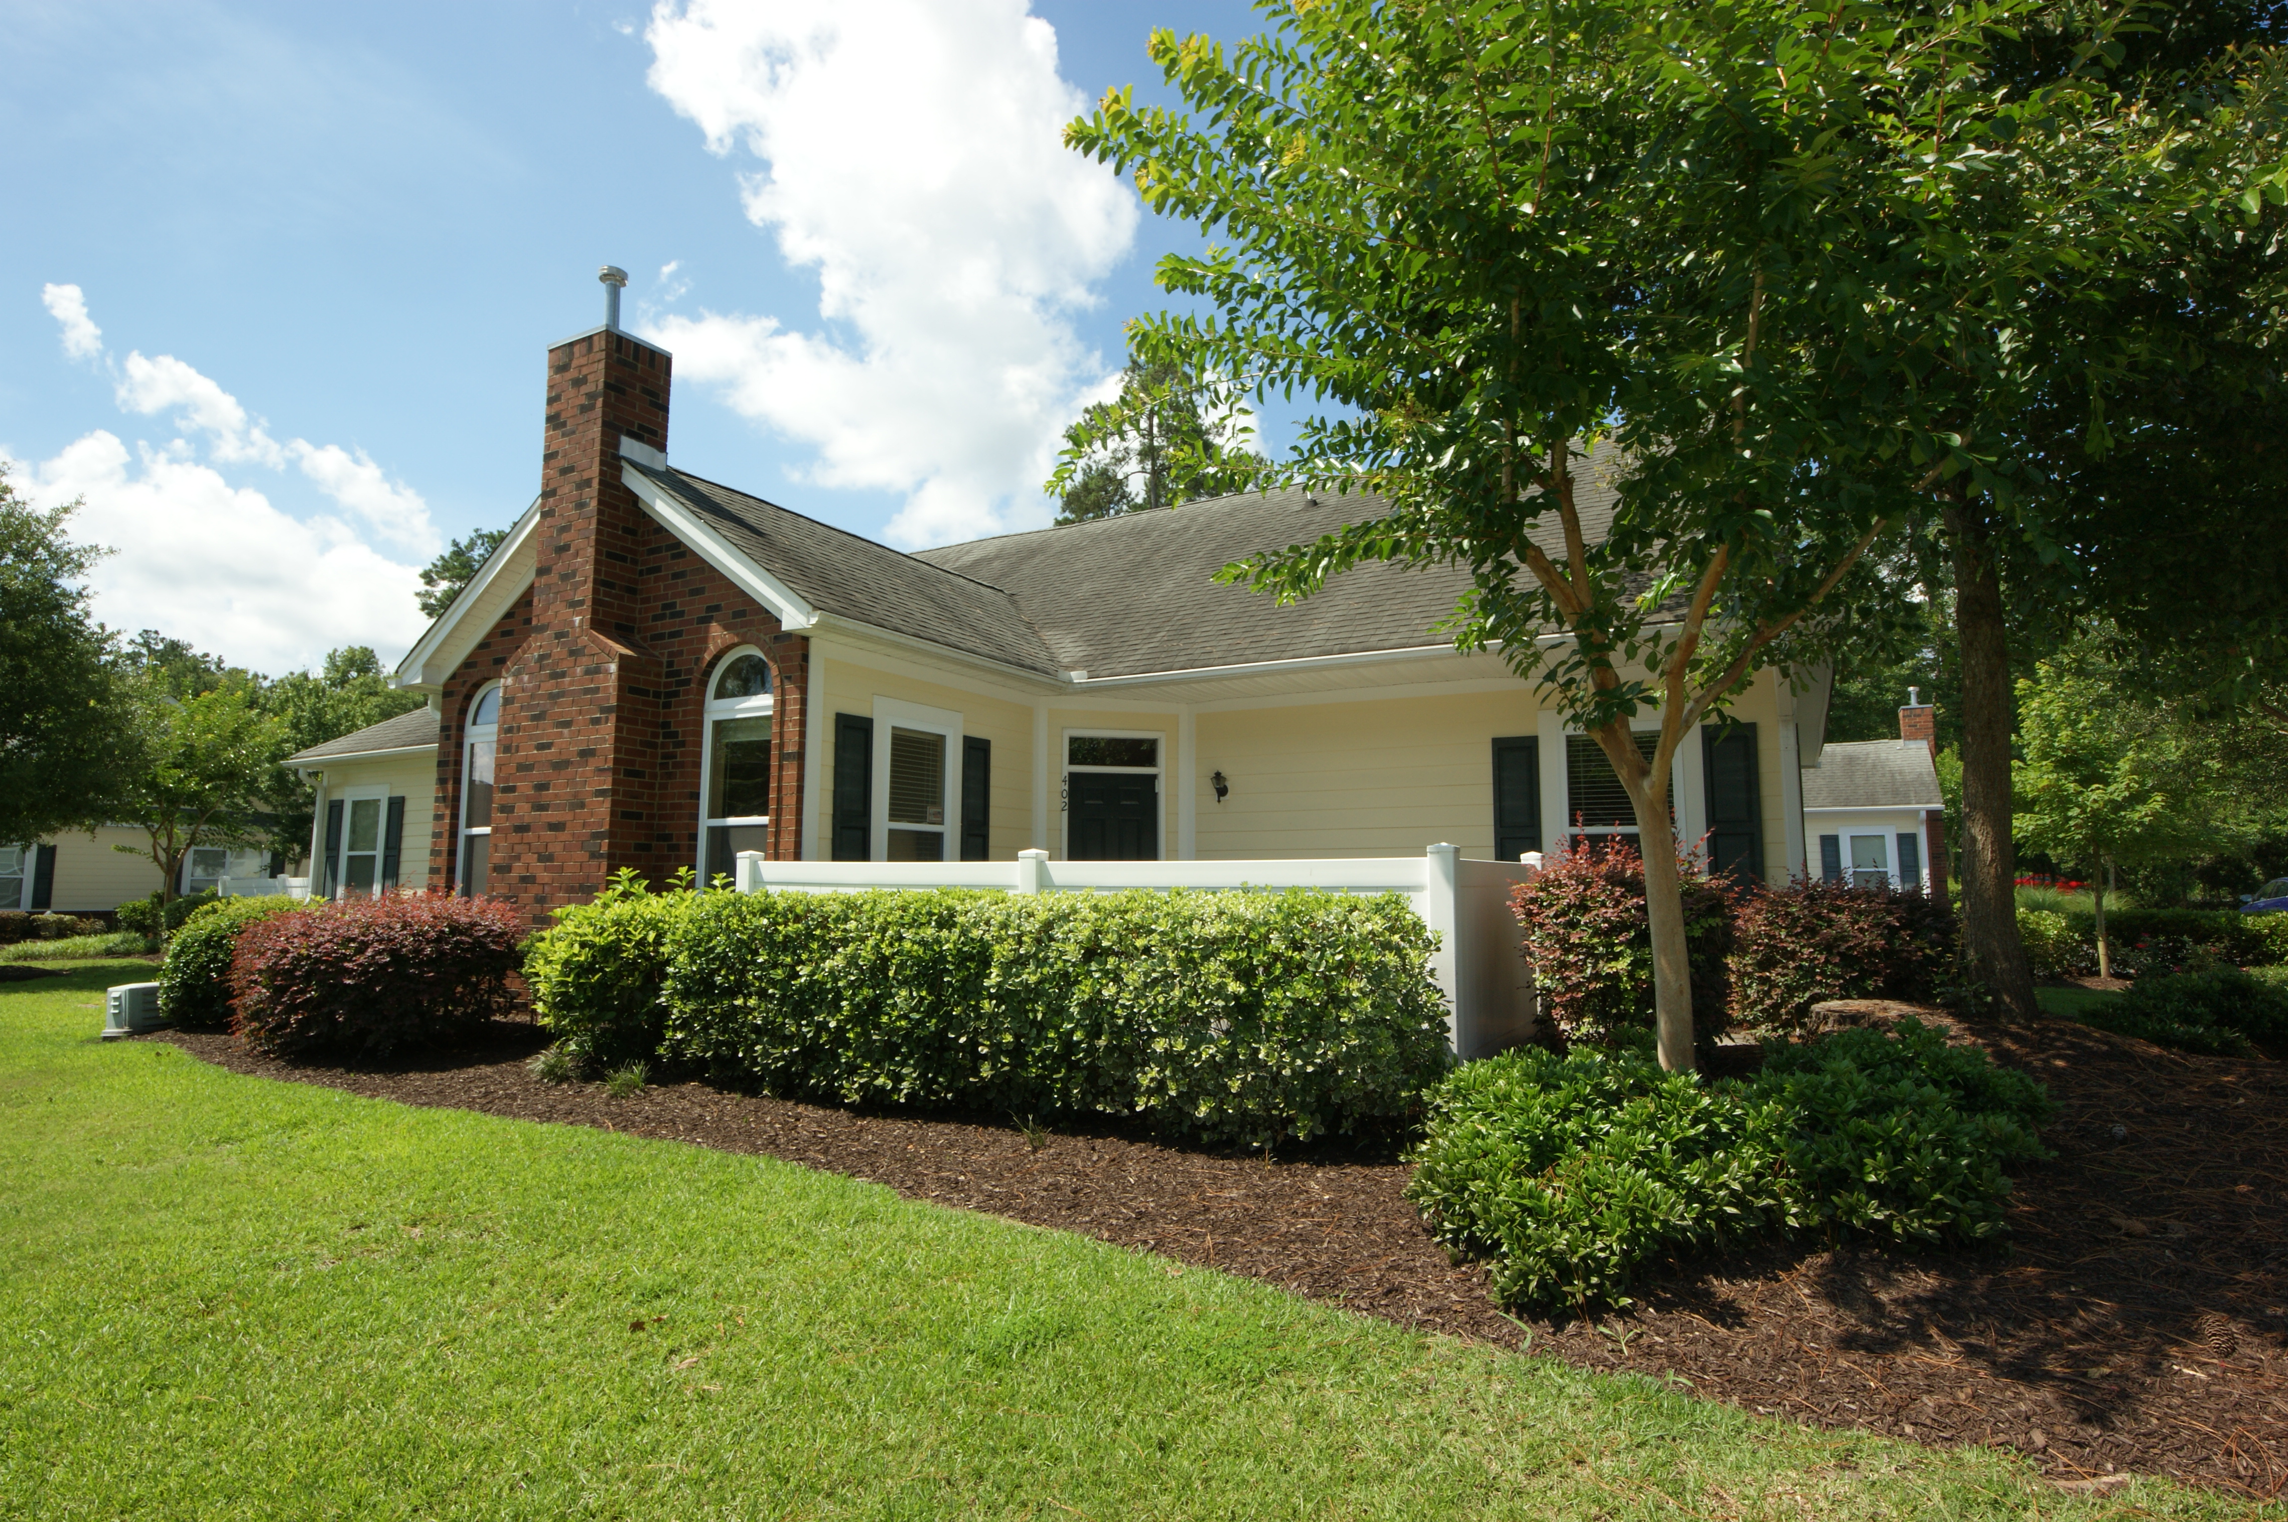
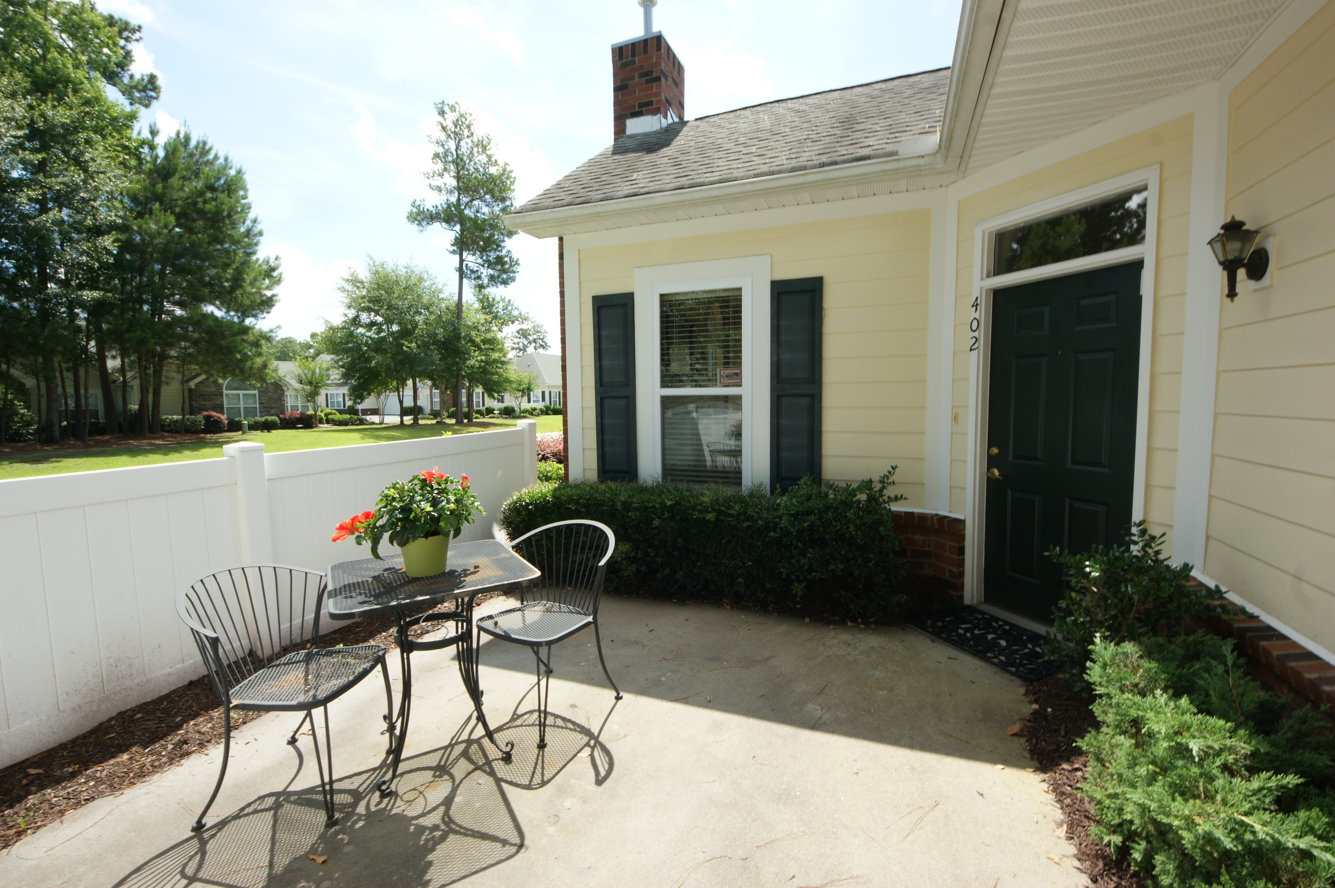
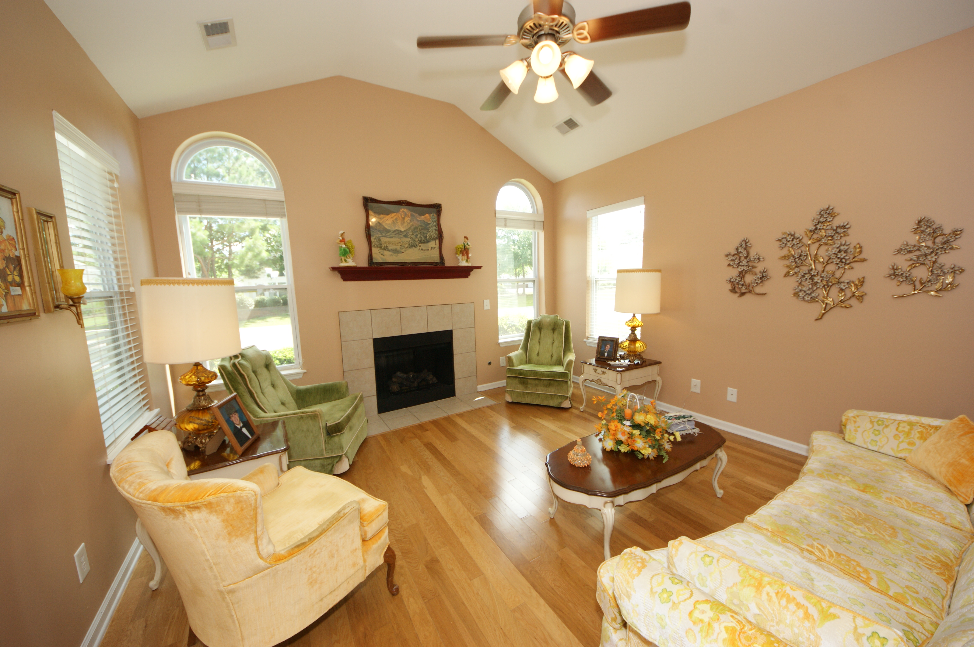
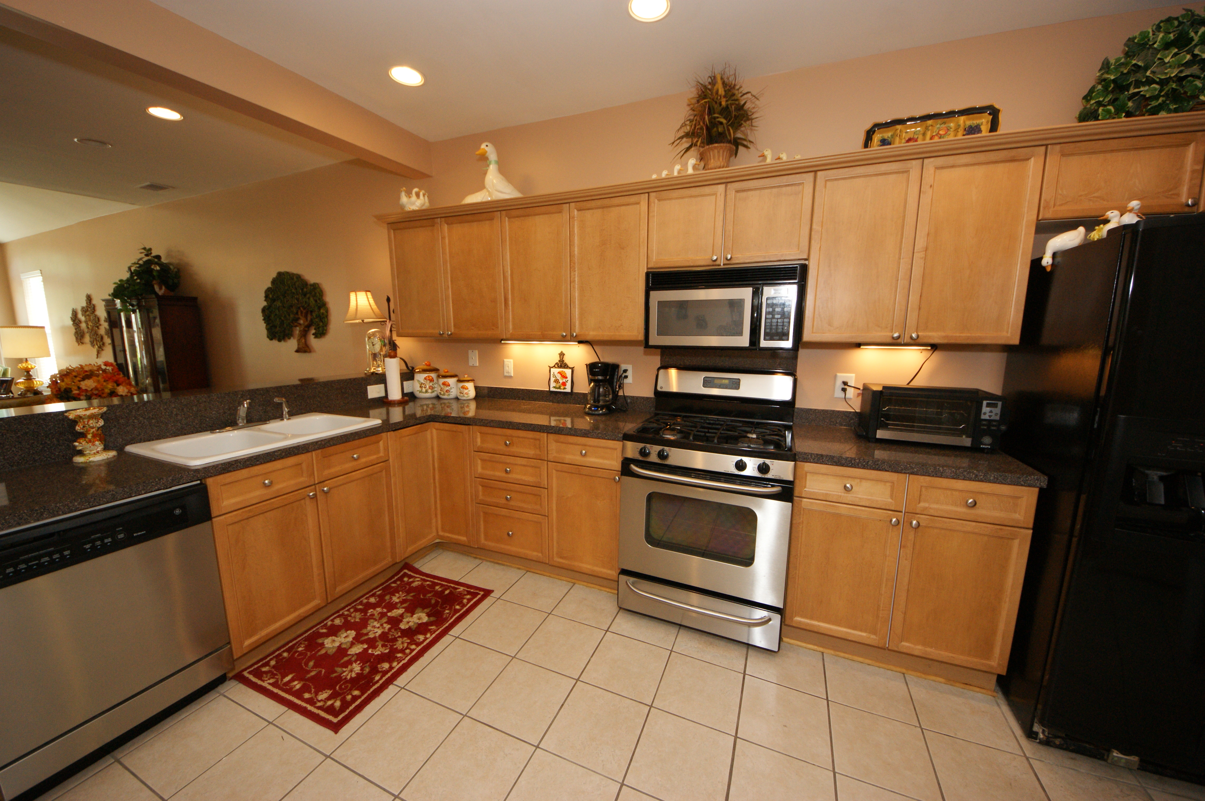
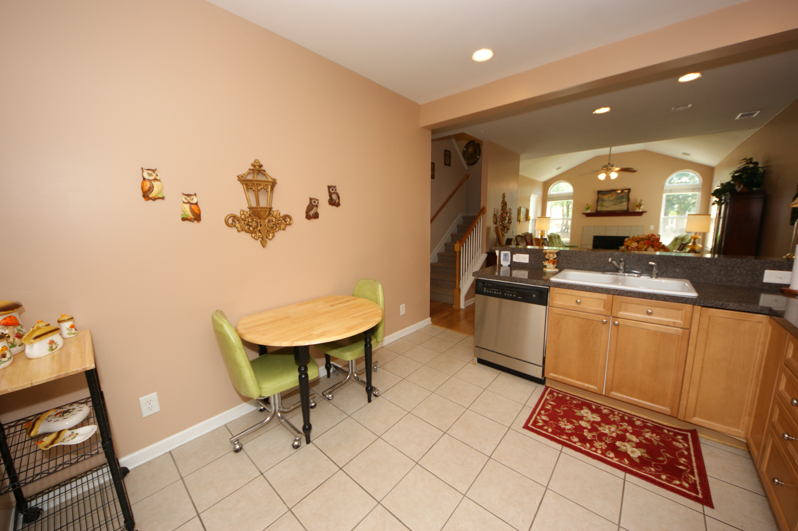
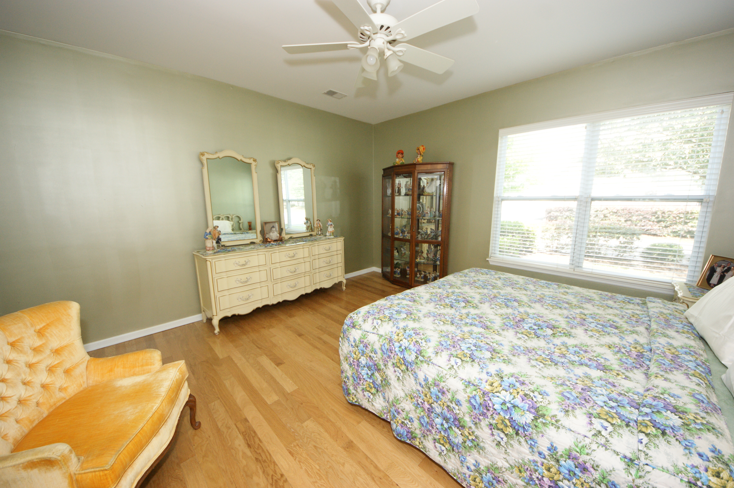
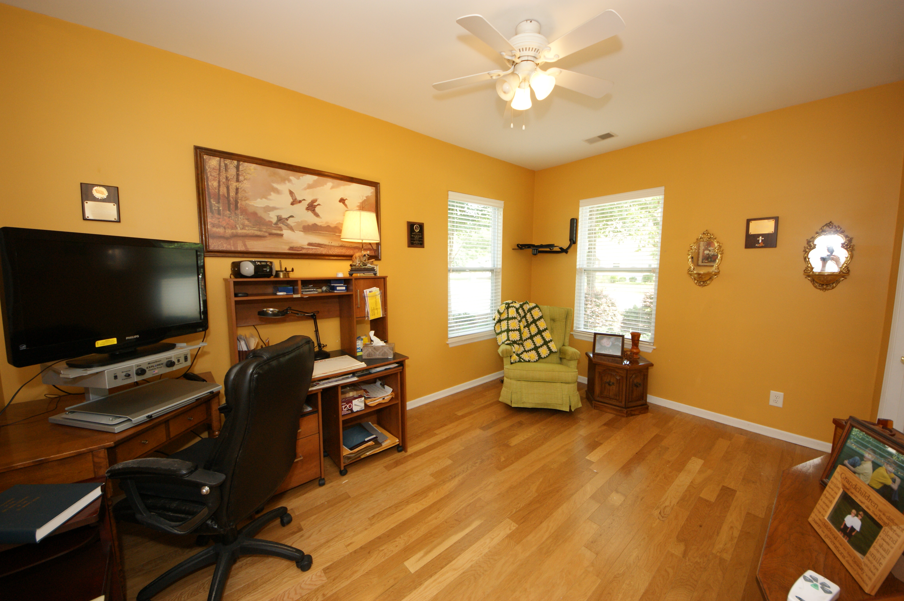
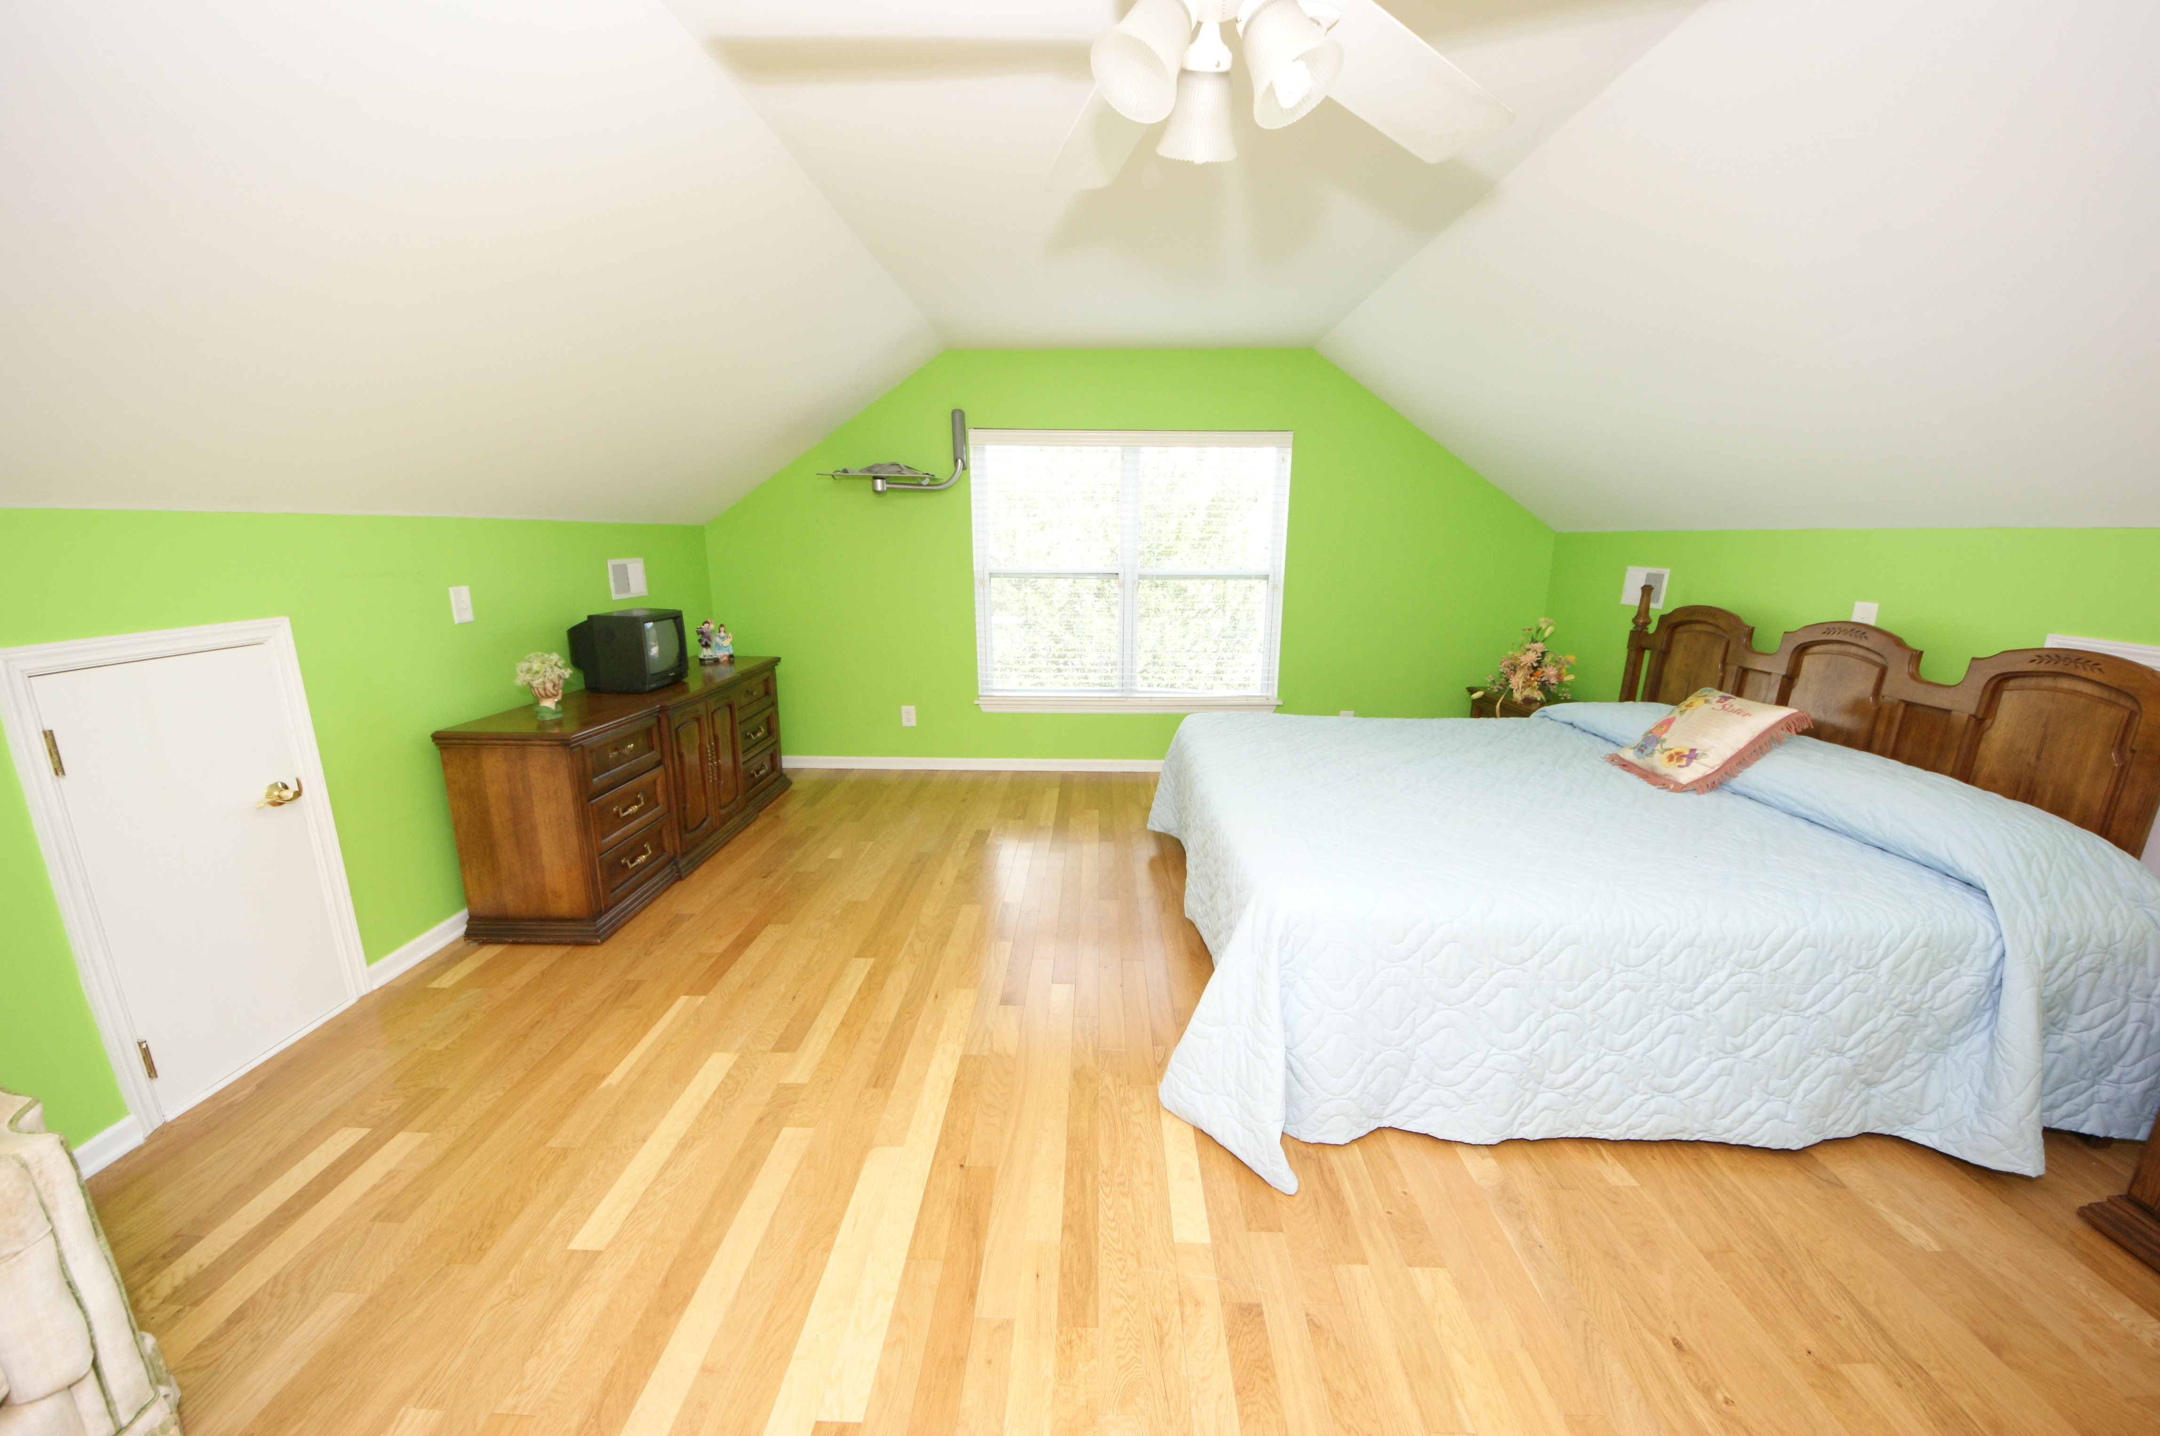
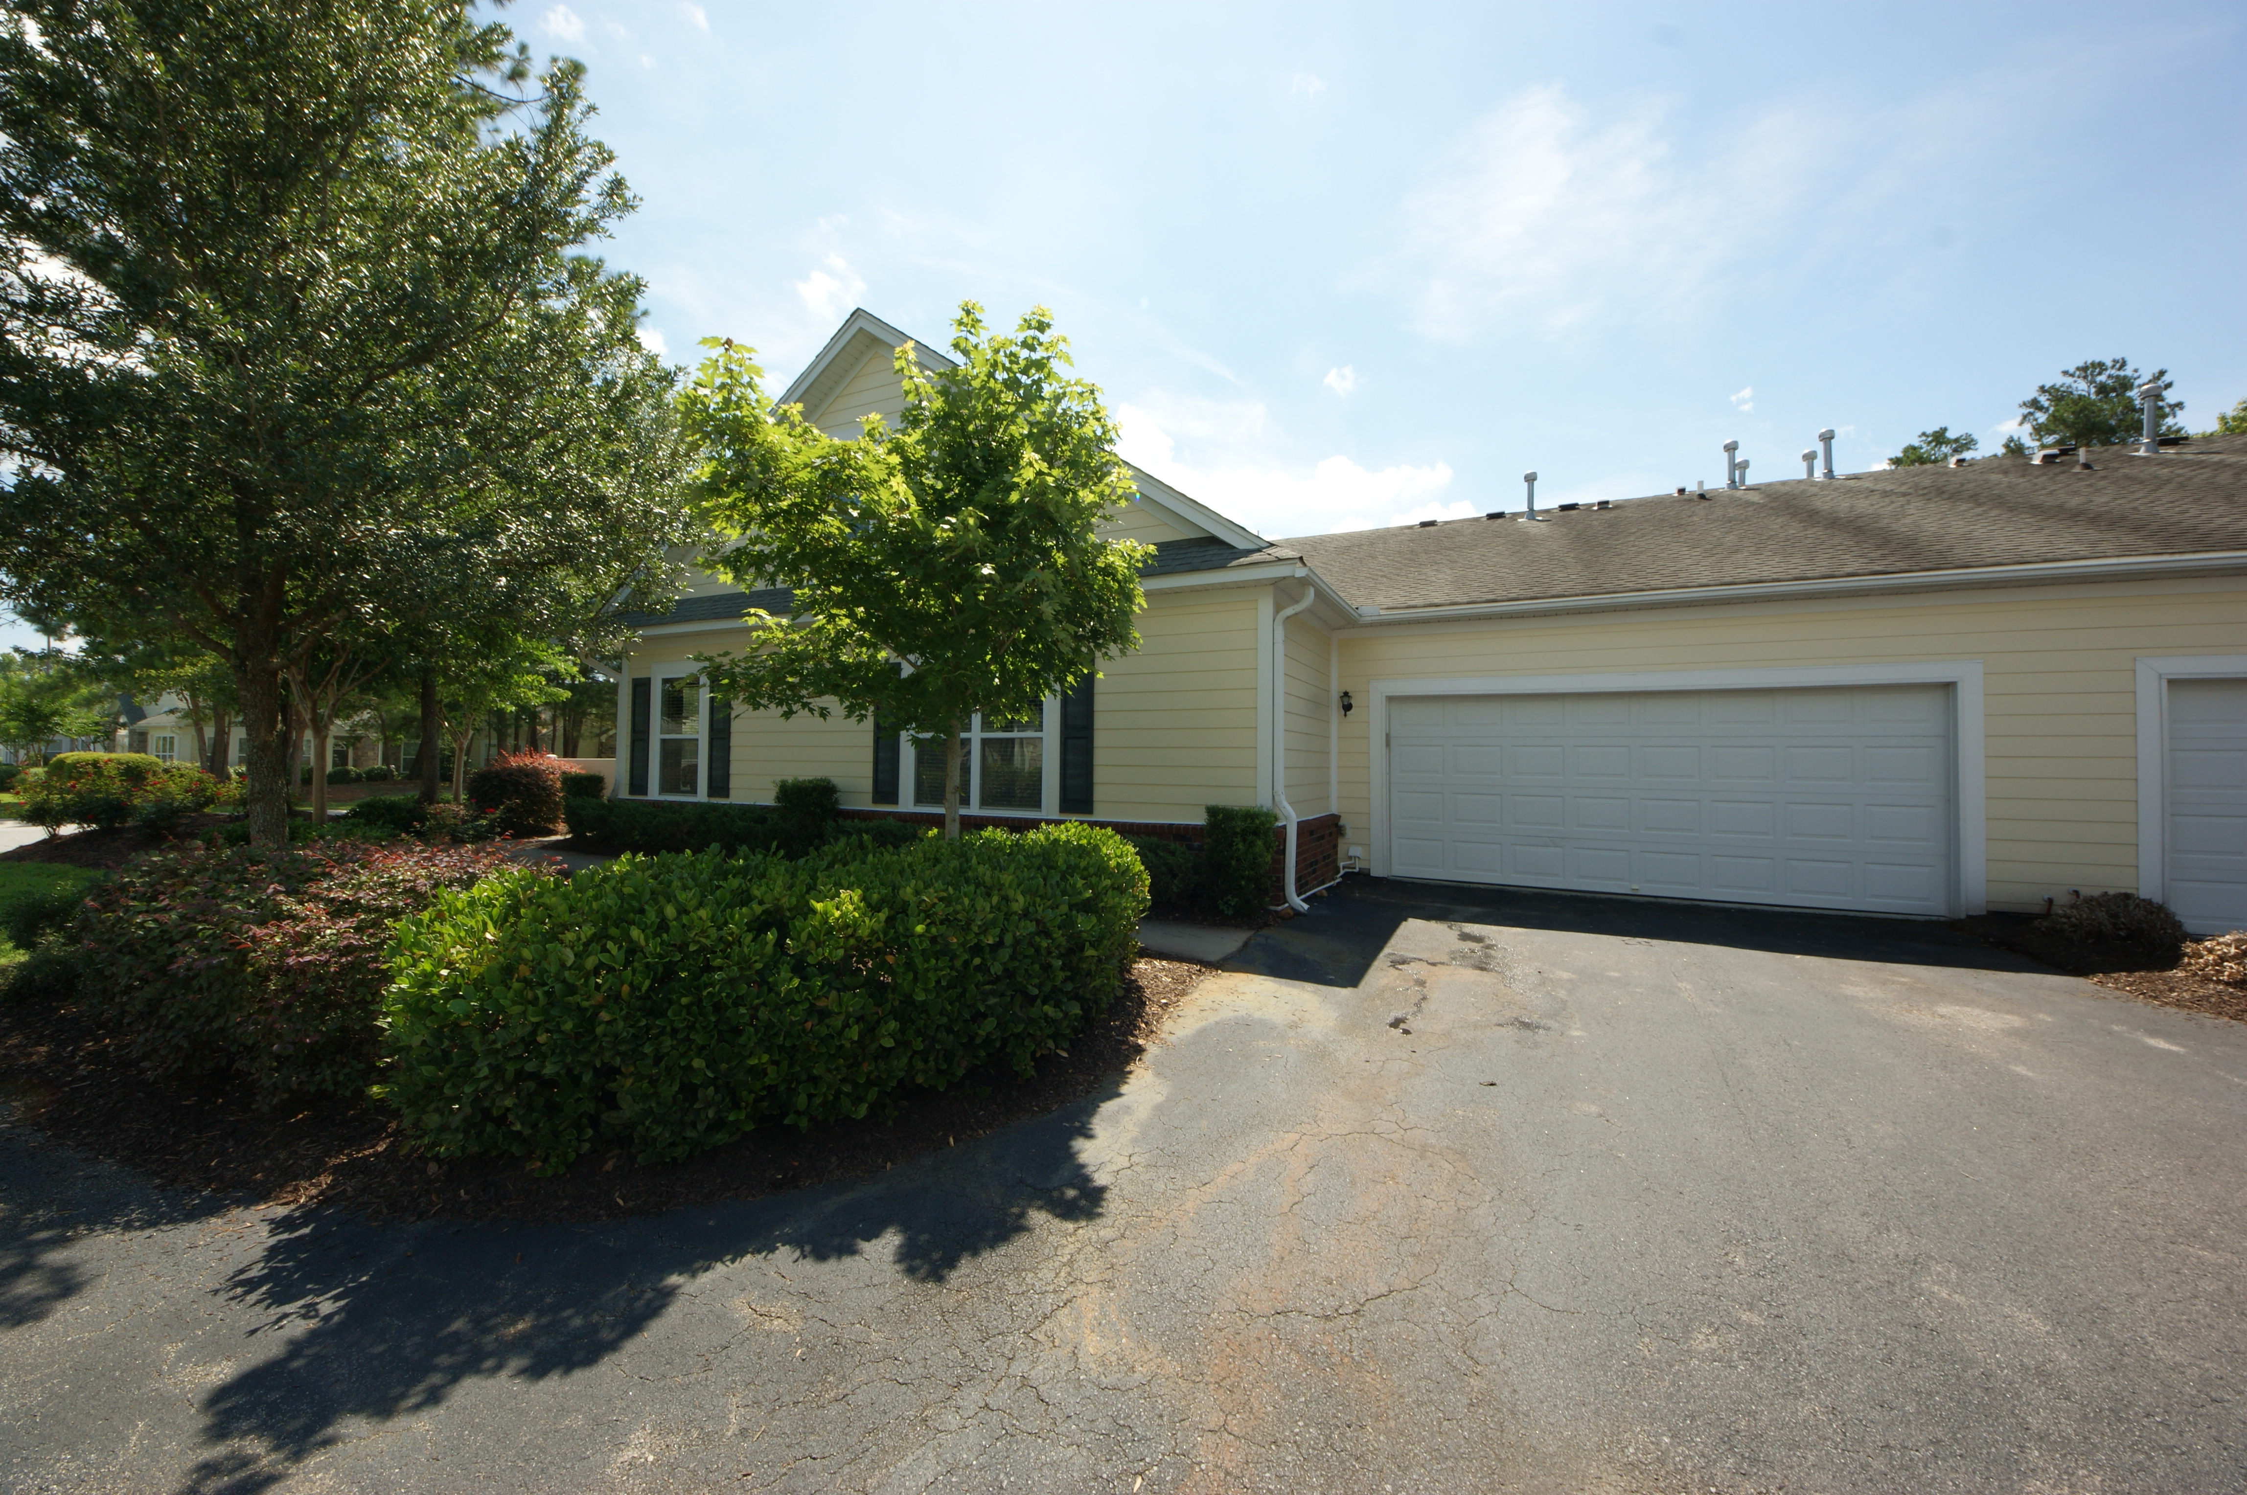


Great Location! Low Maintenance Living!!
$5,000 Buyer's Agent Bonus at Closing!
8800 Dorchester Road #402 Villas at Charleston Park ~ North Charleston
MLS# 15015387 ~ $199,000
Special and rare community that includes swimming pool, club house, exercise facility and well maintained landscaping. LOCATION convenient to Charleston International Airport, AFB, Bosch, Chas Coliseum and Tanger Outlet! Just a few minutes to Charleston and great dining and entertainment and the beaches. This great home has a private patio with fence as you enter...beautiful wood floors, gas log fireplace, Master BR on the main level along with another bedroom and half-bath. Third bedroom and second full bath is upstairs. Perfect set-up for visiting guests to give you privacy. Nice large open family room (fireplace)to the kitchen with a breakfast bar and a dining room area. NO YARD MAINTENANCE~~ with the grounds and yard being taken care of for you! Wood floors in all the living areas except kitchen and baths and they have ceramic tile. Lovely to look at and easy to keep. This is a pretty home and will make you glad you took a look!
Susan Weeks
(843) 813-0495
susanweeksdesign@gmail.com
www.agentownedrealty.com
AgentOwned Charleston Group
902 Savannah Hwy
Charleston, SC 29407-7802

