Slide 1
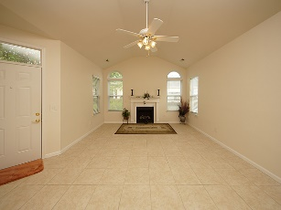
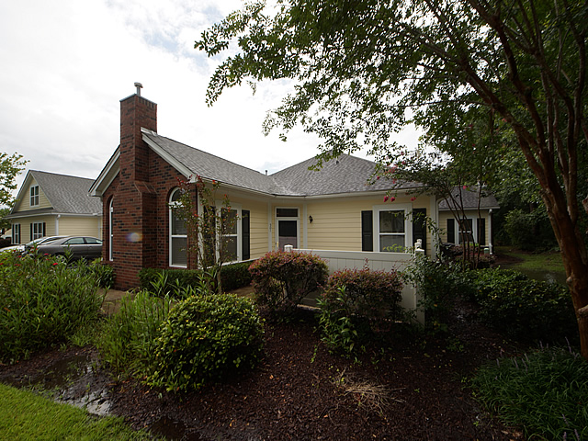
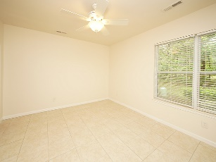
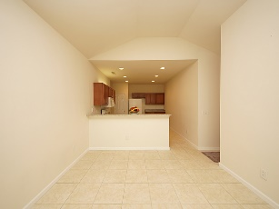
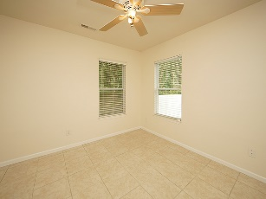
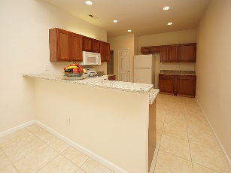
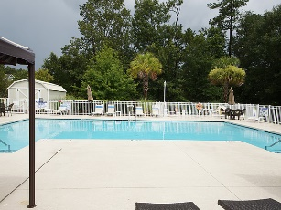


Back on the Market
8800 Dorchester Road 501
Villas at Charleston Park | N Charleston | MLS# 18018947 | $190,000
Welcome home to maintenance-free easy living with a 2 bedroom 2 bath condo in a very convenient location. This unit has been renovated and is move in ready. The living room, dining areas, and kitchen have an open concept so no one is isolated in this beautiful home. The gas burning logs in the living room fireplace provides a cozy ambiance to the room. The kitchen features brand new granite counter tops and new cabinets. Both bed rooms are down the hallway, away from the living areas. The master bedroom is large with private bath and oversize closet. Don't miss this great opportunity for easy living, conveniently located near shopping, dining, AF Base, airport and major highways.
Betty Ellis
REALTOR
(843) 270-2948
betty217@bellsouth.net
www.agentownedrealty.com
AgentOwned Premiere Group
1800 Trolley Rd
Summerville, SC 29485

