Slide 1
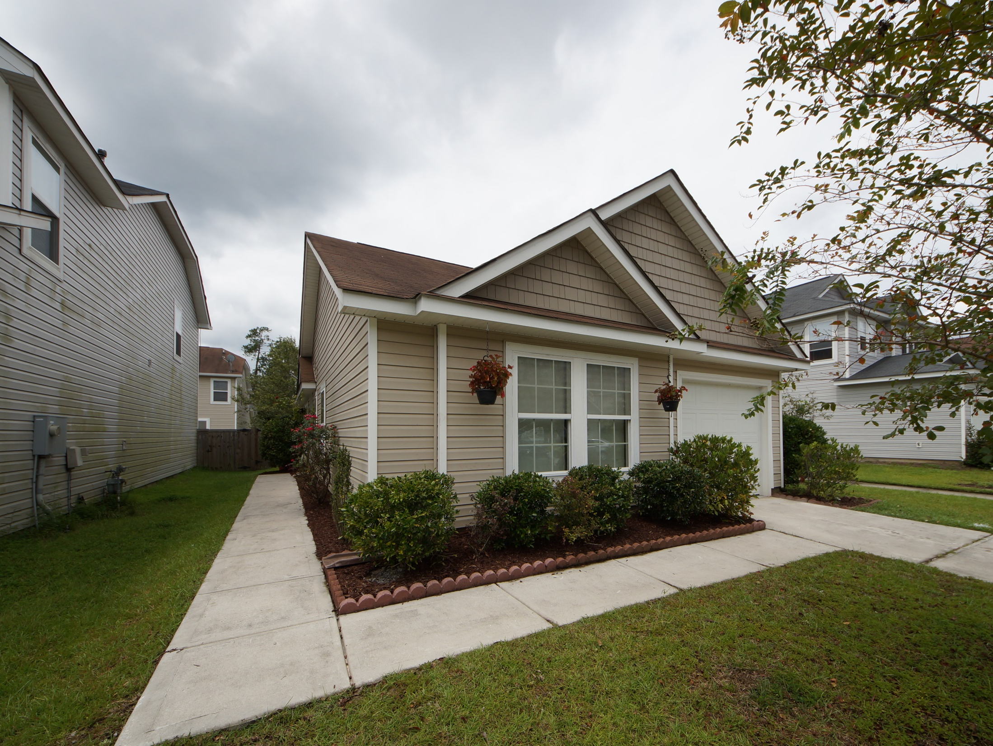
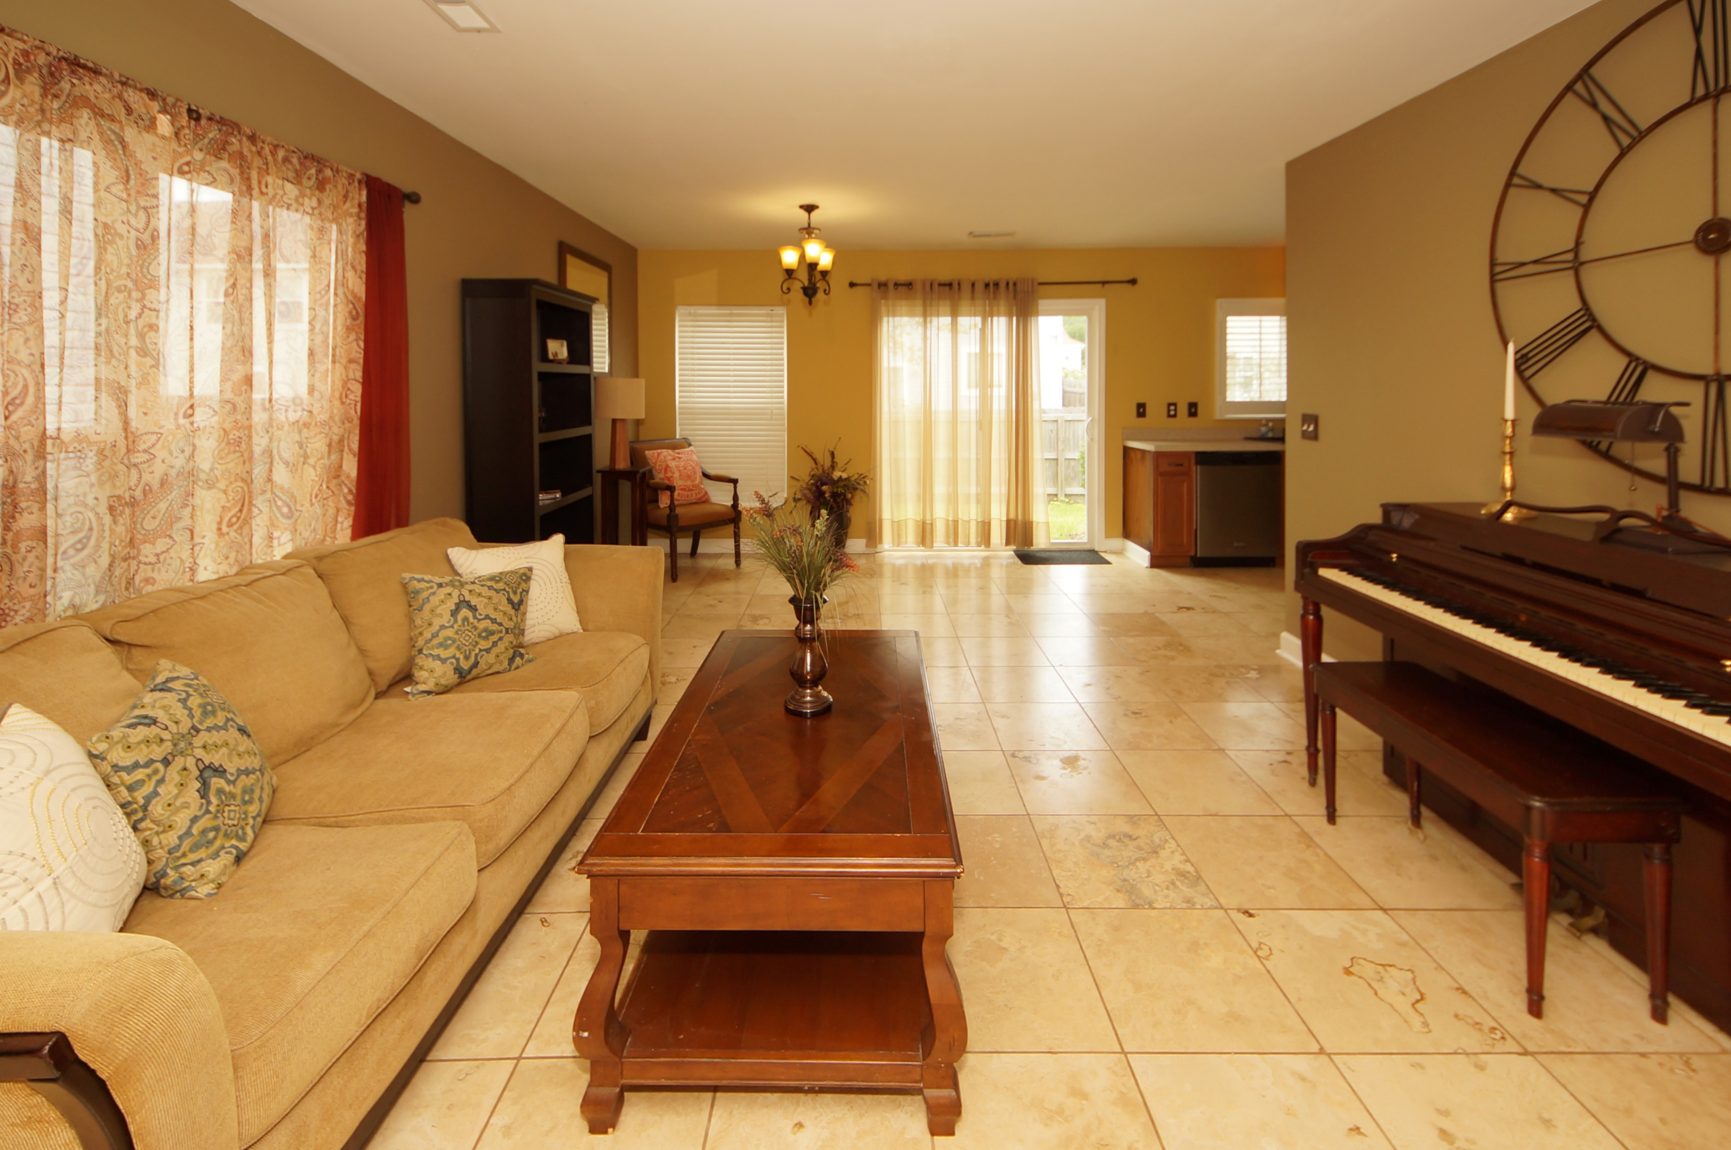
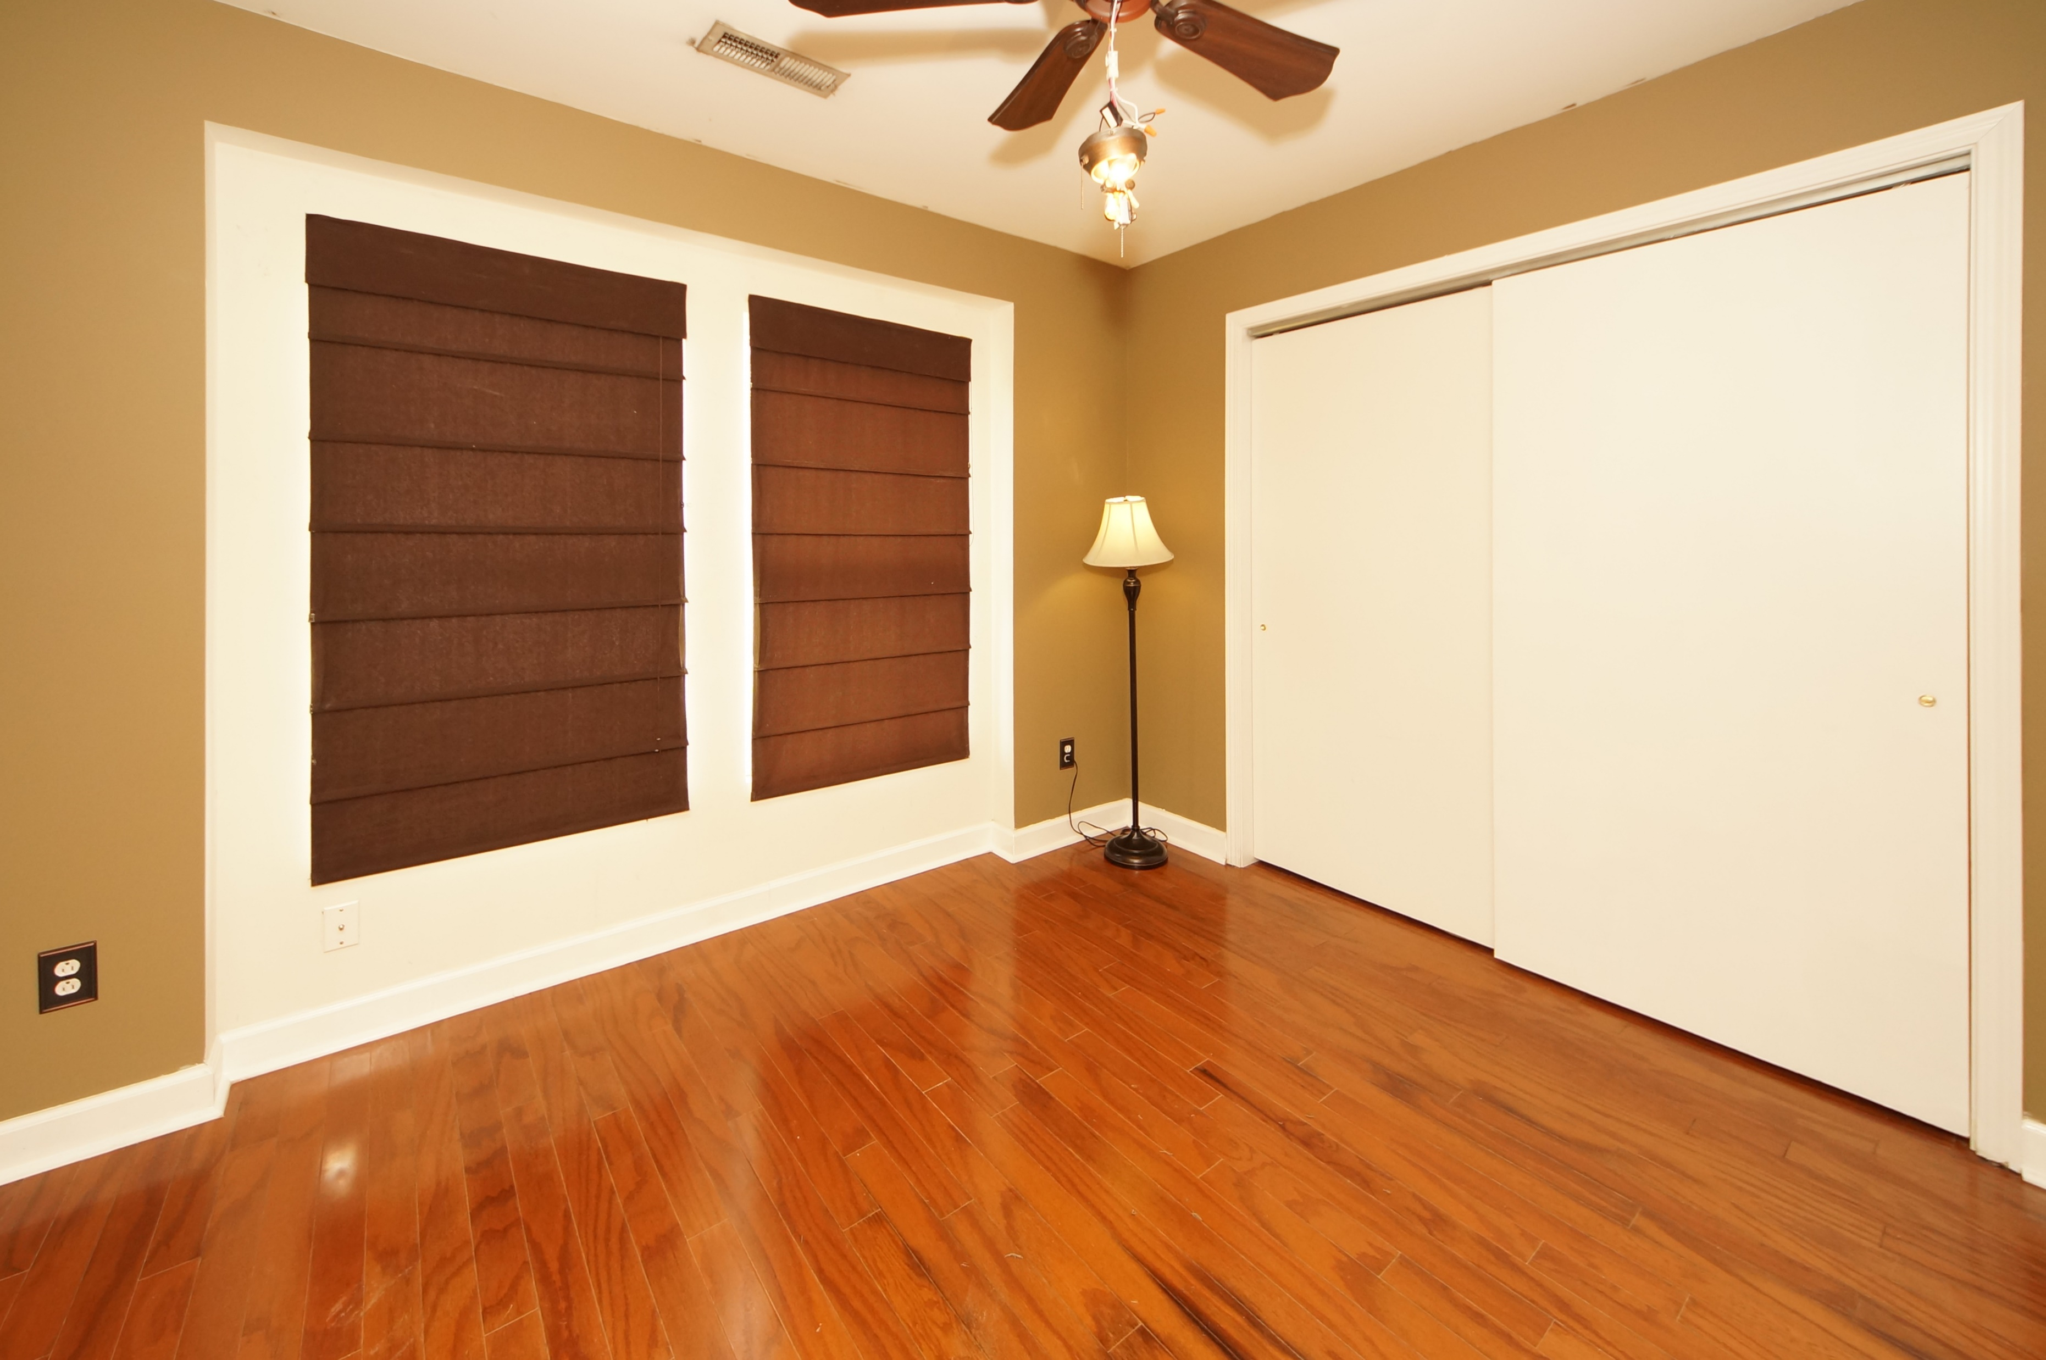
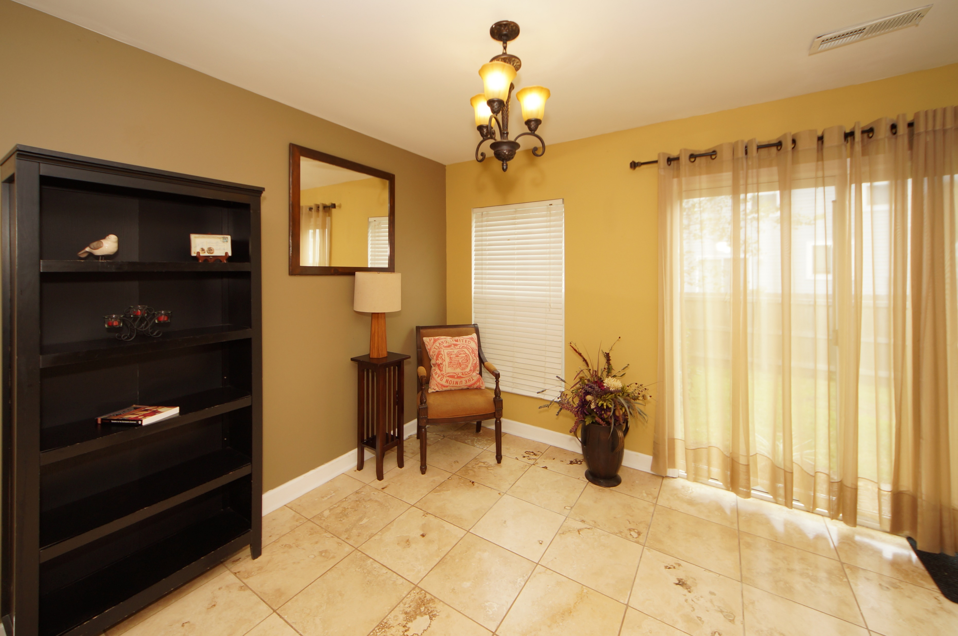
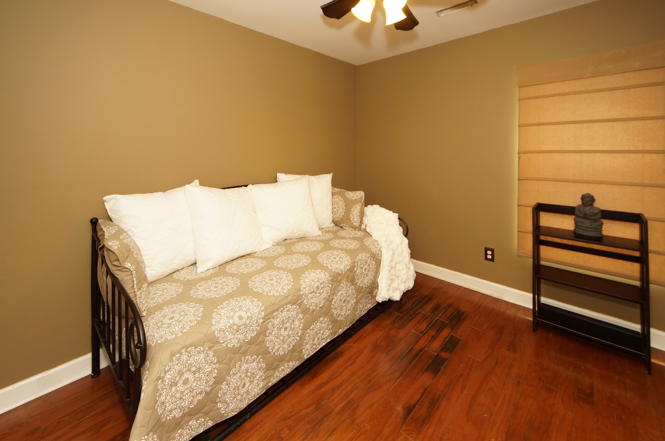
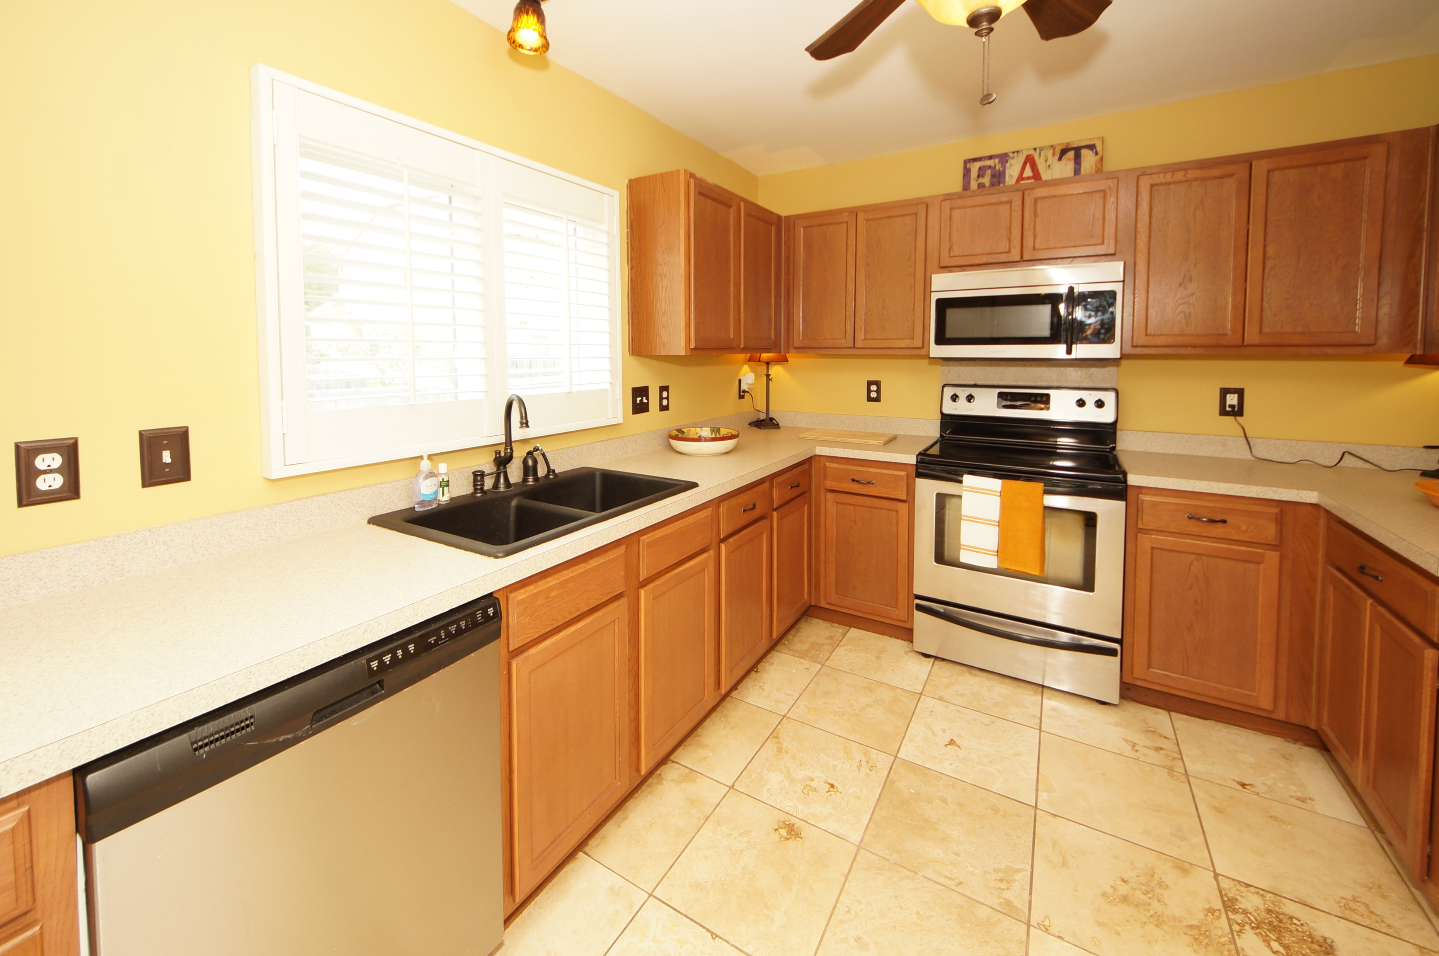
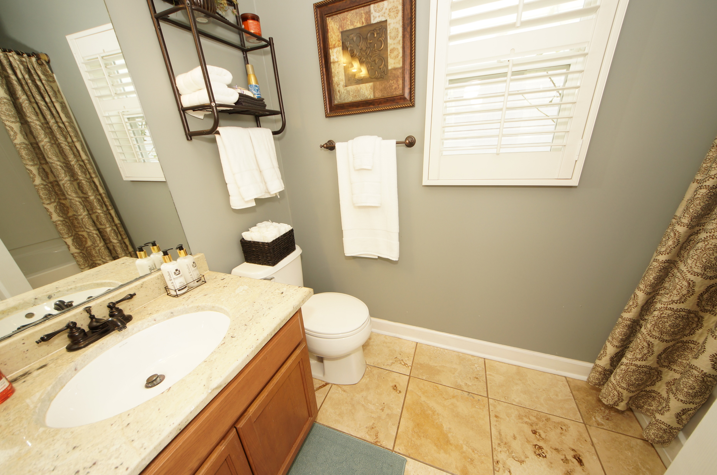
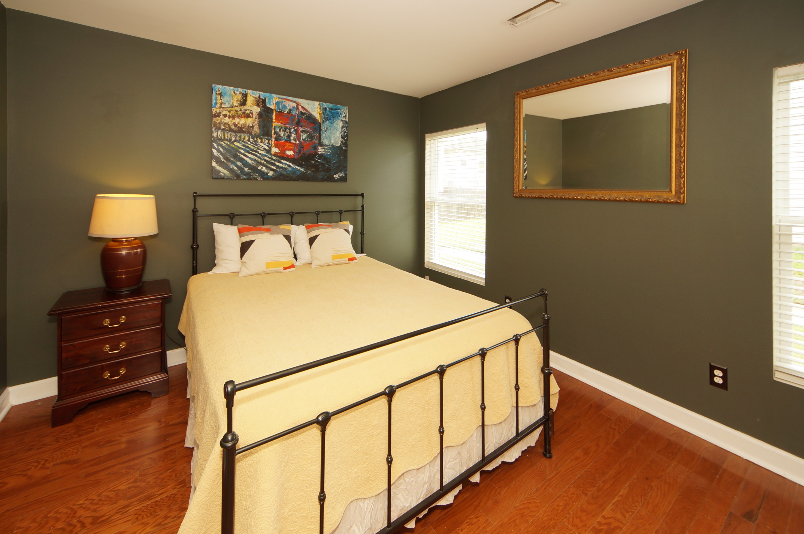
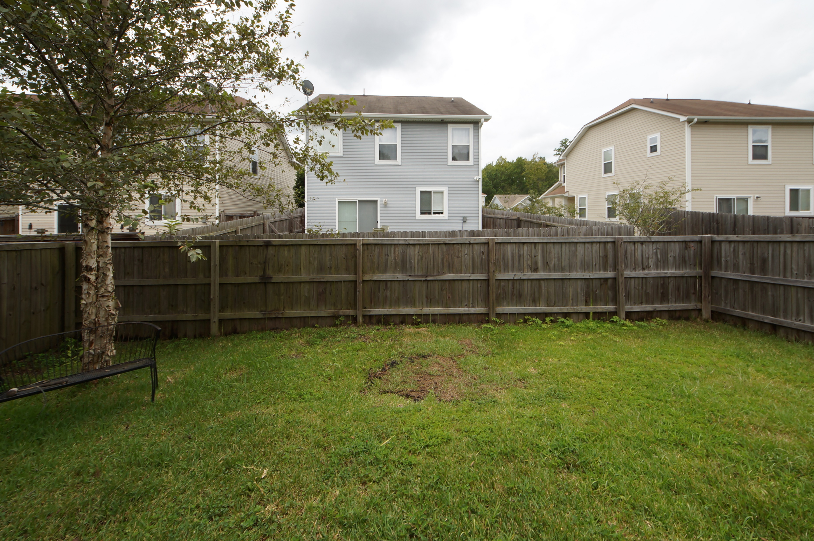
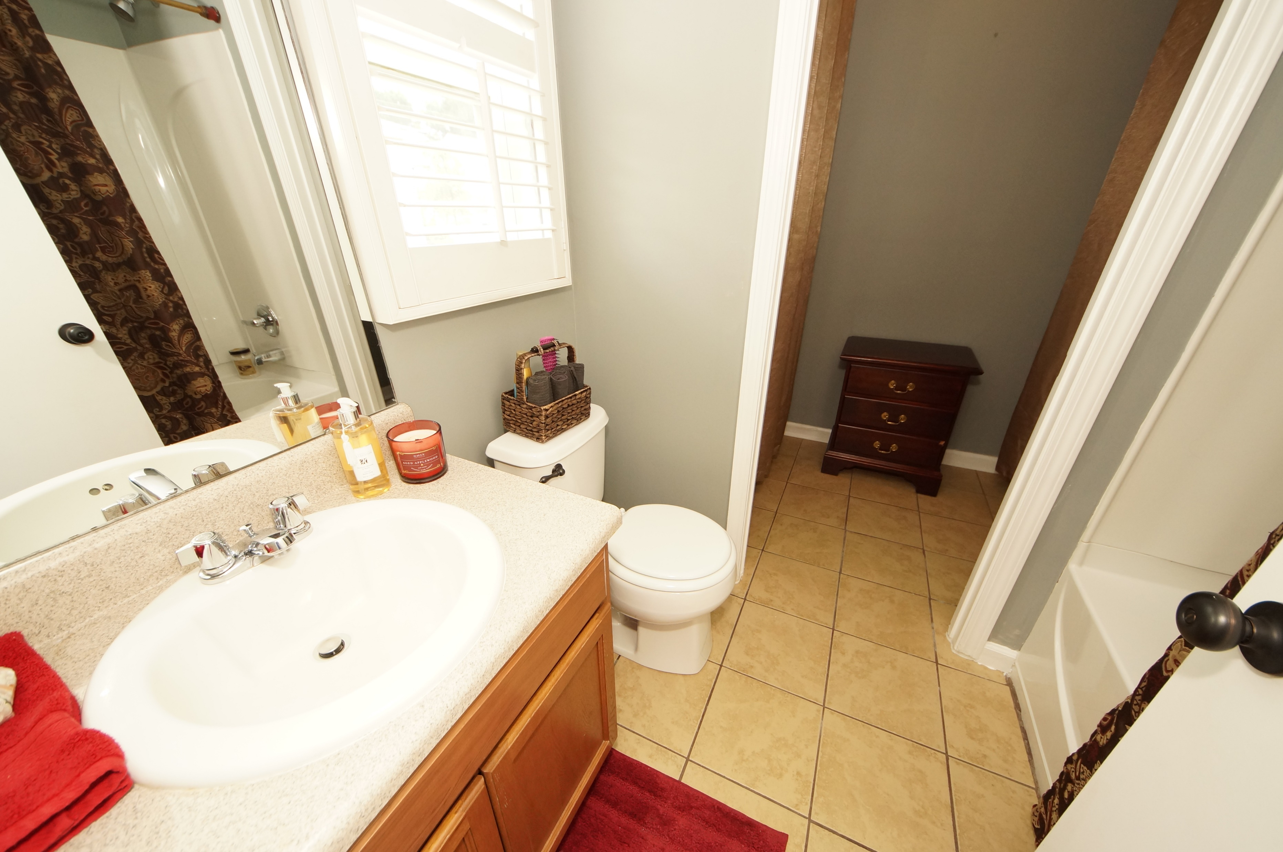
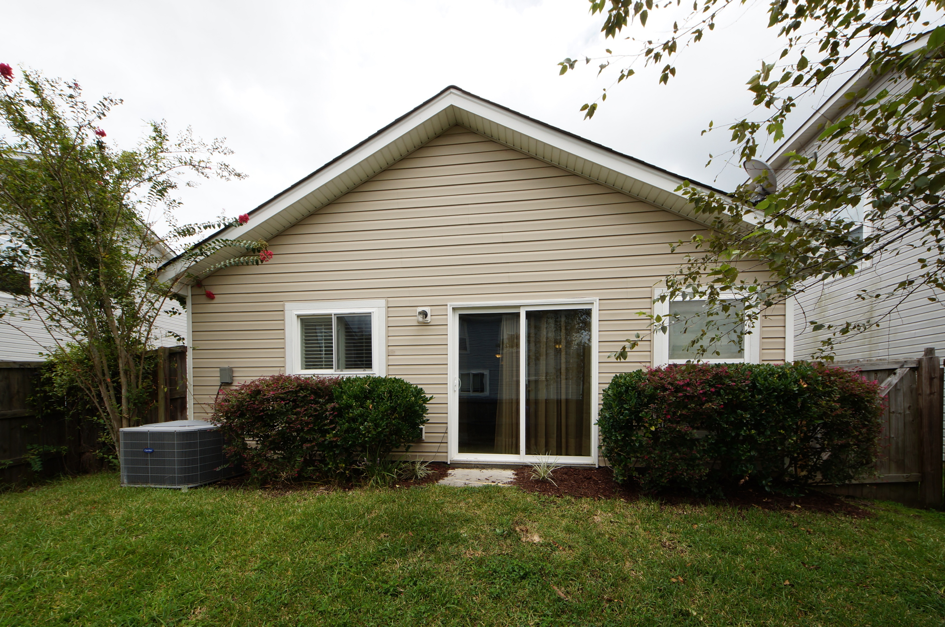
Beautiful "The Parks" Subdivision in convenient North Charleston
8817 Shadowglen Drive
Charleston Park ~ North Charleston
MLS# 17024575 ~ $163,595
One owner home! Won't last long at this price! Adorable house in great location; close to airport, shopping, interstates, churches, restaurants, or anywhere you desire to go. Walk into beautiful travertine tile floors in living/dining area, kitchen, and hallway. Bedrooms and baths have gorgeous hardwood floors, all so easy to keep clean! Built in microwave, stainless steel appliances, convenient pantry in kitchen...3 bedroom, 2 full baths, and a single car garage. Beautiful grounds; playground within walking distance; over 2 miles of walking trails; & a large dog walking field. You'll want to see this very nice house so you may soon call it home.
Jeanette Turner, ABR | (843) 814-1355 | jeanetteturner100@gmail.com
AgentOwned Charleston Group | 902 Savannah Hwy | Charleston, SC 29407

