Slide 1
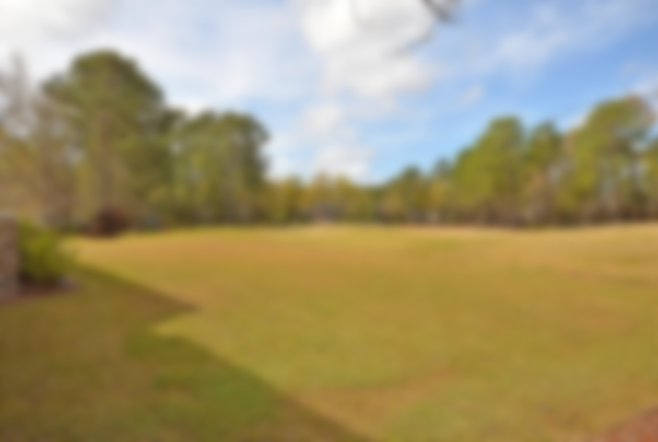
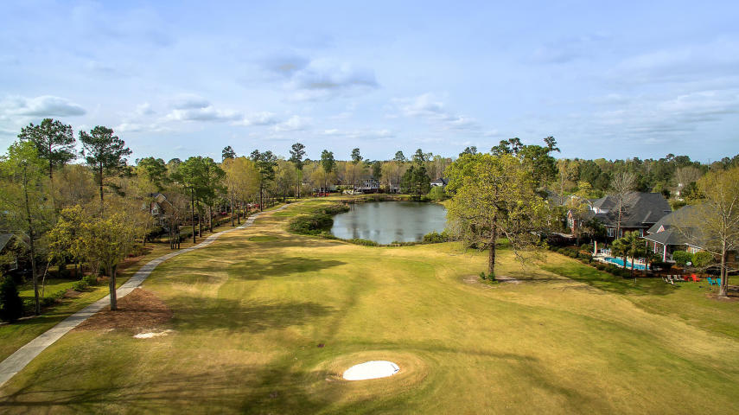
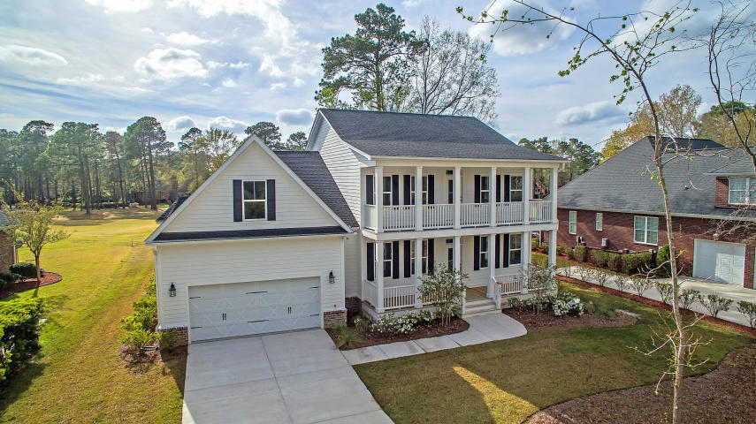
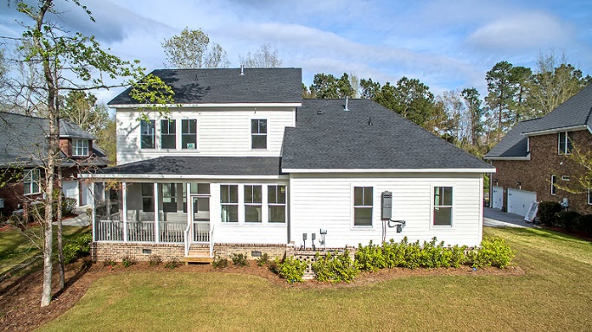
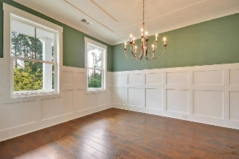
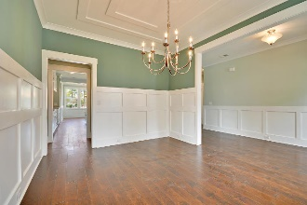
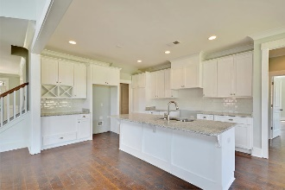
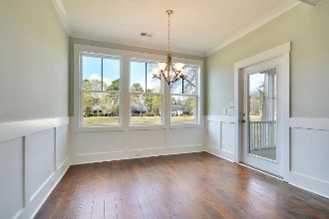
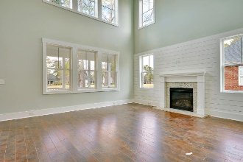

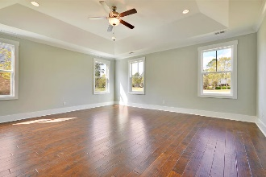
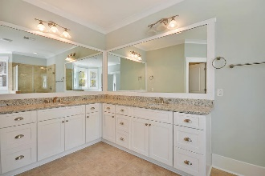
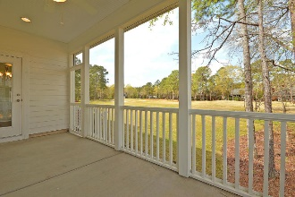
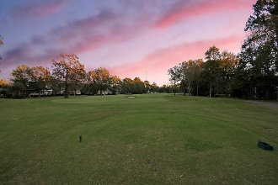
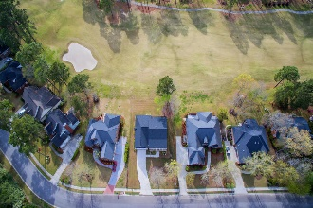
8831 E Fairway Woods Drive Coosaw Creek Country Club :: North Charleston :: MLS# 19002505 :: $459,990
Back on the Market!
New Construction Dream Home overlooking the Golf Course is settled on a quiet street in Coosaw Creek Country Club, an upscale, gated community which is zoned for one of South Carolina's most desirable Dorchester II School District. The Double Front Porches greet you when approaching this home along with the beautiful maintained Landscaping. The double-stacked front porches and well-kept landscaping offer great curb appeal to this wonderful property. Inside, the open floor plan is complimented by a wonderful variation of wall-to-wall carpet and glistening hardwood flooring, tankless water heater, and it is already wired for a smart TV system as well as additional audio entertainment. The two-story foyer offers plenty of natural light and a sweeping view of the backyard and golf course through the abundant windows, and a cozy gas-log fireplace for those chilly nights. Enjoy creating delicious home-cooked meals in the eat-in kitchen, which boasts recessed can lighting, pantry for additional storage, over-sized island with a sink, and breakfast nook with a large window and decorative wainscoting. Builder offering $4500 appliance credit upon purchase, with three appliance packages available with an acceptable offer as part of the sales contract. Details for packages will be inside the home and can be viewed during showings. The formal dining area, with a tray ceiling and decorative wainscoting, is great for hosting special dinners with family and friends. The downstairs master suite is tucked away for added privacy, and features a tray ceiling, recessed can lighting, walk-in closet with built-in shelving, and an wonderful en-suite with a dual vanity, garden tub, and separate step-in shower. The bathrooms and laundry room exhibit beautiful tile you'll be sure to appreciate. The rest of the bedrooms are found upstairs, along with a finished bonus room above the garage which can be used as a entertainment area, storage space, or fifth bedroom. Relax and entertain guests on the screened-in porch, overlooking the backyard which backs up to the golf course fairway. Coosaw Creek Country Club is an established and sought-after community, with a 24-hour gate guard. It is home to the 2014 Charleston golf course of the year: an 18-hole Par 71 golf course that was designed by Arthur Hills, along with a complete golf practice facility with a natural grass driving range, as well as a chipping and putting range. It hosts member tournaments and weekly golf leagues. The club house offers a well supplied golf shop, locker rooms, two conference rooms, and the Palmetto Grill, and impressive restaurant. The community pool is great for the whole family, with a junior Olympic six-lane pool, a kiddie wadding pool, spacious sundeck and pool side cabana, with pool side service available from the bar and kitchen. Other amenities you'll be sure to appreciate include a play park, basketball and tennis courts, weekly activities, holiday events, and wine dinners. Coosaw Creek Country Club is conveniently located near shopping, dining, and the interstate, with only a short drive to Historic Downtown Summerville and Charleston. Come see your new home, today!
Chris Eller
EPRO, GRN, SFR, REALTOR, CRS
(843) 343-3359
Chris@GallowayFamilyHomes.com
GFH Realty, LLC
498 Wando Park Blvd Suite 1125
Mt. Pleasant, SC 29464
www.gallowayfamilyhomes.com

