Slide 1
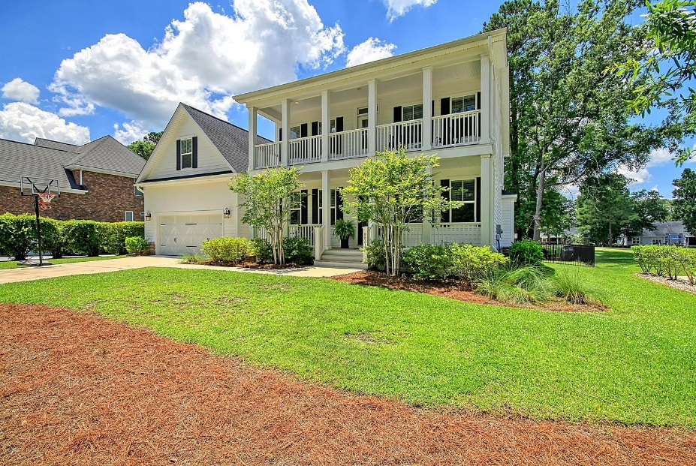
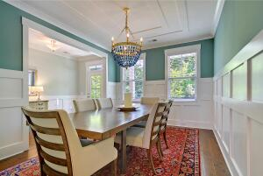
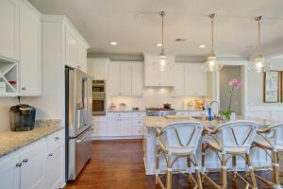
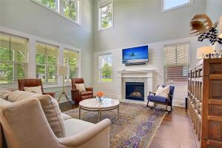
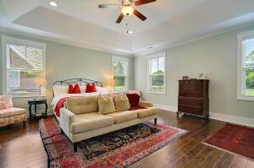
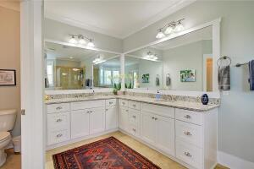
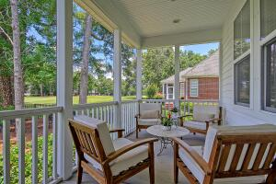
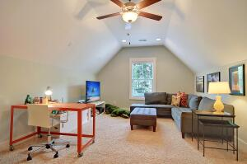
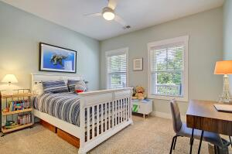
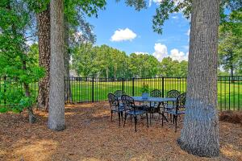
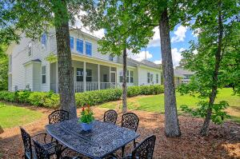
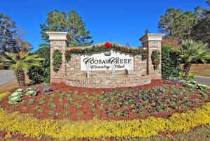
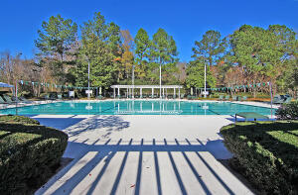
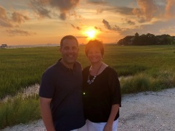

3 Year Old Home on Golf Course in Gated Community!
8831 E Fairway Woods Circle
Coosaw Creek Country Club
North Charleston, SC 29420
MLS# 22014441
$639,000
5 Bedrooms | 3 Baths | 3,297 sf
This beautiful 3,297 Sq. Ft. custom built, golf course home is one of the most recently built homes in Coosaw Creek so no worries about making renovations, roof & HVAC age or excessive wear - just move right in! Curb appeal galore with front double porches. This home features a master bedroom downstairs with a walk in closet, tray ceiling and a master bathroom with granite counters and separate tub and shower. The gourmet kitchen offers an island with sitting bar, granite counters, stainless steel appliances, gas cooktop, eat-in kitchen area and is wide open to the spacious family room with high vaulted ceilings! Buyers will also find a separate dining room with excellent trim work, laundry room and screened porch entrance from family room on the first floor. The screened porch overlooks a fenced-in backyard and beautiful golf course views! Upstairs buyers will find 3 spacious bedrooms and a huge FROG that can be used for practically anything! Coosaw Creek is an amazing place to live! The neighborhood has 24 hour 7 day a week gated security, unlimited golf for all household members, and the location, wow...close to it all! Boeing, Bosch, AFB, Volvo, Mercedes are all a short drive away. Come live the good life in a golf course community that has tons of activities and events, great food in the restaurant, great community pool with an award winning swim team, tennis courts, basketball courts, pickleball courts, playground and the most beautiful golf course you'll ever play on! This home is a MUST SEE within Coosaw Creek!
Larry & Kathy Mazalatis
Larry Cell 843-693-0529
Kathy Cell 843-693-0159
Office 843-871-9133
AGENTOWNED PREMIERE GROUP | 1800 TROLLEY RD | SUMMERVILLE, SC 29485

