Slide 1
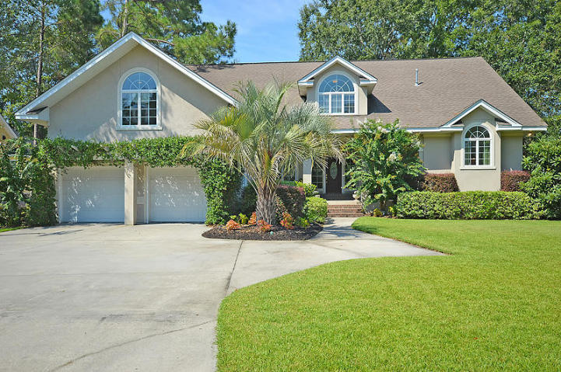
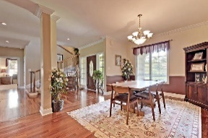
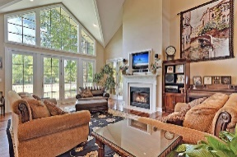
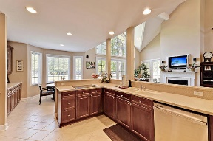
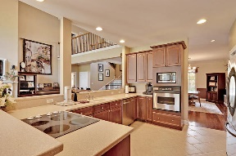
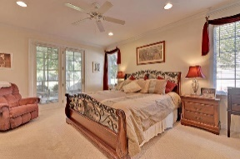
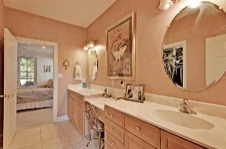
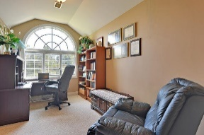
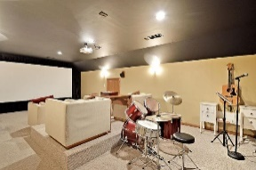
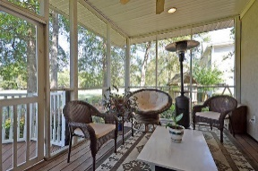
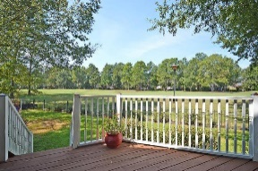
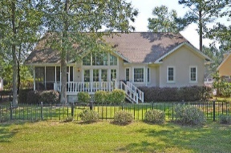



Golf Course Beauty in Gated Community!
8855 E Fairway Woods Dr
Coosaw Creek Country Club
North Charleston, SC 29420
MLS# 17004778
$549,900
5 Bedrooms | 5 Baths | 4,400 sf
Wow! This custom built home is in IMMACULATE condition, be ready to be impressed! Designed by Hilton Head Island architect, Kurt Herrman, Jr., with curb appeal galore! Step inside and immediately notice the great open floor plan and the beautiful Brazilian cherry hardwood floors! The first floor of this home offers a large dining room which flows into the kitchen area. The kitchen is a cooks delight with ample custom cabinetry space, large sitting bar and eat-in kitchen area all overlooking the family room. The family room has a gas fireplace, gorgeous vaulted ceiling and an amazing ''wall of windows'' overlooking the golf course. There is also access to the screened-in porch from the family room. The master suite is on the first floor and offers access to the back porch, a large master bathroom with dual vanities, separate tub and shower and walk in closet. On the opposite side of the house are two more bedrooms on the 1st floor. One bedrooms has its own full bath! Another full bath and laundry room complete that side of the home. Upstairs, you'll find a great loft area perfect for a desk or two. Two more bedrooms, both with ample closet space are upstairs. One bedroom has its own full bath! But that's not all! Buyers will find an awesome media room with theatre seating perfect for movie night, a huge bonus room that can be used as a kids toy room, home gym, you name it. There's also a craft room/office upstairs and tons of storage! This home has so much to offer, it's a must see! Come live the good life of Coosaw Creek with its 24 hour/7 day a week security gate, golf membership, award winning swim team and pool side food service at the neighborhood pool. All this so close to Boeing, Bosch, the AFB and Airport!
Larry & Kathy Mazalatis
Larry Cell 843-693-0529
Kathy Cell 843-693-0159
Office 843-871-9133
AGENTOWNED PREMIERE GROUP | 1800 TROLLEY RD | SUMMERVILLE, SC 29485

