Slide 1
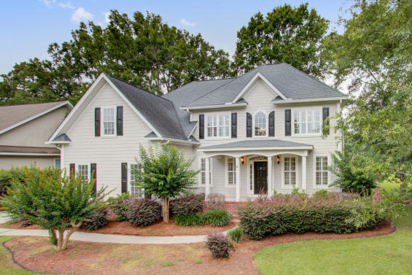
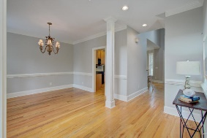
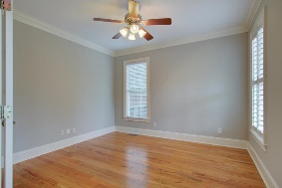
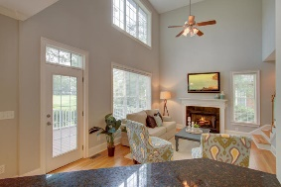
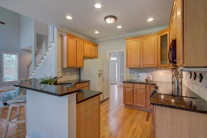
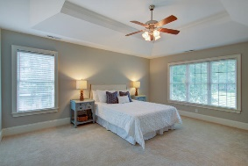
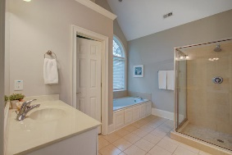
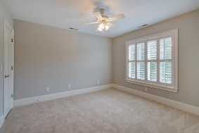
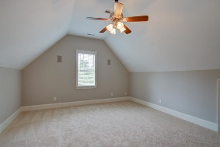
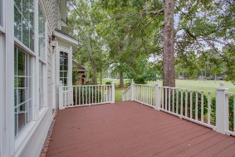
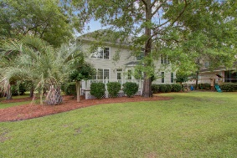
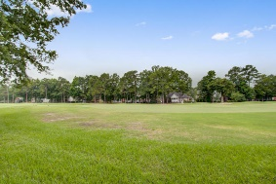



Golf Course Beauty for Under $400k!
8859 E Fairway Woods Dr
Coosaw Creek Country Club
North Charleston, SC 29420
MLS# 19022460
$379,000
4 Bedrooms | 3 Baths | 2,800 sf
Come live the good life in the gated golf course community of Coosaw Creek! For well under $400k, you can live in this gorgeous neighborhood with 24/7 security! This beautiful home, located on the golf course, is move-in ready! The front porch is so welcoming and has room for a few rocking chairs. Upon entering the home, you'll notice the beaming wood floors. To your right, is a formal living room or office with French doors for added privacy. To your left, is the dining room. Through the dining room you enter the kitchen which is open to the family room and eat-in kitchen area, all with great views of the golf course. The family room offers a gas fireplace and has access to the large back deck. Down the hall, you have a first floor bedroom, perfect for guests, as well as a full bathroom!
The laundry room is off the kitchen as has cabinetry as well as a large closet. Head upstairs and you'll find two more large bedrooms with plantation shutters. In the hall is a full bathroom with dual vanities. The master suite is very spacious and has sweeping views of the golf course as well as a large walk-in closet. The master bathroom has dual vanities, a separate shower and tub. Back out in the hall, you'll find a huge FROG or bonus room. This room has so many possibilities (could be a 5th bedroom) and also offers attic storage. This home has been well maintained and is move in ready!! Buyers will be impressed! The neighborhood has 24 hour 7 day a week gated security, unlimited golf for all household members, and the location, wow...close to it all! Boeing, Bosch, AFB, Mercedes, Volvo are all a short drive away. Come live the good life in a golf course community that has tons of activities and events, great food in the restaurant, great community pool with an award winning swim team, and the most beautiful golf course you'll ever play on!
Larry & Kathy Mazalatis
Larry Cell 843-693-0529
Kathy Cell 843-693-0159
Office 843-871-9133
AGENTOWNED PREMIERE GROUP | 1800 TROLLEY RD | SUMMERVILLE, SC 29485

