Slide 1
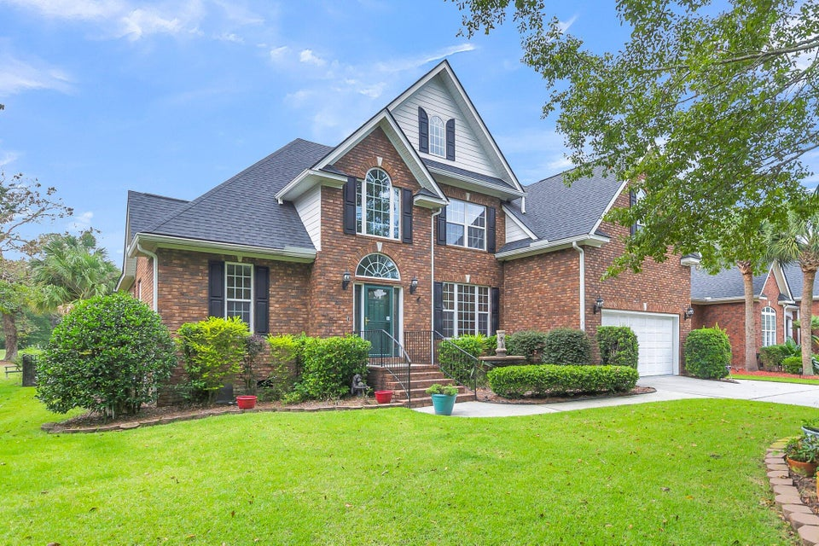
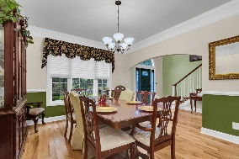
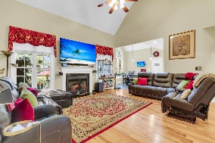
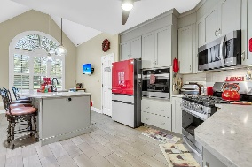
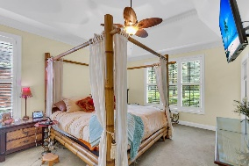
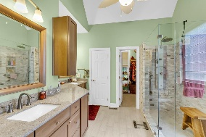
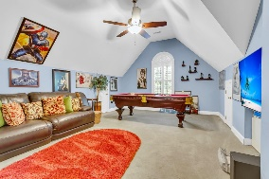
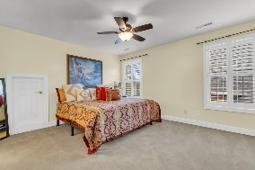
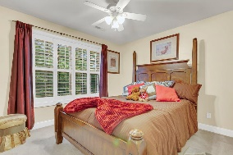
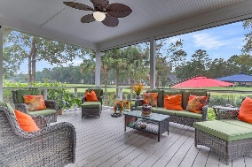
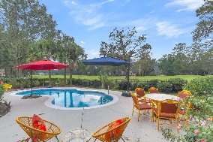
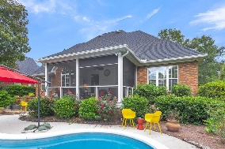
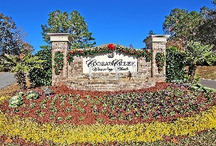
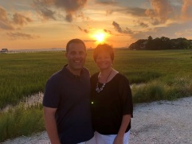

Gated Community ~ On Golf Course with Pool
8867 E Fairway Woods Circle
Coosaw Creek Country Club
North Charleston, SC 29420
MLS# 24025355
$617,777
4 Bedrooms | 3 Baths | 2,780 sf
Get ready to be impressed! Welcome home to 8867 E Fairway Woods located in the gated golf course community of Coosaw Creek! This home has a great floor plan, it's on the golf course, is a smart home (mostly all lights, thermostats, even the kitchen sink can be controlled by an alexa command!) and it has a built in pool. Upon entering in to the two story foyer, to your right is the formal dining room which is the perfect size for entertaining and has arched doorways, creating an open flow in to the living room and kitchen. The living room has vaulted ceilings, a gas fireplace and is open to the kitchen. The kitchen is a chef's delight and has been updated to offer a gas cooktop, two ovens, stainless steel appliances, granite countertops and an oversized island that can seat at least four!
Access the large screened in porch from the kitchen. This porch is perfect for relaxing before you step out to your gorgeous saltwater pool. Head back inside to the first floor primary bedroom which has views of the golf course, a tray ceiling, plantation shutters as well as access to the porch. The primary bath has been updated as well and offers dual vanities, a gorgeous shower with body sprays and a walk in closet with ample storage. On the other side of the first floor is another bedroom, perfect for guests, with a full bathroom located just outside of it. On this same side of the house you'll find the laundry room which has its own sink and extra cabinet storage. Upstairs, you'll find two more bedrooms with large closets, a full bathroom in the hallway as well as some attic storage. The huge FROG can be used as a fifth bedroom if needed or just a great media/entertainment room. Coosaw Creek is a hidden gem and the golf course is a beauty offering an 18 hole Par 71 course designed by Arthur Hills, a driving range as well as a chipping and putting range. There are leagues and tournaments offered as well as a pro shop. Unlimited rounds of golf for the member, spouse/significant other and dependent children up to the age of 23. The community pool facility features a salt water junior Olympic size salt water pool, a covered cabana, pool side service available from the bar and kitchen, kids splash pad, playground, tennis courts and pickleball, volleyball, basketball, shuffleboard and bocce area. So many fun events and activities are always on the calendar at the clubhouse which makes it a great way to meet people! Don't forget the delicious restaurant, The Palmetto Grill, also located in the clubhouse. This neighborhood is convenient to the airport, AFB, Bosch and Boeing. Dorchester District Two Schools! Come live the good life!
Larry & Kathy Mazalatis
Larry Cell 843-693-0529
Kathy Cell 843-693-0159
mazteamrealty@gmail.com
AGENTOWNED REALTY | 1800 TROLLEY RD | SUMMERVILLE, SC 29485

