Slide 1
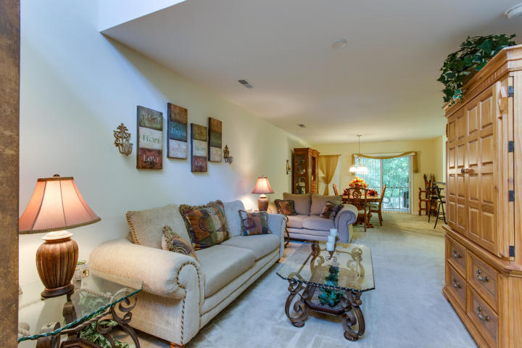
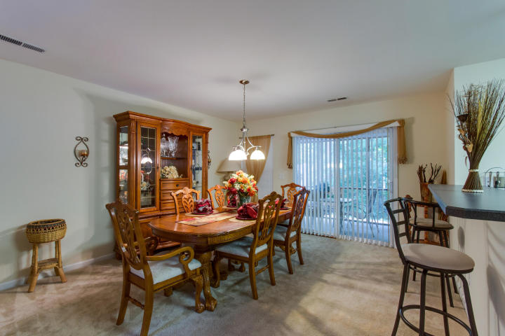
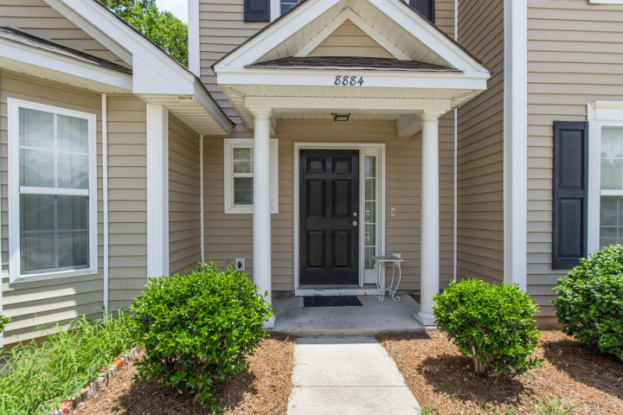
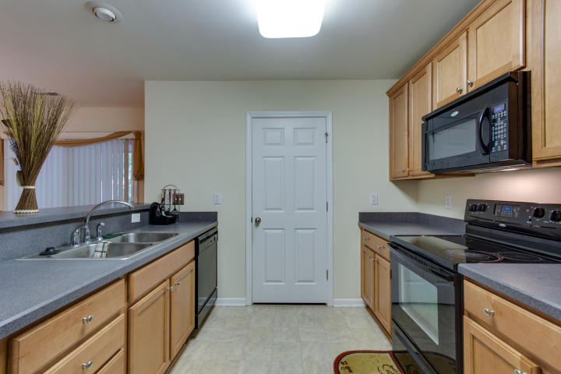
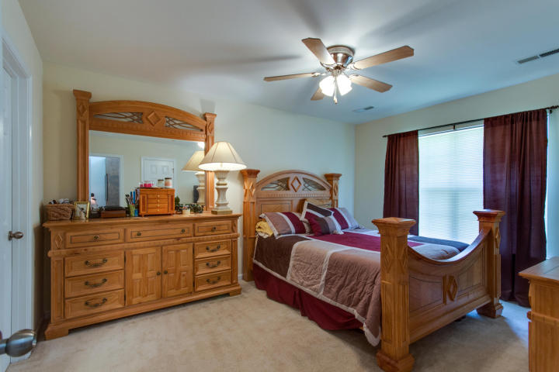
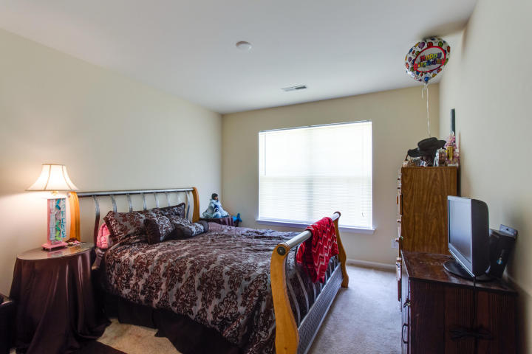
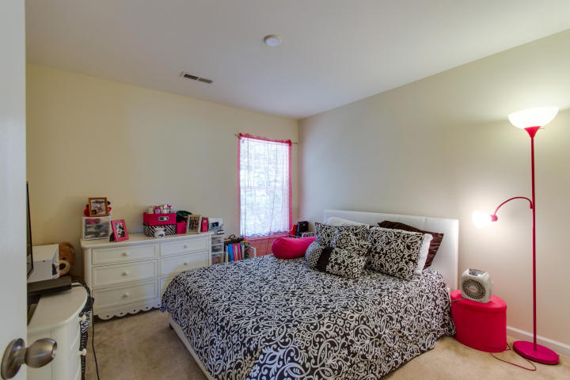
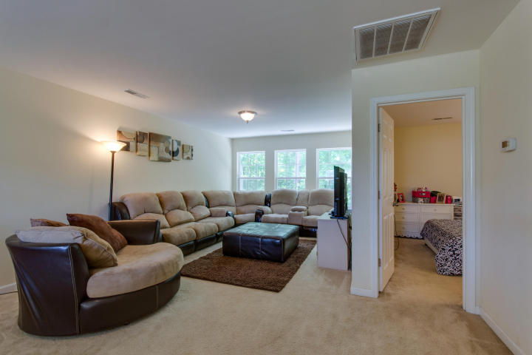
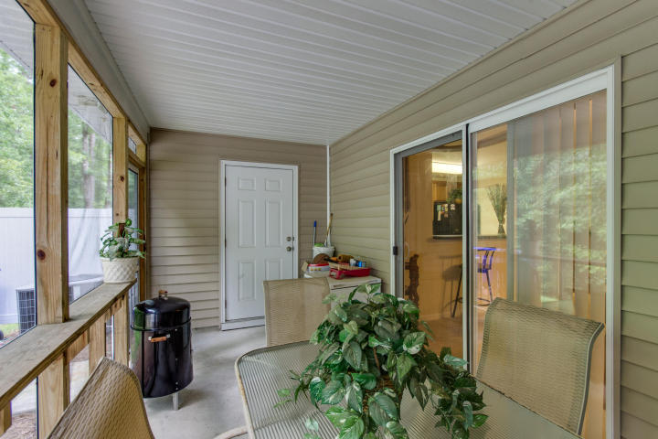

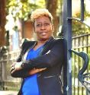
Brokers Open House
7/28/16 from 12-2pm
Come out and win a gift card
8884 Gable Street
University Park | North Charleston | MLS# 16018955 | $154,999
Come see this awesome townhome! This unit features an open floorplan with a two story foyer and the master bedroom downstairs. The kitchen has plenty of cabinets, a breakfast bar, and the laundry is also off of the kitchen. The ample dining space has a sliding glass door to your large screened-in porch. There is also lockable storage room off the porch. Upstairs features a large open loft and 2 additional bedrooms. Great location University Park is centrally located minutes away from Charleston Southern University, Trident Medical Center, Trident Technical College, Charleston Airport, Wannamaker Park, Boeing, and lots of shopping & restaurants.
Felicia Smalls
(843) 460-8009
yourdreamhomebyfelicia@gmail.com
Carolina Elite Real Estate | 1081 East Montague Ave | N Charleston, SC 29405

