Slide 1
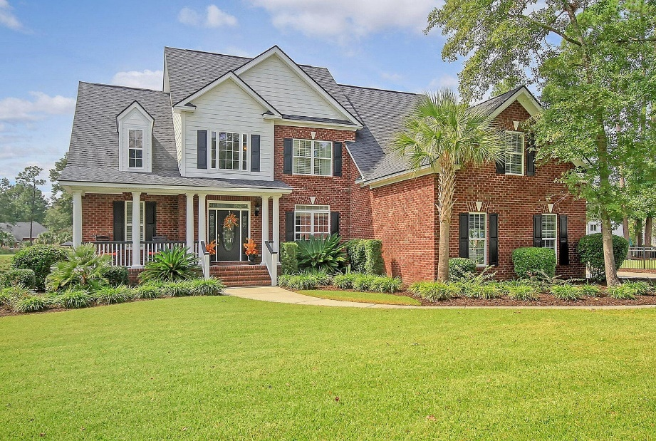
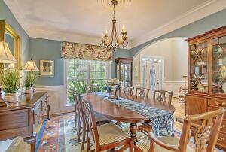
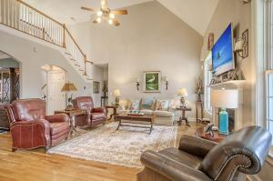
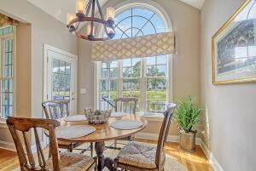
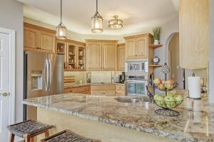



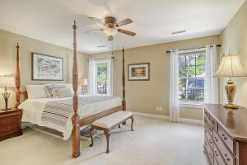
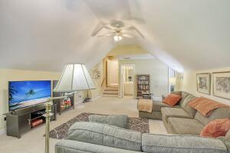
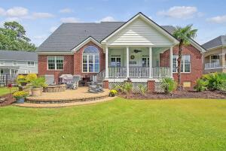
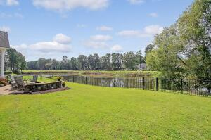
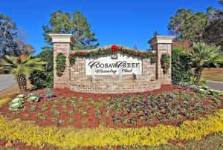
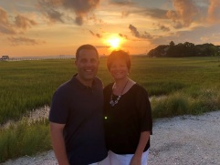

Gated Golf Course Community Beauty!
8887 E Fairway Woods Drive
Coosaw Creek Country Club
North Charleston, SC 29420
MLS# 23022183
$625,000
4 Bedrooms | 4 Baths | 3,000 sf
Welcome home to 8887 E Fairway Woods in the lovely gated community of Coosaw Creek! This beauty of a home is located on the 12th fairway of the golf course and offers a peaceful setting on a pond. The curb appeal and great front porch welcome you home. Upon entering, you'll immediately notice the beautiful wood flooring, arched entryways in to the dining room and beautiful trim work. The vaulted ceiling in the family room gives the home a great open flow. The gorgeous kitchen overlooks the family room and offers a pantry, breakfast bar, eat in kitchen area and ample cabinet space. Along with the main bedroom, there is an additional bedroom on the first floor along with a full bath in the hallway right outside. This is perfect for guests or as a mother-in-law suite.
The main bedroom is on the other side of the house and has great views of the pond and golf course. The main bathroom has dual vanities, a separate tub and large shower. The walk in closet is huge and offers plenty of storage! Head upstairs and find two large bedrooms with big closets and a full bath in the hallway. The FROG can be the 5th bedroom if needed. It also has its own full bathroom! Head back downstairs and outside to the stunning views out the backdoor. There is a patio with a fire pit in the fenced in yard. Sit and watch the variety of birds that visit the pond. Coosaw is an amazing neighborhood that offers you a lifestyle that will keep you busy! The clubhouse has so many planned activities and a great restaurant. The golf course, pool, tennis courts, pickleball courts, playground...all great ways to keep you active and to meet lifelong friends! Coosaw is close to it all...Bosch, the airport, Mercedes, shopping, you name it! Come live the good life in one of the areas most beautiful gated golf course communities!
Larry & Kathy Mazalatis
Larry Cell 843-693-0529
Kathy Cell 843-693-0159
mazteamrealty@gmail.com
AGENTOWNED PREMIERE GROUP | 1800 TROLLEY RD | SUMMERVILLE, SC 29485

