Slide 1
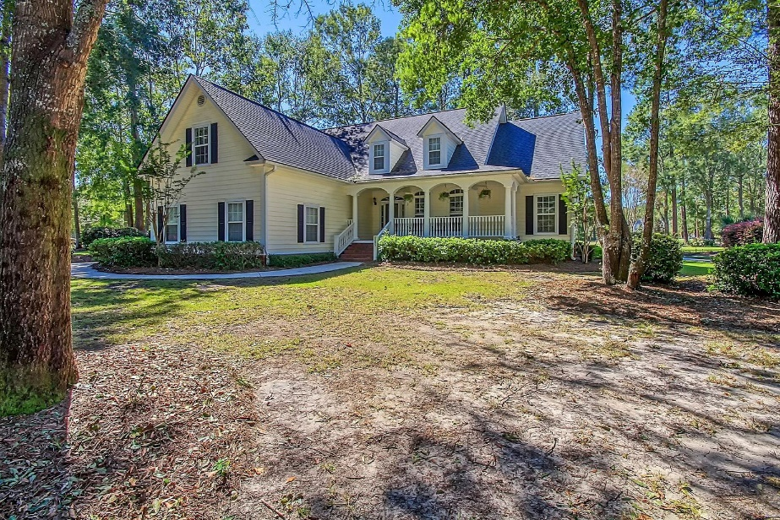
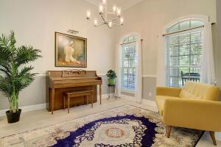
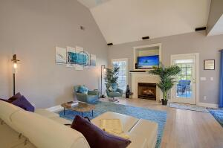
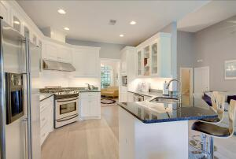
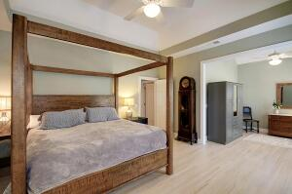
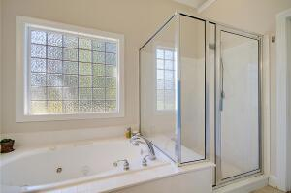
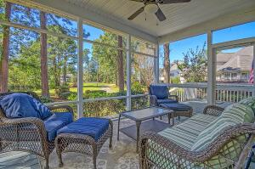
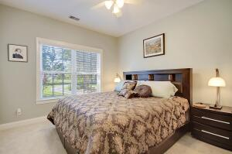
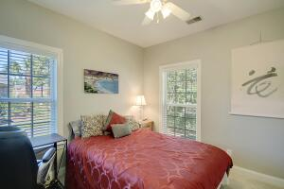
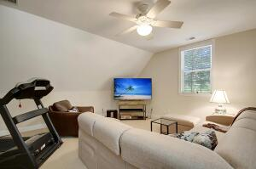
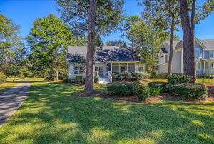
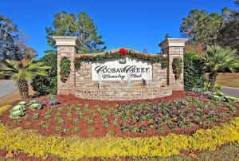
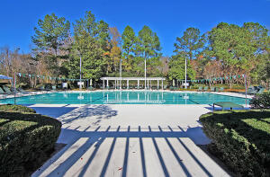
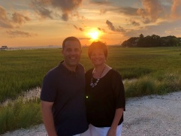

One Story on Golf Course! Gated Community!
8895 E Fairway Woods Circle
Coosaw Creek Country Club
North Charleston, SC 29420
MLS# 22025760
$512,000
4 Bedrooms | 3 Baths | 2,500 sf
Welcome home to this lovely one story house located in the gated community of Coosaw Creek Country Club! This golf course home has great views of the 12th tee box and a pond. A full front porch welcomes you in to this beautiful four bedroom, three bathroom home. You'll immediately notice the hardwood floors, which have recently been refinished, and open floor plan with vaulted ceilings. The dining room is a great size and opens up to the kitchen. The kitchen offers granite counters, gas range, stainless steel appliances, a breakfast bar as well as an eat-in kitchen area. The kitchen overlooks the living room which features a gas fireplace, vaulted ceilings and entrance to the screened in porch. This is a great home for entertaining! Head down the hall to the master suite! The first floor master bedroom is conveniently located on the opposite side of the home from the other bedrooms. The master bedroom has tray ceilings and a large area that can be used as a sitting room, study or office. The master bathroom features a dual vanity, jetted tub and a large glass shower with seat. On the other side of the home are two more bedrooms on the first floor that share a full bathroom in the hall. The HUGE 4th bedroom is the FROG (only room upstairs) and has a full bathroom. This room can also be a great playroom / office or guest suite. Back outside, step out in to the screened in porch which also has a beautiful deck off of it, with gas hook-up for grill. The lot is gorgeous and offers the best of both worlds, wooded and private in the front, and open and sunny in the back with a view of the pond and the 12th tee. This home is in the Dorchester District 2 school system, close to Bosch, Boeing, Mercedes, the airport and the Air Force Base. Unlimited golf green fees for all household members, tennis courts, basketball courts, pickle call courts, playground and a super active Club with tons of special events, restaurant and clubs. Come see this house today!!
Larry & Kathy Mazalatis
Larry Cell 843-693-0529
Kathy Cell 843-693-0159
Office 843-871-9133
AGENTOWNED PREMIERE GROUP | 1800 TROLLEY RD | SUMMERVILLE, SC 29485

