Slide 1
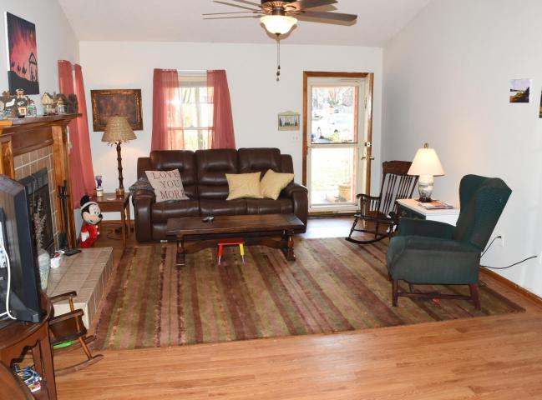
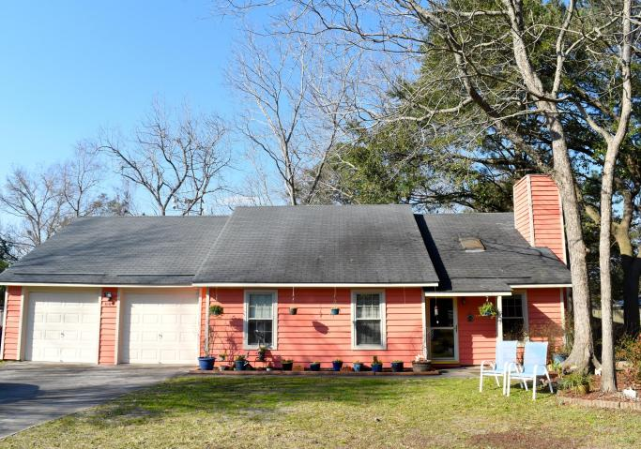
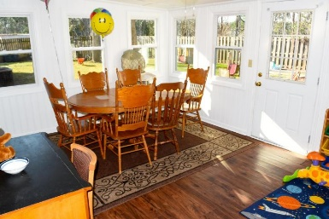
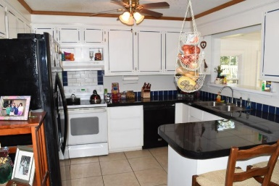
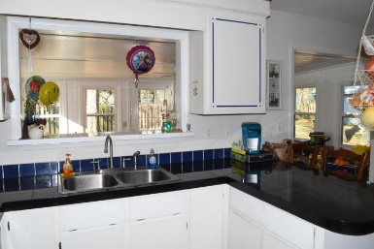
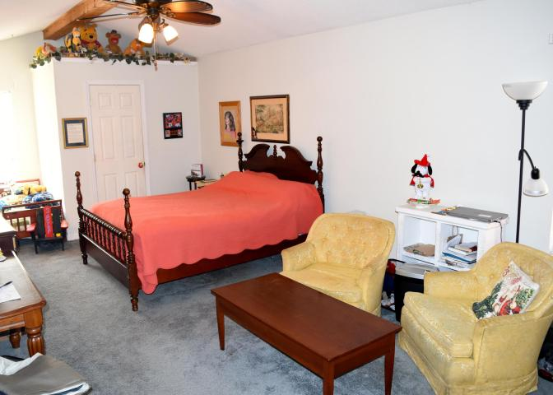
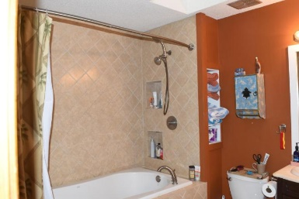
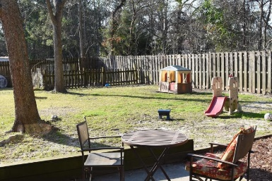
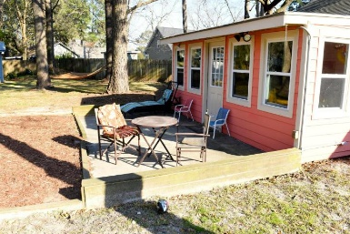
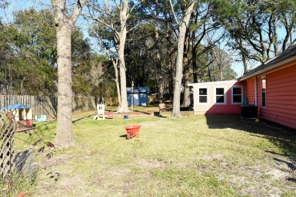
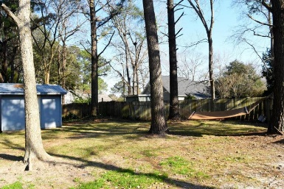


889 Corinth Court Candlewood ~ Mount Pleasant, SC 29464 MLS# 16005567 ~ $379,500
If you are looking for a Mount Pleasant home with a large backyard, NO FLOOD INSURANCE and NO REGIME FEE, this may be what you are looking for! Both bathrooms have been recently updated. The master bathroom includes a 6' soaking tub and new tile, the master bedroom has multiple closets and vaulted ceilings, the kitchen has a breakfast bar, and there is a sunroom for dining, reading or just family time. The seller recently installed a Nest thermostat to make assist with efficiency of heating and cooling in the home. The two car garage has full attic storage above it and there is additional storage throughout the home. The large backyard is fully fenced and there is backyard shed that has power. The home has been recently painted and is located at the back of a private cul-de-sac.
Agent Open with Southern Season Gift Card! ~ May 5th, 11a-1p
Cheryll Woods-Flowers
ABR, e-Certified, SHS
(843) 442-2219
www.woodsflowers.com

