Slide 1
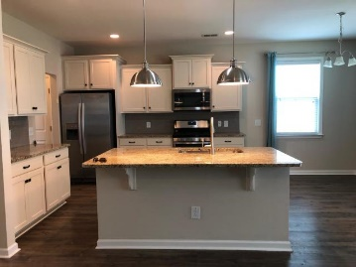
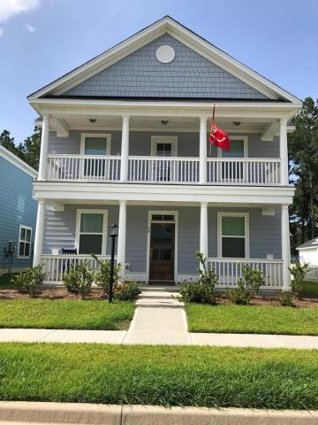
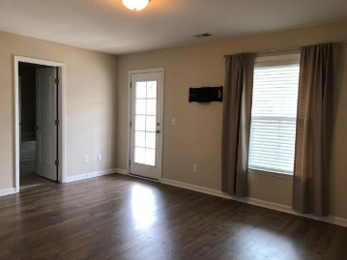
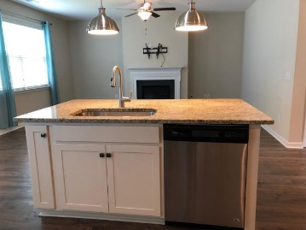
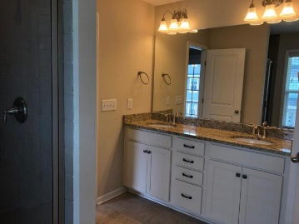
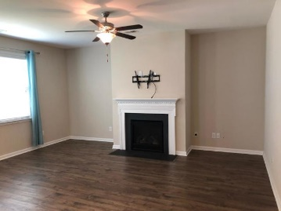
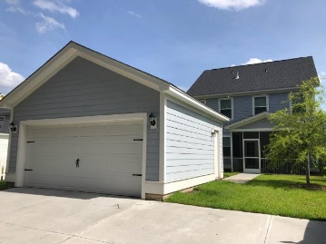
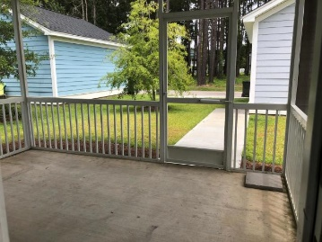
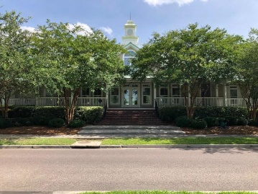


88 Crossandra Avenue
White Gables | Summerville, SC 29483 | MLS# 19018618 | $319,999
New Price!
Welcome home to this beautiful 3 story Charleston single that exudes Southern Charm! Step inside to a foyer with a formal dining room and living room on each side. Continue in to the spacious kitchen that flows into the eat-in area and great room. A screen porch adds to your living space, along with a 2-car detached garage and extra parking pad. Head upstairs to the second floor that includes the master bedroom along with 2 additional bedrooms and a loft. The 3rd floor has a bedroom and full bathroom. Crescent built home offering eco-friendly features and high energy standards including EStar appliances, radiant barrier in attic, Carrier Purion 14 SEER AC, high efficiency gas furnace, HVAC ductwork insulated to R-8, tankless water heater, programmable thermostats, Low-E window.
Check out the Hampton B floor plan at crescenthomes.net
Beth Mandell
M 803-463-7734 | O 843-871-2121
bmandell@century21properties.com
www.bestcarolinahomedeals.com
Century 21 Properties Plus of Summerville | 118 W Richardson Ave | Summerville, SC 29483

