Slide 1
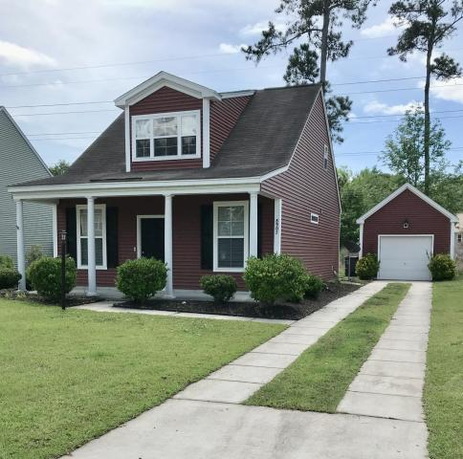
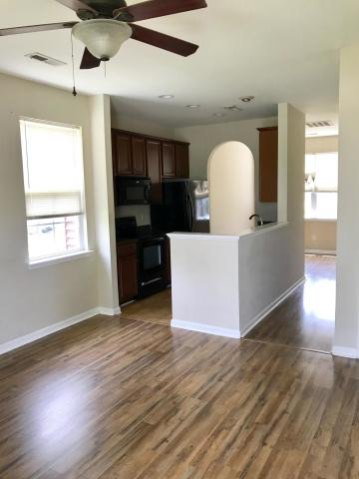
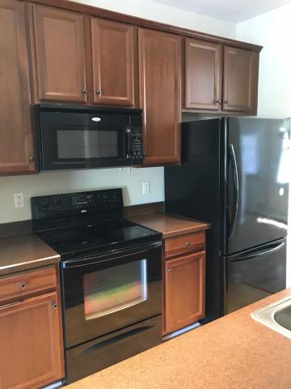
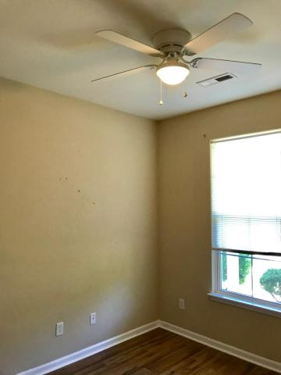
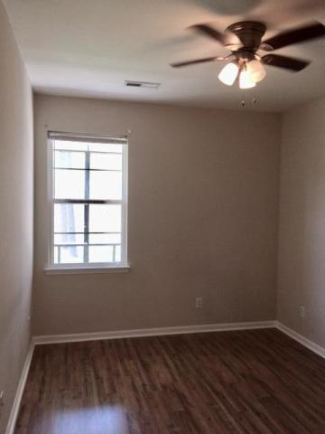
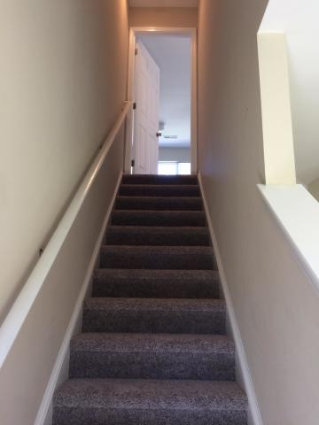
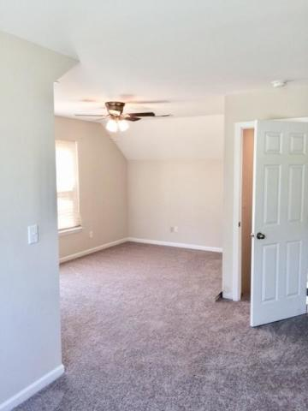
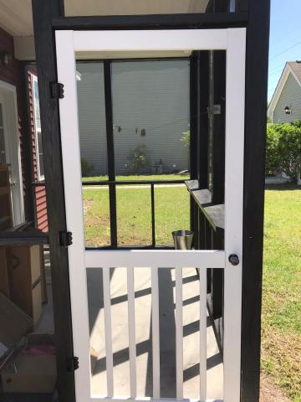


Come See This Cutie Today! EASY To Show!
8907 Planters Row Lane Wescott Plantation | Summerville, SC 29485
MLS# 18012266 | $189,000
~~Limited time through December!~~
$2000 towards Buyer Closing Costs for ratified contract that goes to closing!
Golf course community! Adorable cottage-like 3 BR/2 BA home on a quiet cul de sac - no worries about thru-traffic. Two bedrooms downstairs and Master BR upstairs. Master is HUGE with large walk-in closet and bathroom. NEW carpet. Living Room and Dining Rm have wood look laminate floors as well as the other 2 bedrooms. Laundry Area downstairs. Open galley kitchen with neutral colors. Detached garage and screened porch. Large back yard! This sweet home is waiting to be enjoyed!
Susan Weeks
(843) 813-0495
susanweeksdesign@gmail.com
www.agentownedrealty.com
AgentOwned Charleston Group
902 Savannah Hwy
Charleston, SC 29407-7802

