Slide 1
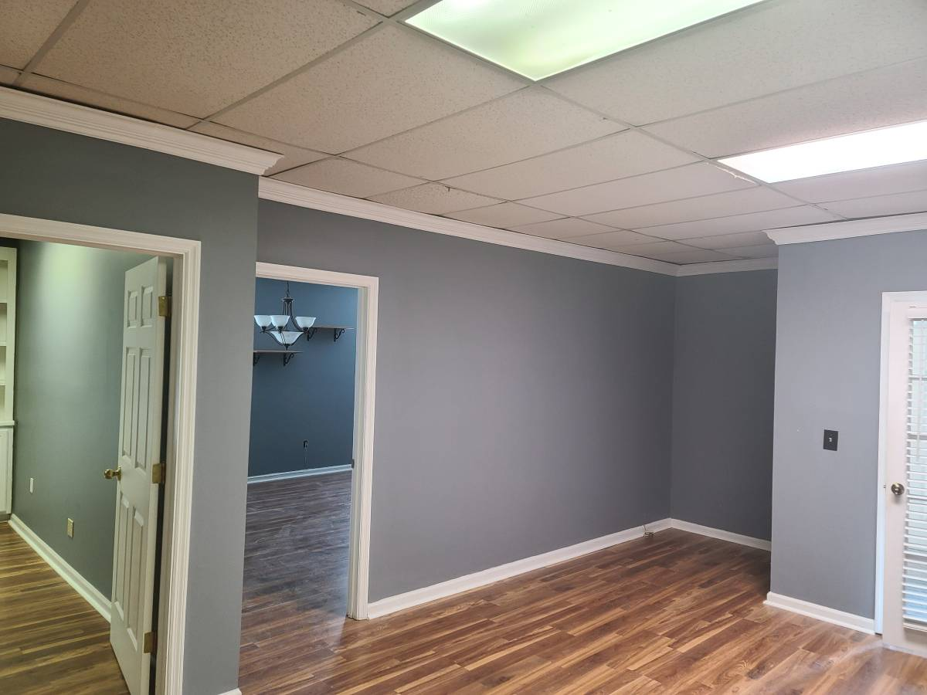
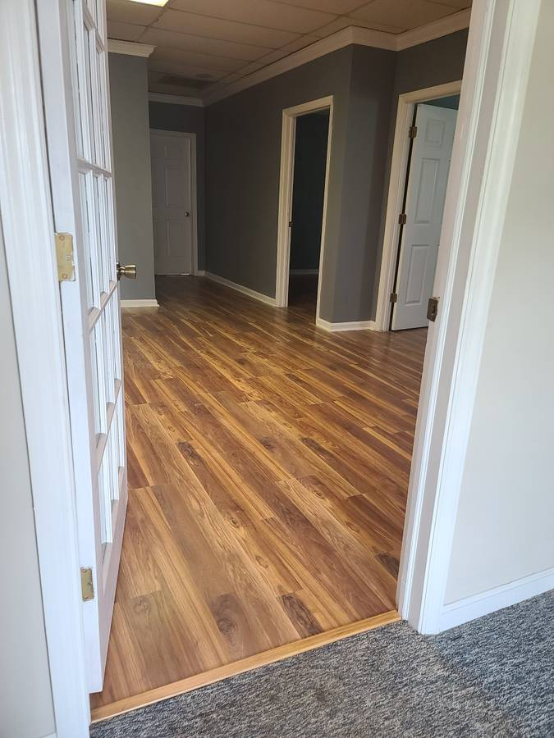
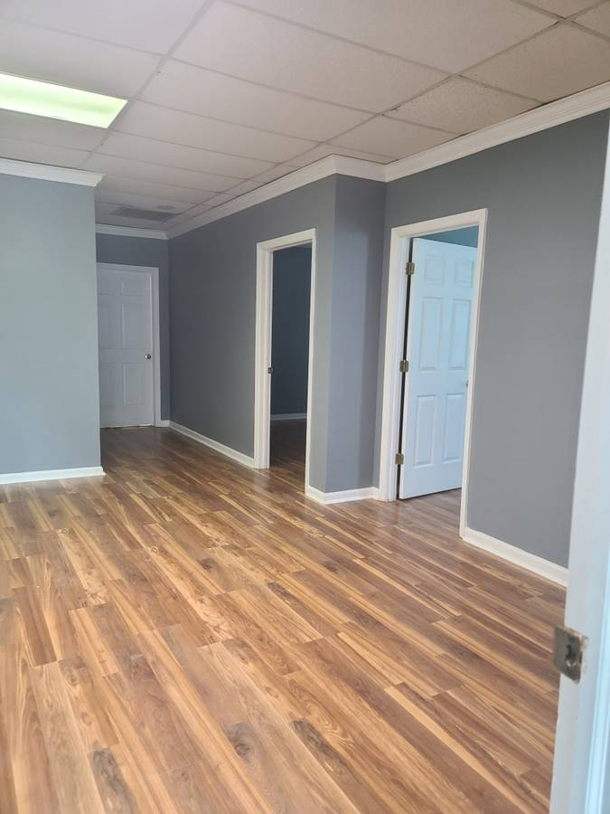
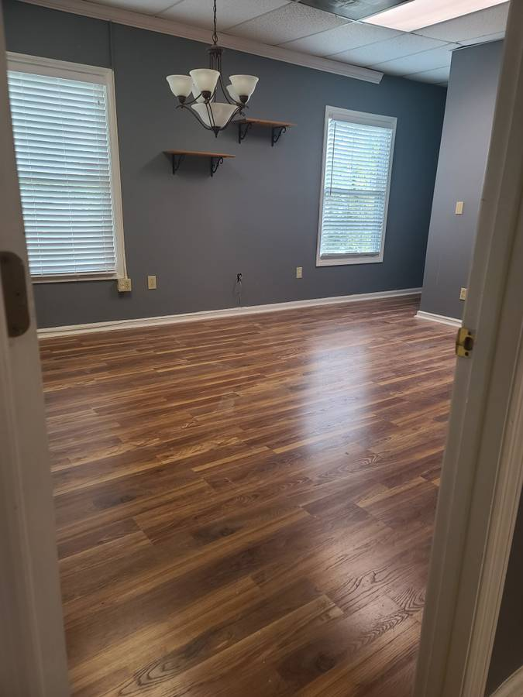
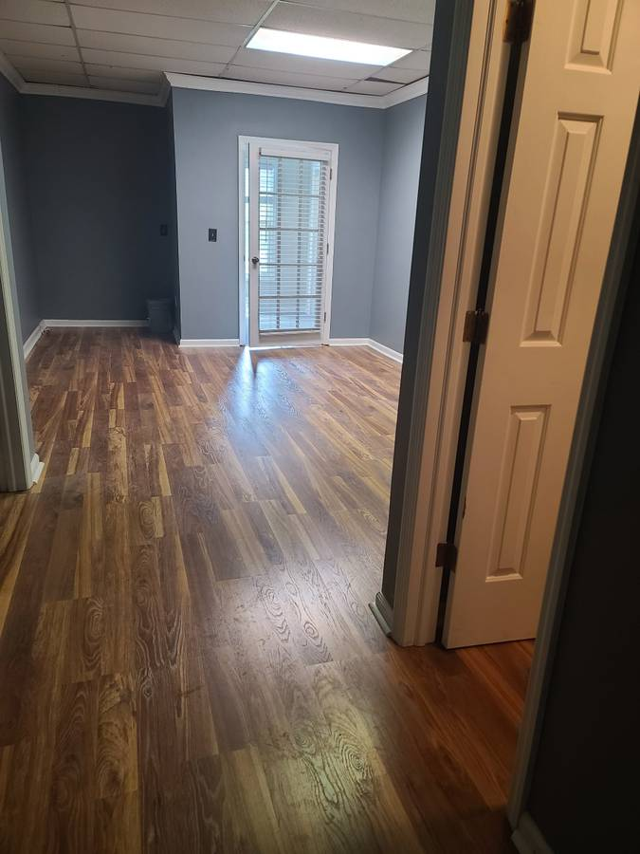
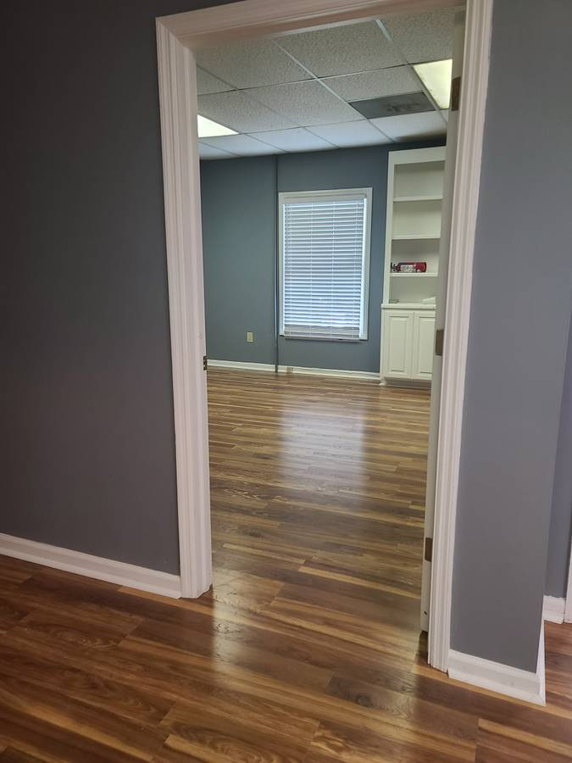
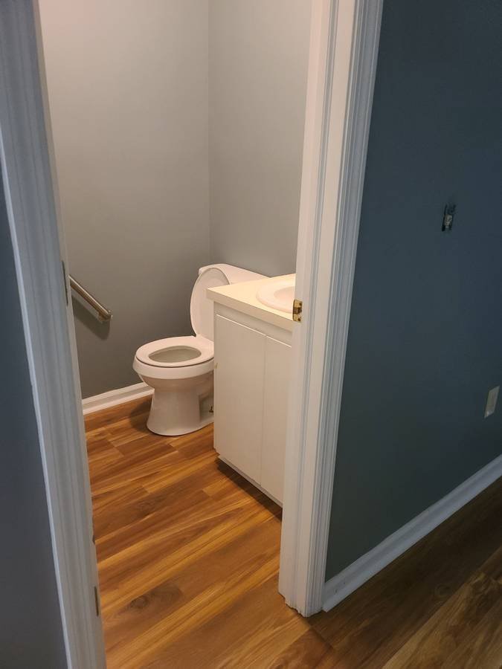
Office Suite For Lease!
890 Johnnie Dodds Blvd Bldg #2 Suite B
Mount Pleasant, SC ~ $1,600
Approx 1750 Sqft Office Suite.
Large reception/waiting area plus 2 spacious private offices.
Common area/kitchen shared.
Private bathroom.
Entire suite freshly painted, and new laminate flooring throughout.
Office suite located in Bldg # 2 Suite B on the 2nd floor.
Bonnie Miller
843.884.3901 O ~ 843.693.2647 M
bcm.olddom@gmail.com
Old Dominion, REALTORS · 890 Johnnie Dodds Blvd · Mt Pleasant, SC 29464

