Slide 1
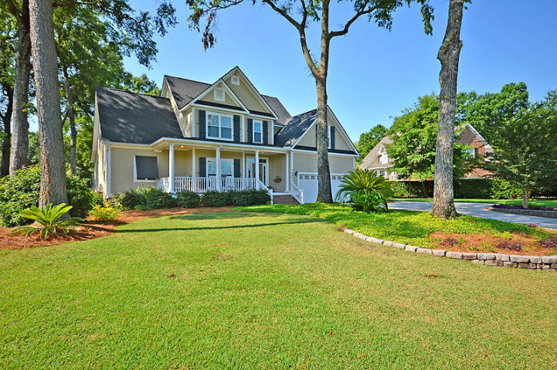
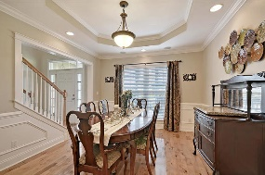
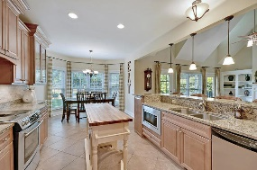
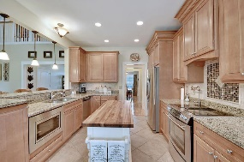
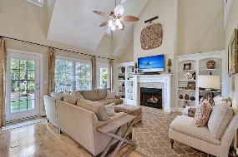
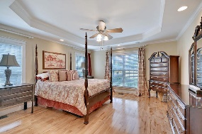
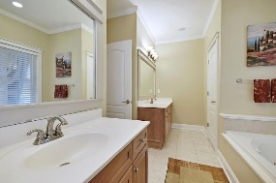
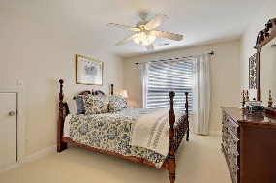
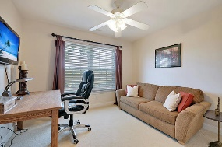
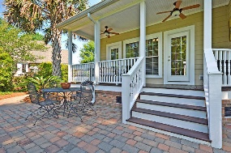
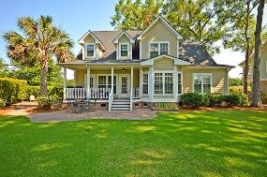
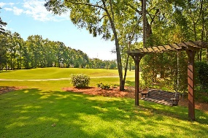



Under $400k on Golf Course in Gated Community
8931 E Fairway Woods Dr
Coosaw Creek Country Club
North Charleston, SC 29420
MLS# 19034270
$399,990
4 Bedrooms | 2½ Baths | 3,098 sf
Looking for a move in ready home? Want to be in a country club gated community and live on the golf course? This is the home for you!!! You'll be impressed from the moment you pull in the driveway. A great front porch welcomes you and as you enter the home, you'll immediately notice the wood floors throughout the first floor. The dining room to your left, has beautiful trim work as well as a built in corner cabinet. Walking towards the kitchen, you'll notice a wet bar and butler's pantry. Another great area offering storage! The kitchen is a cook's delight! Ample storage, granite countertops, breakfast bar, under the counter built in microwave and large eat in area, all overlooking the family room. The family room has built in cabinetry and shelving as well as a gas fireplace. From here, you can access the back porch which offers gorgeous views of the 13th green of the Coosaw Creek golf course. The first floor master, also has wood floors, offers a tray ceiling, his and her closets, dual vanities in the master bathroom as well as a separate jetted tub and shower. Upstairs, you'll find three more bedrooms, all with great closet space, as well as a full bathroom. Off the bedrooms, you'll find tons of attic space as well. Down the hall, you'll find a huge bonus room. This room has tons of possibilities. With two closets, as well as attic space, this room can be a 5th bedroom, a media room, workout space, etc! The choice is yours! Back outside, you have many options for relaxing. The back porch of course, then on the side of the home there's a lovely large patio with a custom made gate. This could be a great spot for a fire pit or some chaise lounges as it offers tons of shade. Or if you want to check out the golf course, there's a great bench swing where you can watch your neighbors playing golf. This home has had many upgrades that you will not have to worry about - newer roof, hvac, freshly painted and new carpeting! Move in ready!! Come see this home today as well as Coosaw Creek! The neighborhood has 24 hour 7 day a week gated security, unlimited golf for all household members, and the location, wow...close to it all! Boeing, Bosch, AFB, Mercedes are all a short drive away. Come live the good life in a golf course community that has tons of activities and events, great food in the restaurant, great community pool with an award winning swim team, and the most beautiful golf course you'll ever play on!
Larry & Kathy Mazalatis
Larry Cell 843-693-0529
Kathy Cell 843-693-0159
Office 843-871-9133
AGENTOWNED PREMIERE GROUP | 1800 TROLLEY RD | SUMMERVILLE, SC 29485

