Slide 1
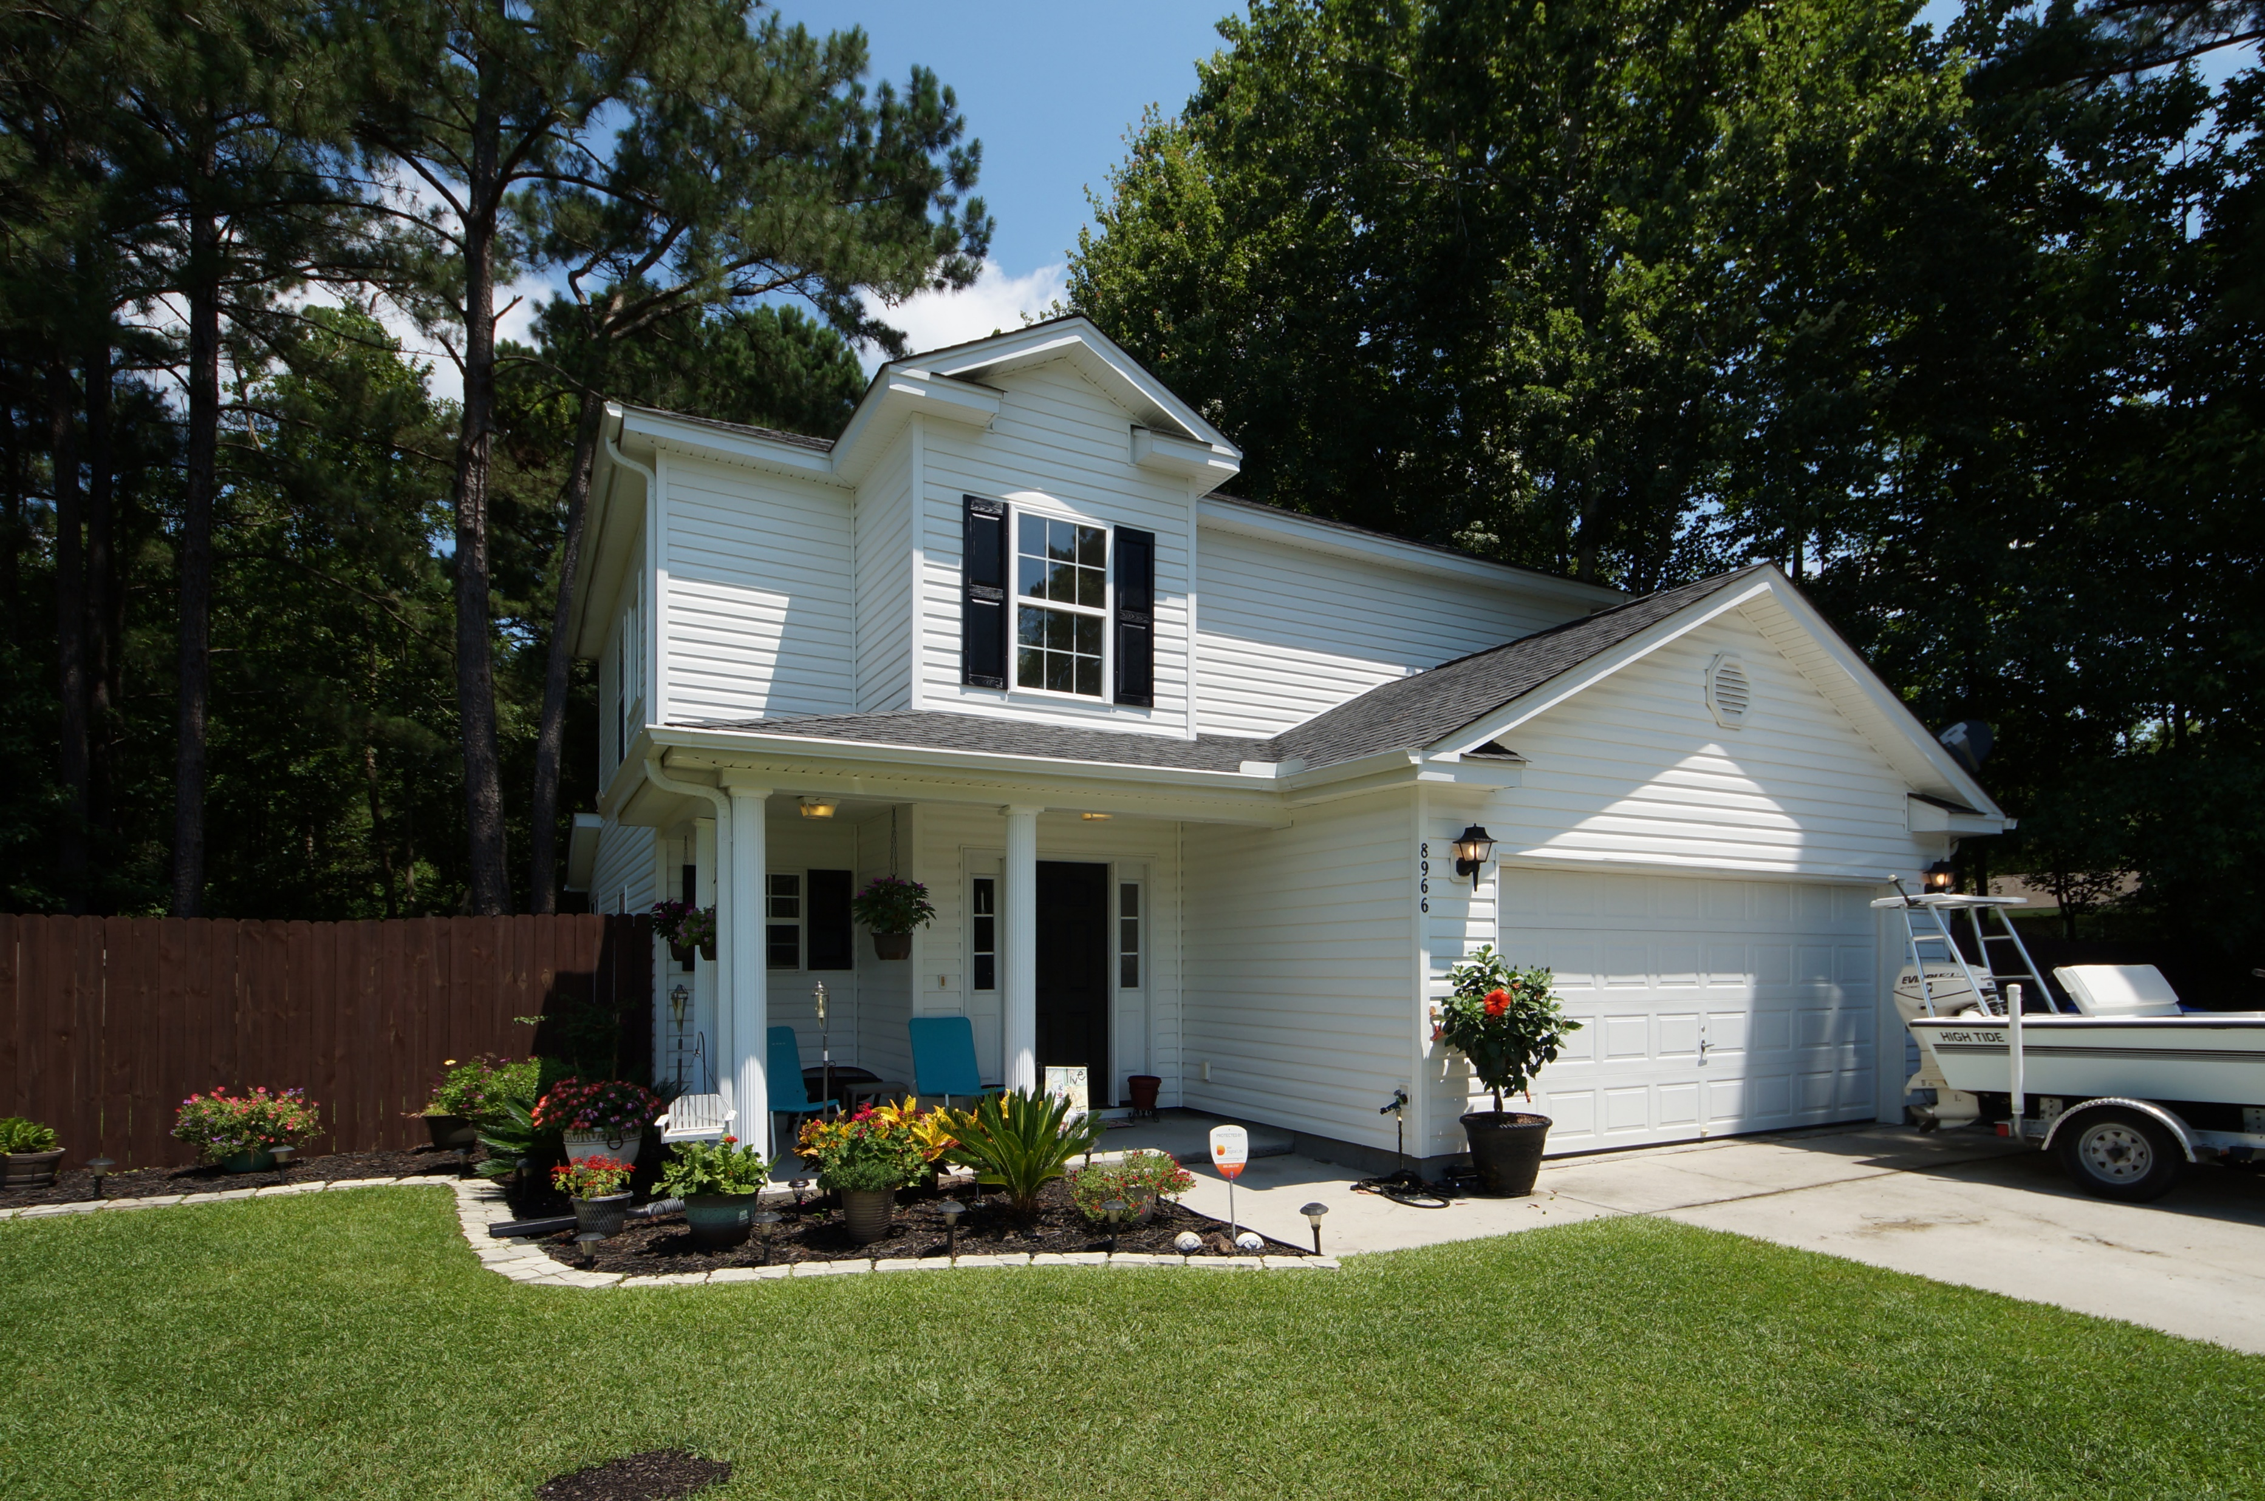
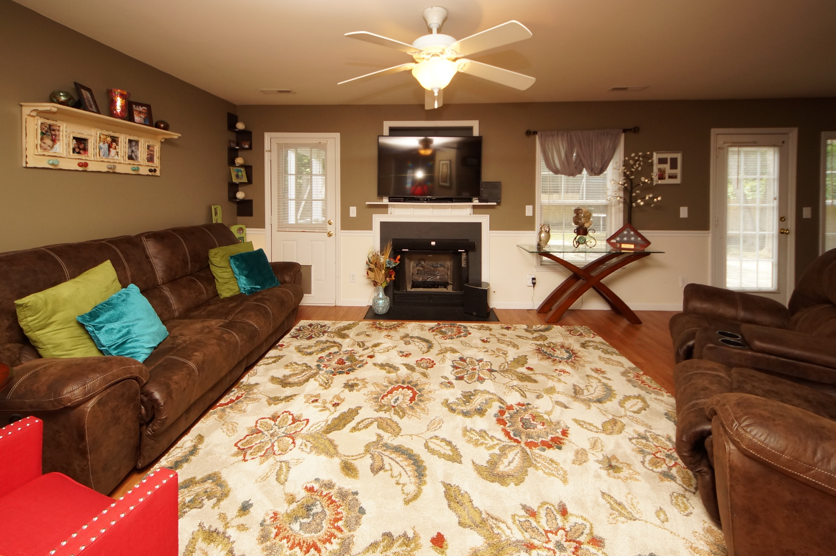
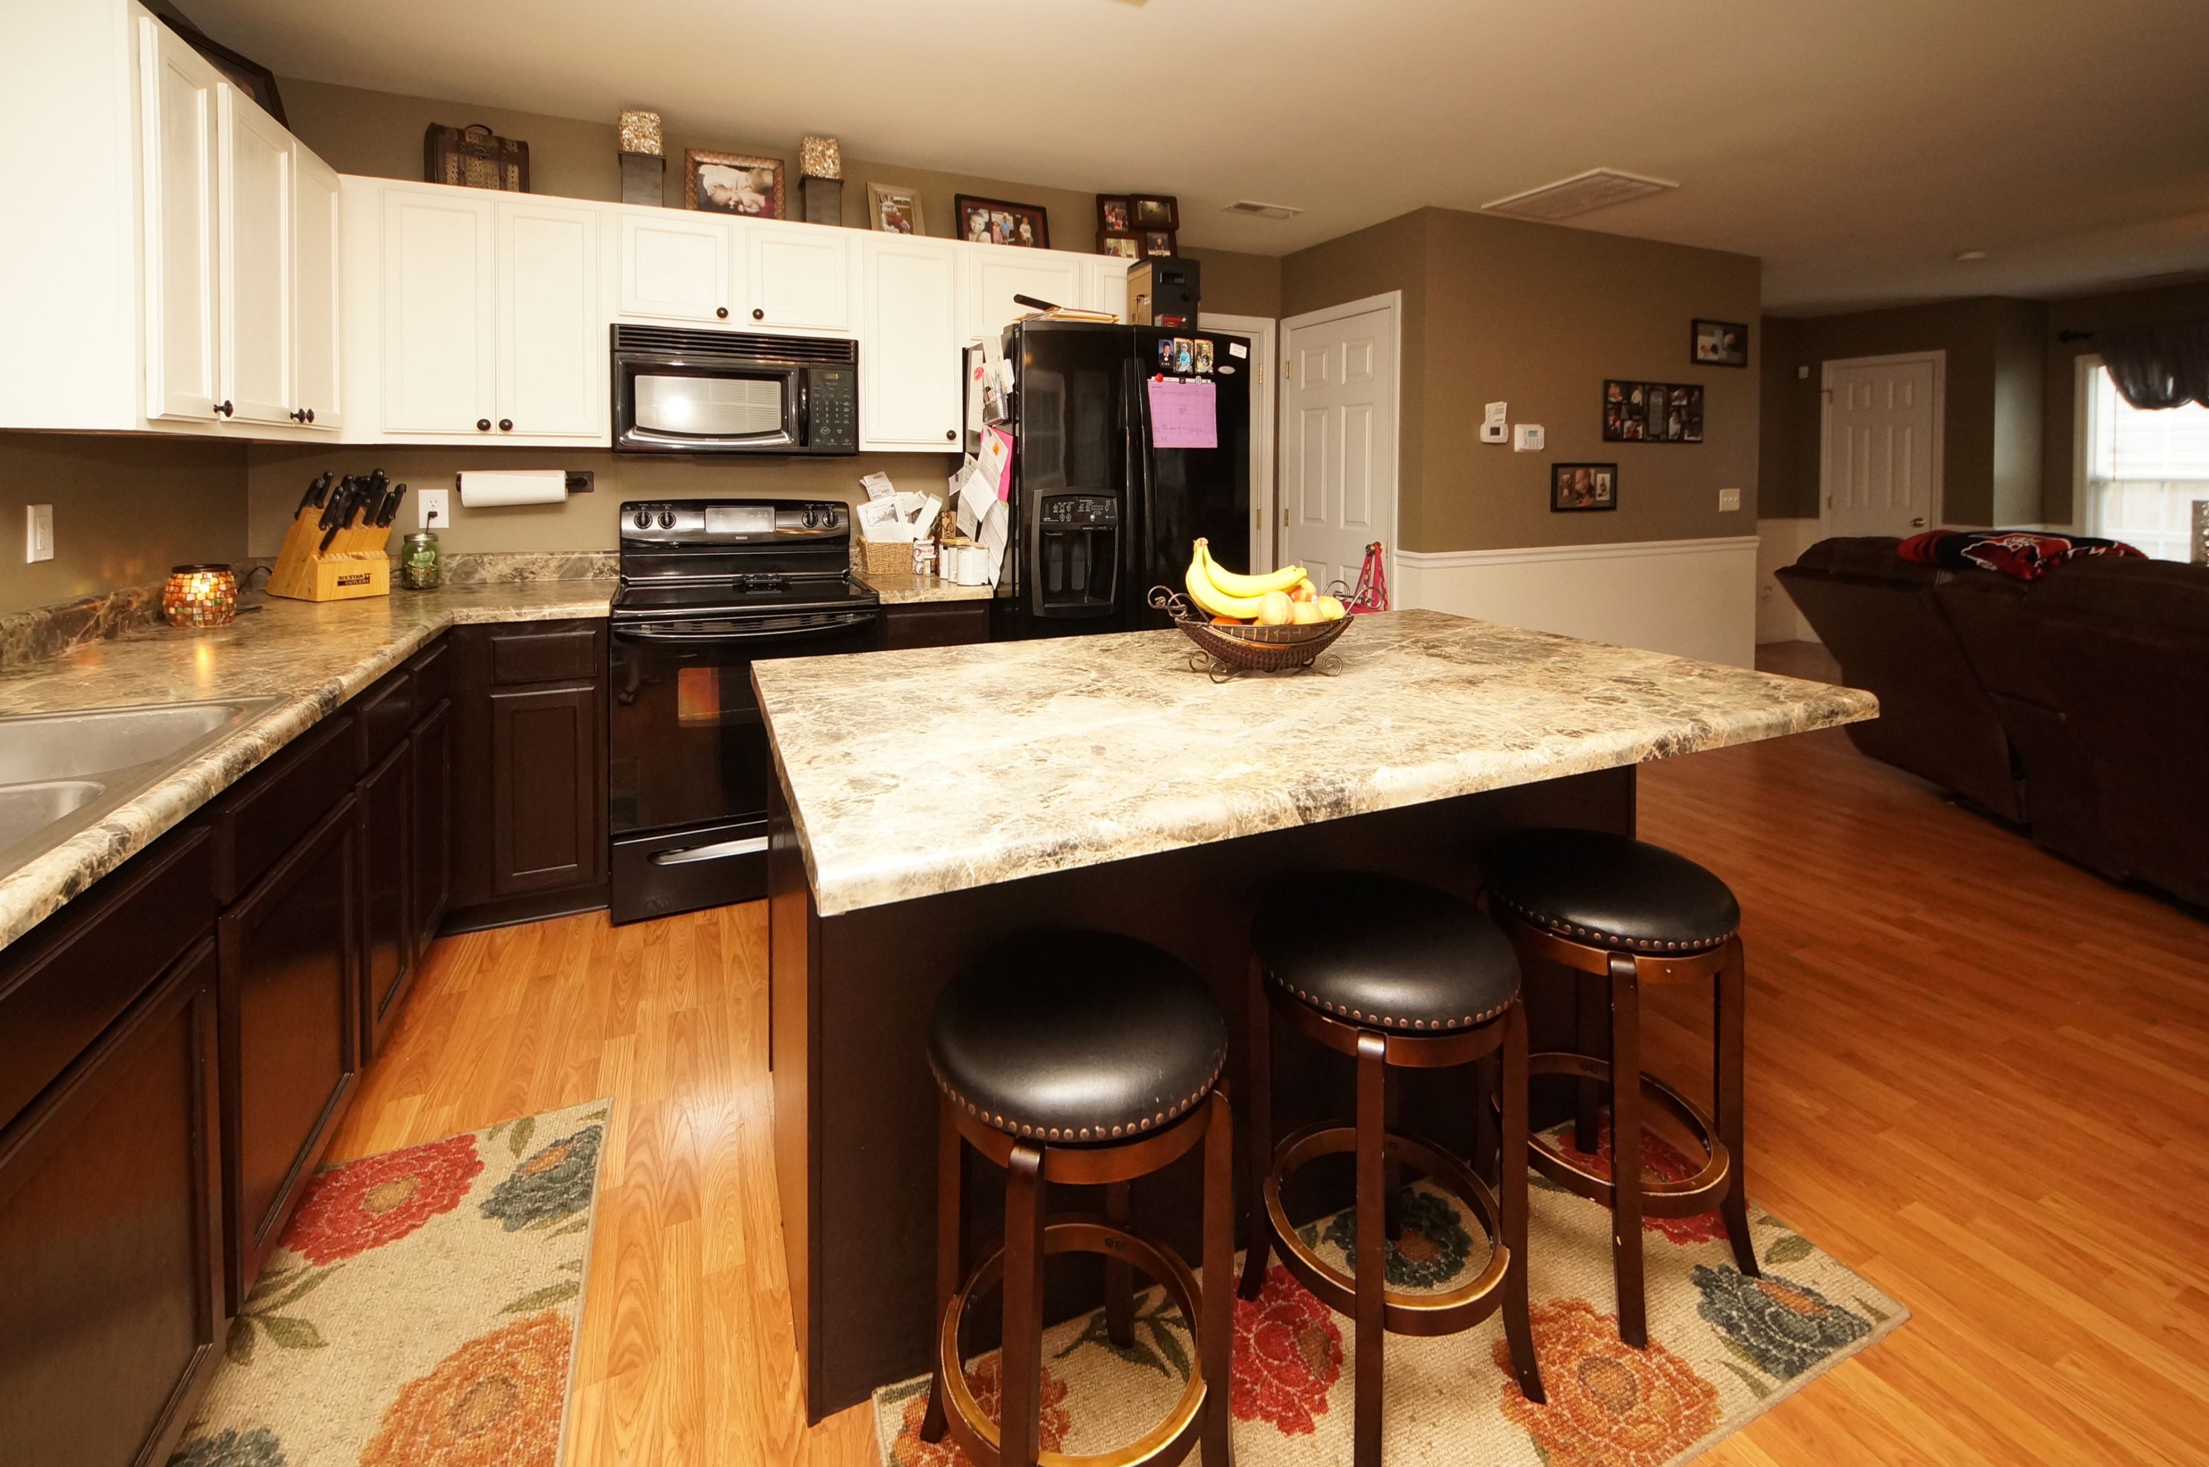
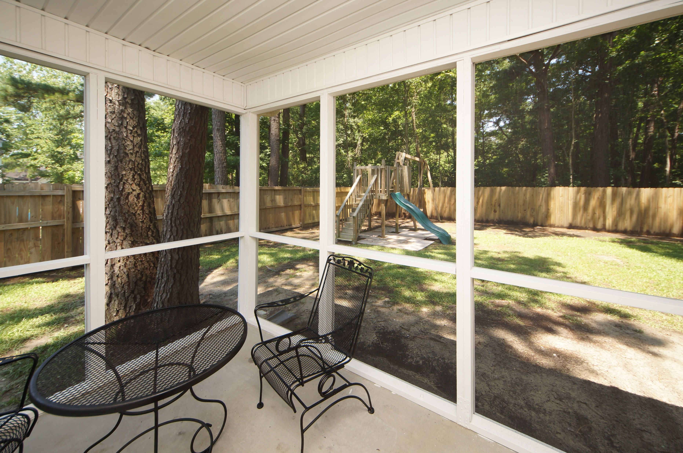


8966 Buck Run Court Buck Run at Deer Park :: North Charleston MLS# 18016683 :: $225,000 3 Bed / 2½ Bath
Just Reduced $785,000!
Quiet Cul-de-sac Home Near Everything
This charming 3 bedroom 2.5 bath home has everything you are looking for! Smooth ceiling, gas fire place, open living room, open kitchen with professional paint and design! Our genius seller built the kitchen island and it is moveable! What better way to entertain your guest with an island you can move!! Bedrooms are located upstairs and painted equally as charming as the decor down stairs.
Master bedroom is over sized and comfortably fits a California King and the master bath boasts a jetted tub and separate shower. Screened porch, privacy fence and cul-de-sac finish off the check list for everything you want in your new home! Buck Run is in a super location close to I-26, Trident Hospital, CSU, Wannamaker Park and Boeing.
Connie White, Broker
843-532-3356
conniesyouragent@gmail.com
Charleston Homes · 597 Old Mt. Holly Road · Suite 301 · Goose Creek, SC 29445

