Slide 1
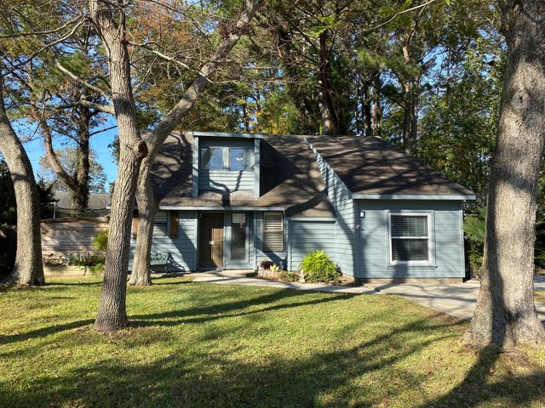
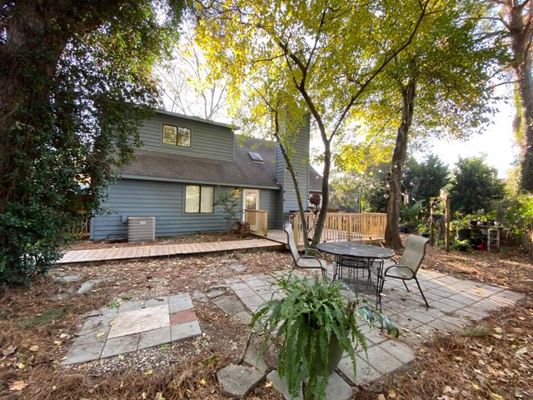
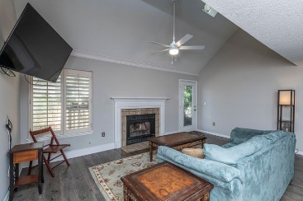
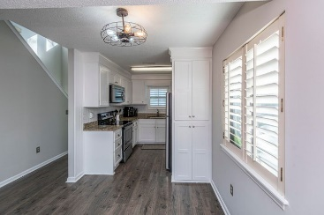
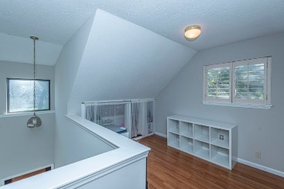
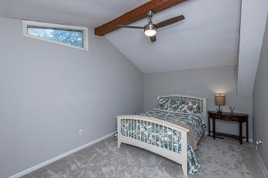
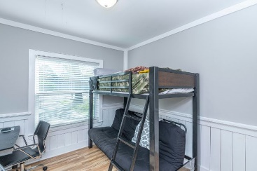
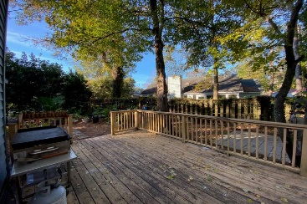
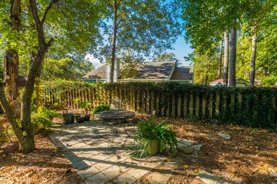
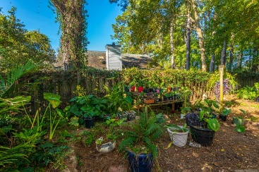



Open House Sunday, Dec 20th 1pm-3pm
896 Harrington Court
Candlewood | MLS# 20032679 | $400,000
This updated and on-trend 4 bedroom, 1.5 story home can be found in the desirable community of Candlewood. NO HOA! This home is nestled on a cul-de-sac with a large, fully-fenced yard perfect for corralling playful pets & kiddos! In fact, this yard is a combination of Secret Garden meets Pets Paradise! There is plenty of spillover space for your outdoor parties on the huge deck and patio. Two additional storage sheds complete this low maintenance yard. The private & spacious Owners' Retreat is located on the second floor with an additional loft office The first floor boasts 3 bedrooms, kitchen, great room w/fireplace & laundry/storage room. The updated kitchen includes custom-built shaker cabinets, Stainless Steel appliances & granite countertops. The Exterior of the home has been updated with a new coat of paint. The Interior has been freshly painted (agreeable gray w/crisp white trim) throughout the entire house including closets, kitchen cabinets, and wainscoting!
Caitlin Waddington
843-789-9820
caitlin.waddington@carolinaone.com
2713 Highway 17 North, Mt. Pleasant, SC 29466

