Slide 1
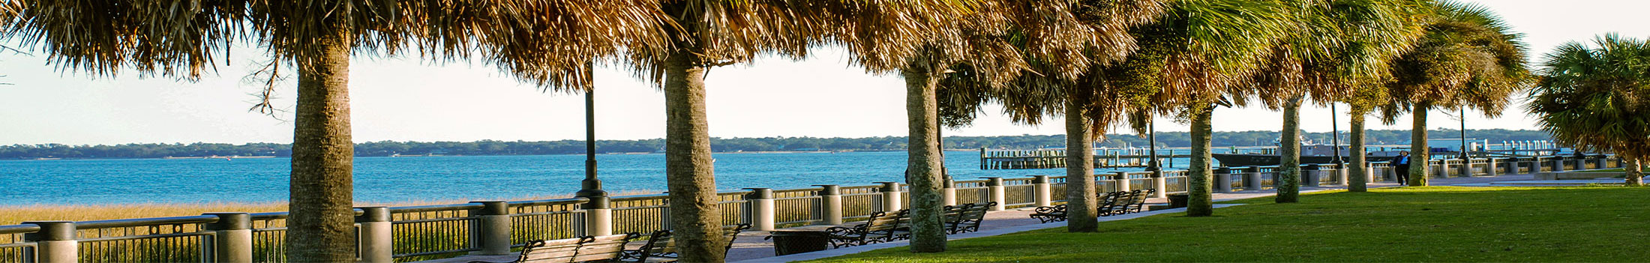



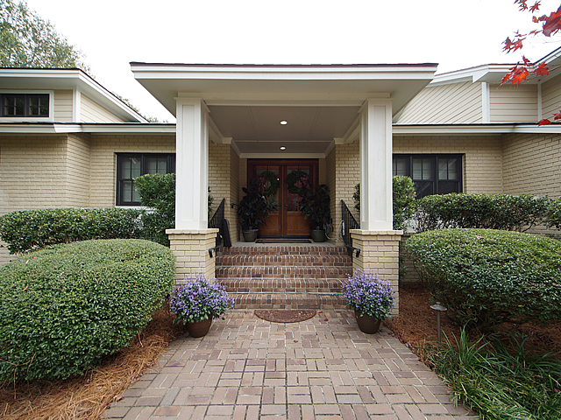
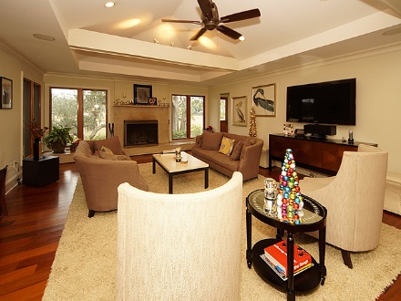
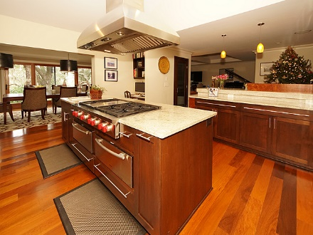
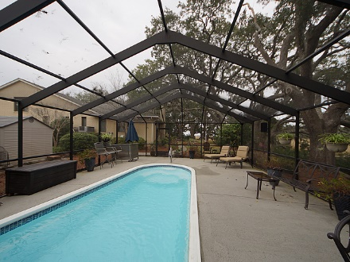
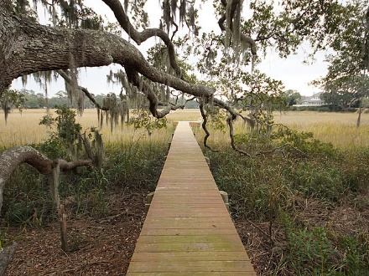
Stiles Point Plantation Open House
Thursday 2/22 ~ 11-1 ~ Lite Lunch Served
Lennie Woods
843-864-6760 lenniewoods@gmail.com
897 Kushiwah Creek Court
Charleston, SC 29412
MLS# 17032202 ~ $1,799,000
1771 Sq Ft
Open Floorplan
Totally New Kitchen
Huge Screened Porch
Updated Bathrooms
Solid Hardwood Floors
X Flood Zone
Walk To Stiles Point Elementary
An amazing view of Charleston's harbor! Complete renovation in '08 to include Custom cabinets, Wolf 6 burner gas cooktop, griddle and industrial hood, 2 Miele warming drawers, dishwasher and coffee system that offers latte, espresso, cappuccino and more. There is a separate entertaining bar with sub zero/2 zone wine fridge, ice maker and copper sink. Custom windows and doors and Brazilian walnut floors throughout living areas. The baths and laundry are natural stone. All house sound system with speakers in most rooms including outside are synced with TV's throughout the home. Views are of moss draped oaks, the harbor and the Ravenel bridge all seen from the private dock. The room over the garage has a private bath and wood floors. Two tankless water heaters, Koi pond, Heated salt water pool is fueled by natural gas.

