Slide 1
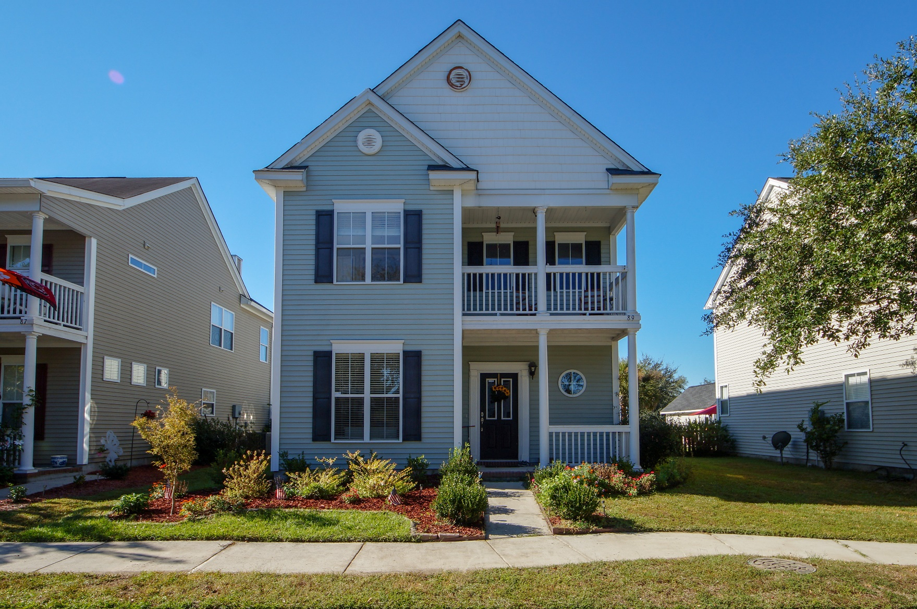
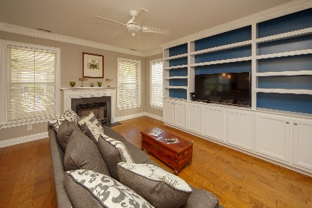
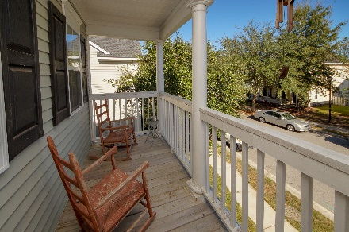
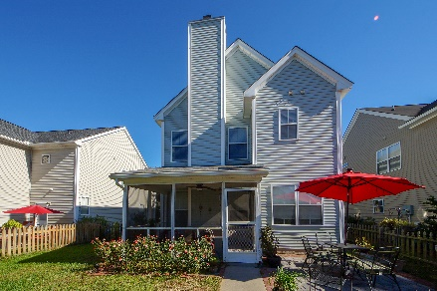


89 Cross Timbers Drive
Summerville, SC 29485
MLS# 18029539 :: $258,000
3 Bed / 2½ Bath
Bridges of Summerville
Move In Ready
Just Reduced!
Elegant Upgrades, Move In Ready! Own a Charleston Single with engineered wood floors throughout the house to include the stair case, new tile floor in kitchen and baths, new paint, new crown molding, fire place, custom built shelves, new hot water heater, new hardware on doors and upgraded light fixtures. Seller has made this home warm and inviting for the new buyer. Screened porch is 12x14, detached 2 garage and professional landscaping and Double Front Porch add to the charm!
Connie White, Broker
843-532-3356
connie@chrepros.com · conniewhiterealestate.com
Charleston Homes · 597 Old Mt. Holly Road · Suite 301 · Goose Creek, SC 29445

