Slide 1
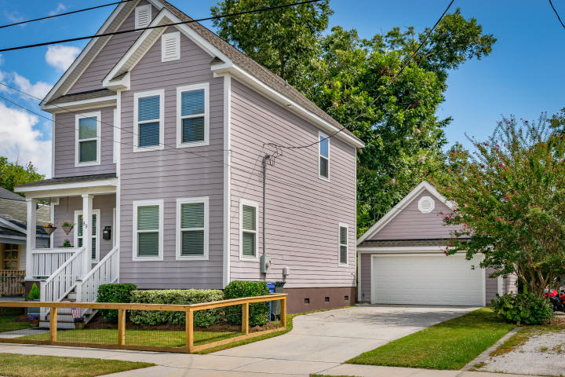
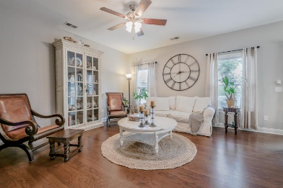
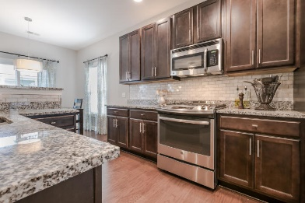
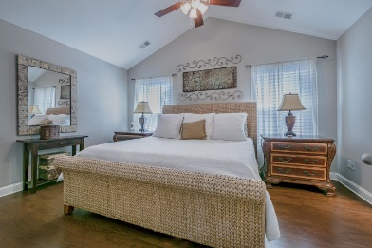
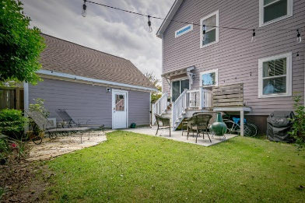


89 Simons Street North Central Charleston, SC 29403 MLS# 18025747 $564,500
Open House
Saturday, Oct 6th from 1-4pm
Better Than New!
Serving deliciousness from The Harbinger which is right down the street. Walk to The Park Cafe, Rutledge Cab, Container Bar Chs, Moe’s Crosstown Tavern, Monarch Wine Merchants and more!
Special guest appearance: Bubba. #walkability #newprice
Two of the many reasons to own a home Downtown: Walkability & Rentability! Still under builder warranty - Yes, with a 2 Car Garage (aka additional dwelling unit) and an oversized Driveway! Garage can be finished into a Studio, ADU, potential rental income etc. Features include Hardwood & Tile Floors throughout, Gas range, Energy Efficient Tankless water heater, Fenced front and backyard, Vaulted ceiling in MBR, Oversized Master Shower w/Frameless glass door, an actual Laundry 'room' upstairs convenient to bedrooms. Walk to Hampton Park, Harbinger Cafe, Monarch Wine, Moe's Crosstown, Rutledge Cab, Rodney Scott's, Redux Art gallery, Library, Grocery, Pharmacy & Worship. Walkability is key! Seller is Licensed Realtor
Donna Andreano
843-256-3348
donnaa@agentownedrealty.com
www.yourhomeincharleston.com
AgentOwned Preferred Group | 824 Johnnie Dodds Blvd | Mt Pleasant, SC 29464

