Slide 1
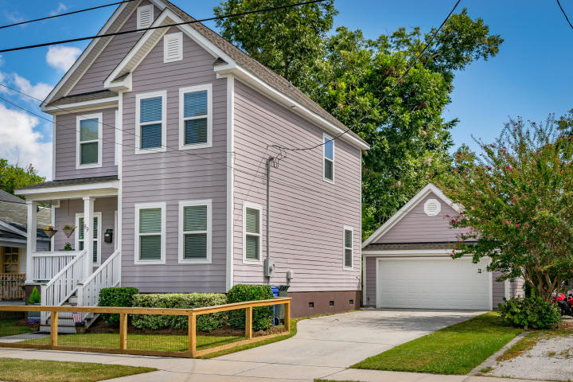
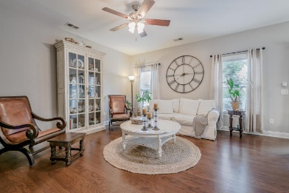
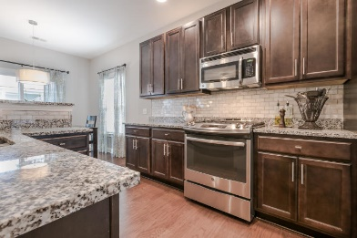
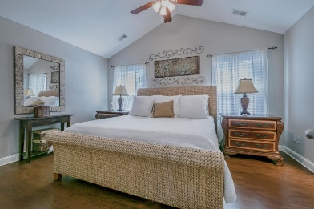
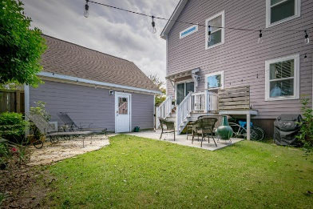


89 Simons Street
Downtown Charleston
MLS# 18025747
$564,500
3 Bed · 2½ Bath · 1,468 sf
2-Car Garage
Open House
Saturday, Oct 6th from 1-4pm
Better Than New!
Two of the many reasons to own a home Downtown: Walkability & Rentability! Walk to Hampton Park, Harbinger Cafe, Monarch Wine, Moe's Crosstown, Rutledge Cab, Rodney Scott's, Redux Art gallery, Library, Grocery, Pharmacy & Worship.
Walkability is key!
Still under builder warranty - Yes, with a 2 Car Garage (aka additional dwelling unit) and an oversized Driveway! Garage can be finished into a Studio, ADU, potential rental income etc. Features include Hardwood & Tile Floors throughout, Gas range, Energy Efficient Tankless water heater, Fenced front and backyard, Vaulted ceiling in MBR, Oversized Master Shower w/Frameless glass door, an actual Laundry 'room' upstairs convenient to bedrooms. Seller is Licensed Realtor
Donna Andreano
843-256-3348
donnaa@agentownedrealty.com
www.yourhomeincharleston.com
AgentOwned Preferred Group | 824 Johnnie Dodds Blvd | Mt Pleasant, SC 29464

