Slide 1
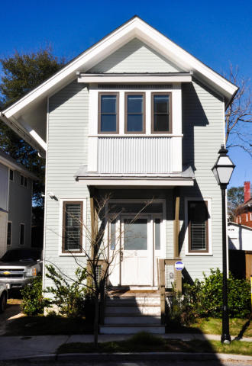
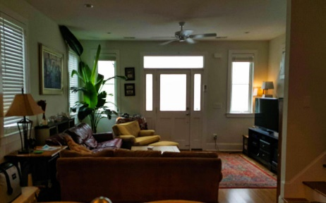
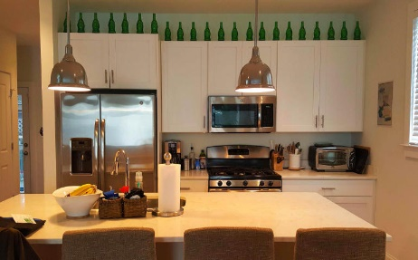
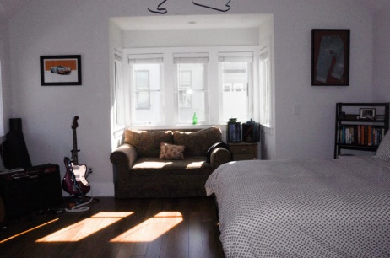
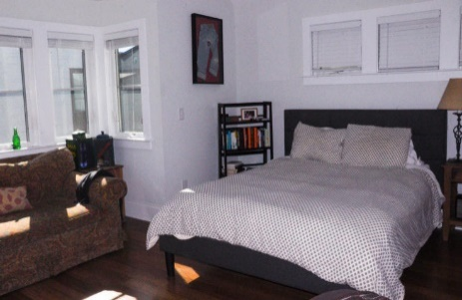
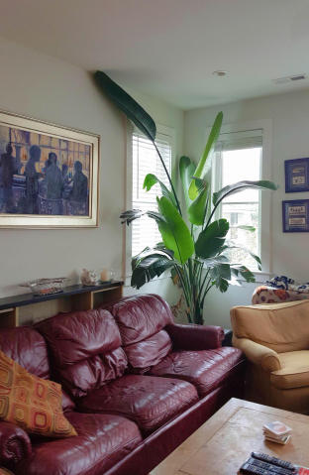
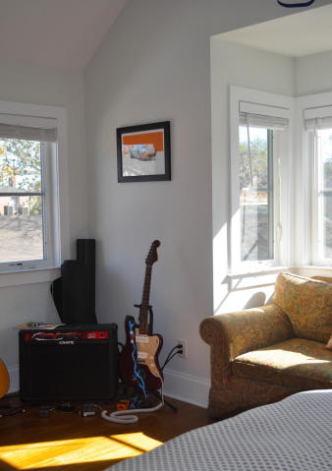
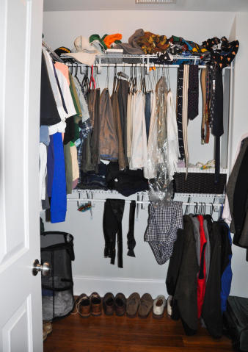
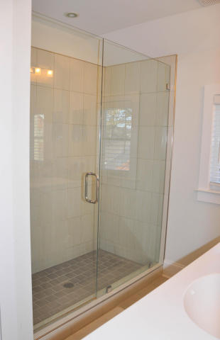

~ Downtown Hidden Gem ~
Now With A Great New Price!
$5,000 Buyer's Agent Bonus at Closing!
8 Fields Place
North Central
Charleston, SC 29403
MLS# 16001649
Now offered for $489,900
Single family home in desirable downtown Charleston!
3 bedrooms and 3 full baths with 1 bedroom downstairs.
Beautiful kitchen with Quartz Cambria counters, 5 burner gas range, large pantry, stainless steel appliances and a central island with extended countertop for seating.
Downstairs is great for entertaining with the open plan and deck
that wraps around the back.
The master bath features double vanity with tiled walk-in shower with frameless door.
This little neighborhood is a hidden gem!
Jennifer Daly
(843) 817-6860
lowcountrynests@gmail.com
Amee Baker
(843) 343-1778
ameebaker@comcast.net
AgentOwned Preferred Group | 824 Johnnie Dodds Blvd | Mt Pleasant, SC 29464

