Slide 1
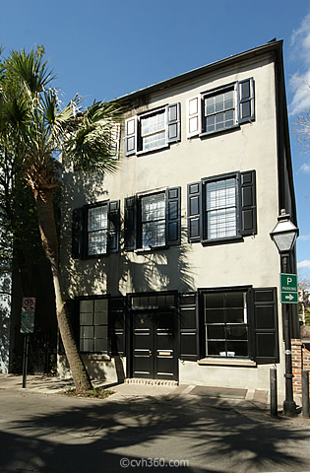
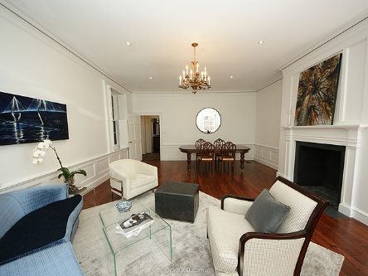
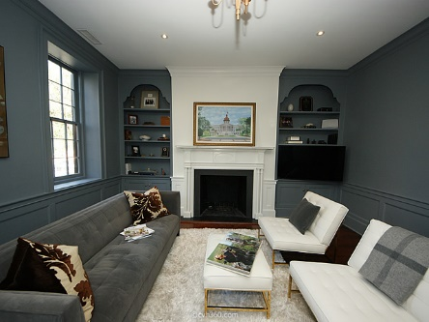
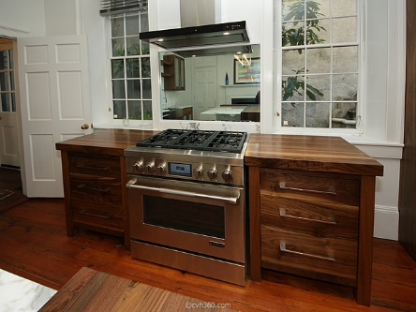
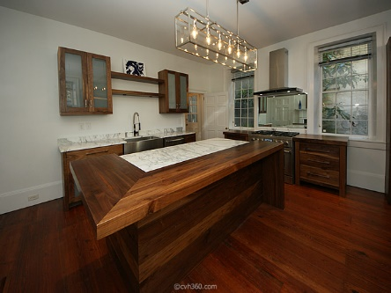
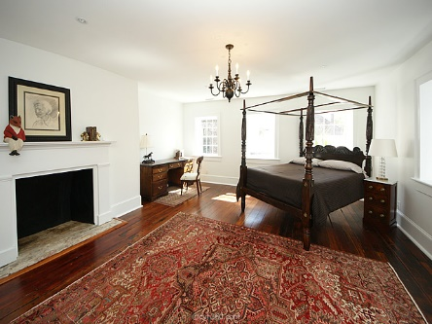
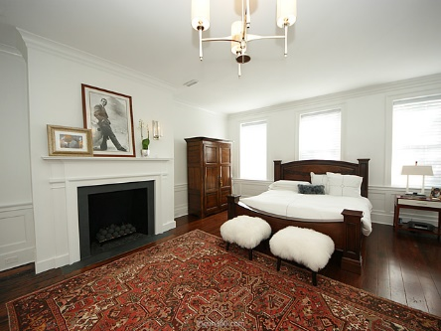


French Quarter Open House
Thursday, March 10th 11:30a-1:00p
8 Queen Street
MLS# 16004962
$2,200,000
3 Bedrooms | 2½ Baths
3,2.76 Square Feet
Completely restored in 2015
In the Heart of Downtown
Angela Black Drake
Broker Associate
(843) 991-0337
Limehouse Properties
8 Cumberland Street
Charleston, SC 29401

