Slide 1
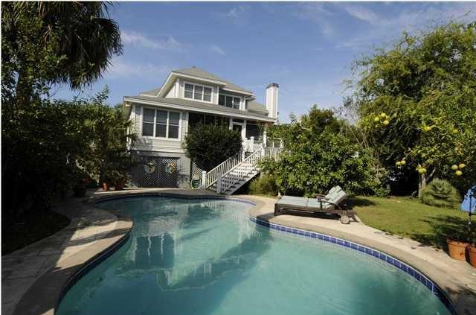
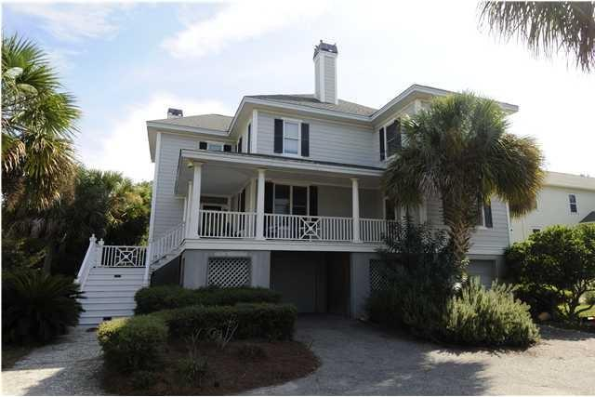
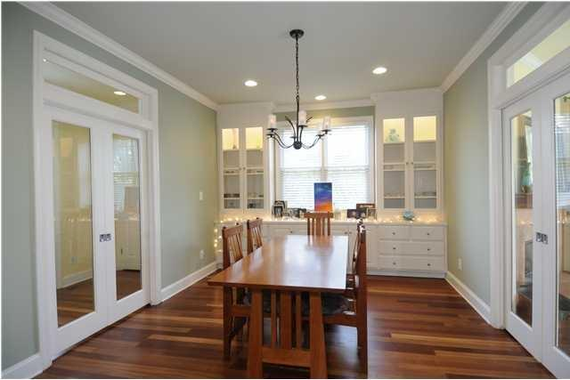
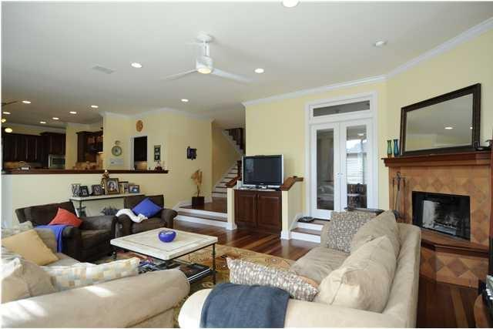
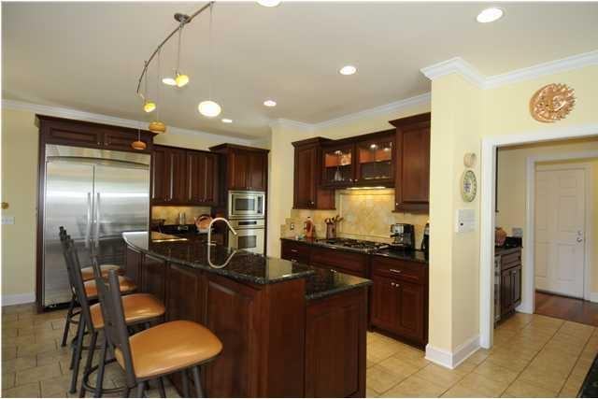
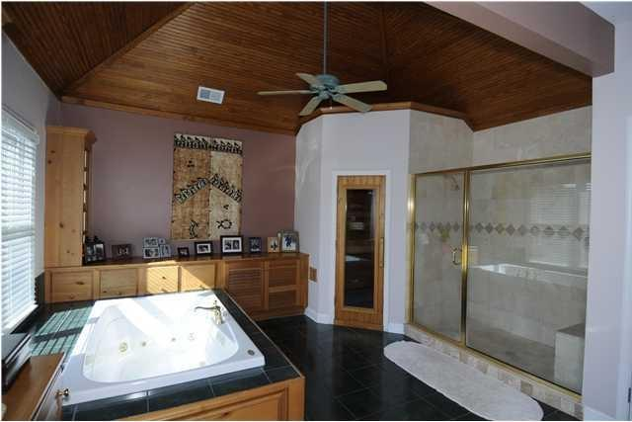
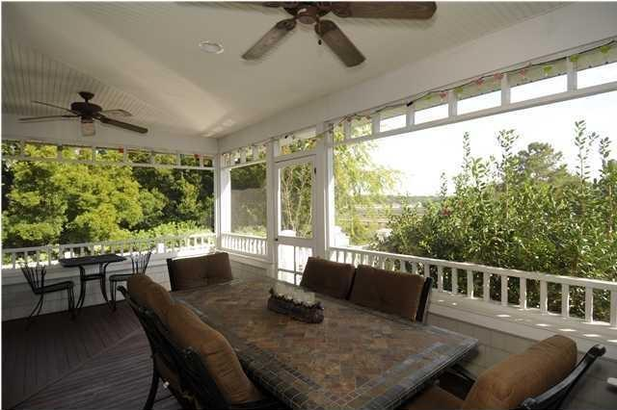
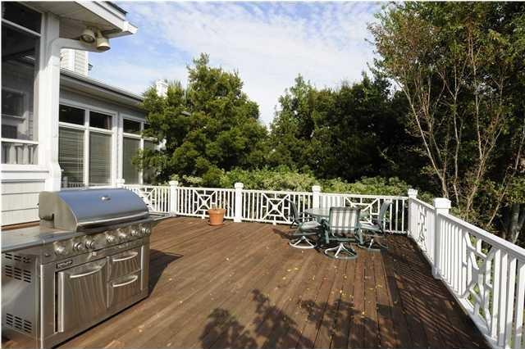
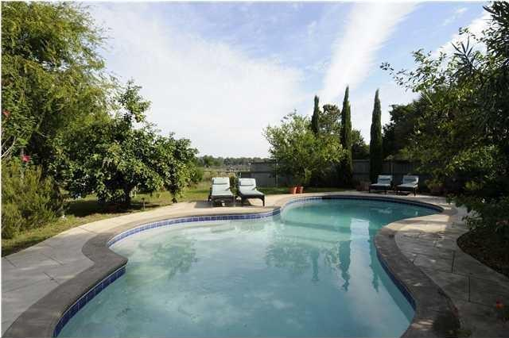

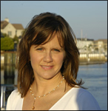
Price Reduced in Wild Dunes!
8 Seahorse Court, Isle of Palms, SC 29451 MLS# 15001433 | $1,325,000
One of the best buys on the island for a home of this size!
Enjoy island life with a view of the Intracoastal Waterway and only a short distance to the IOP Recreation Dept and the beach. Renovated in 2005, home features Brazilian cherry floors and tile throughout (no carpet) and architectural details that fill the home with light. Six bedrooms, one currently used as an office that has a separate entrance. Installation of elevator possible (shaft currently has closets). Saltwater pool, Finnleo sauna, Jacuzzi tub, irrigation system and outdoor lighting... Call for an appointment! Wild Dunes club membership available, no HOA fees.
Linda Gordon
843-324-3476 linda.gordon@agentownedrealty.com
www.agentownedrealty.com
AgentOwned Charleston Group
824 Johnnie Dodds Blvd
Mt Pleasant, SC 29464

