Slide 1
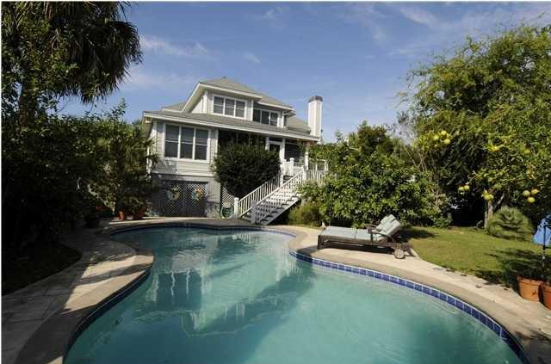
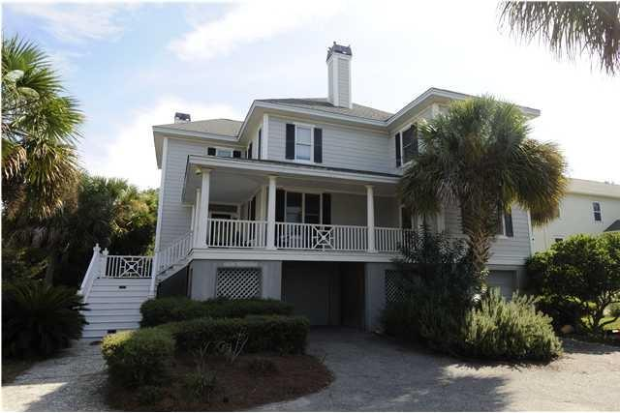
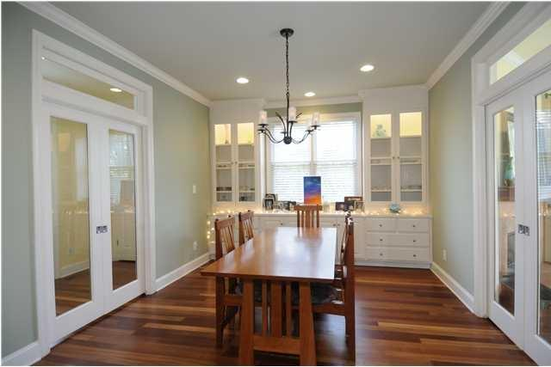
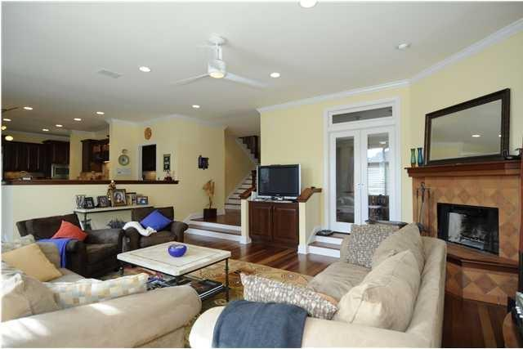
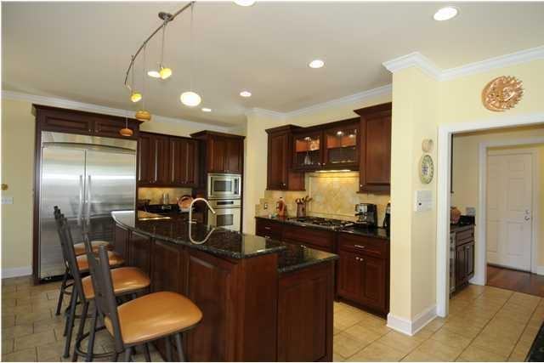
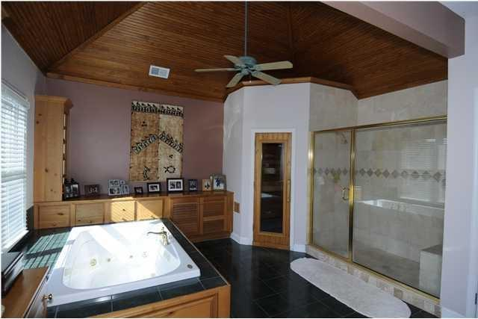
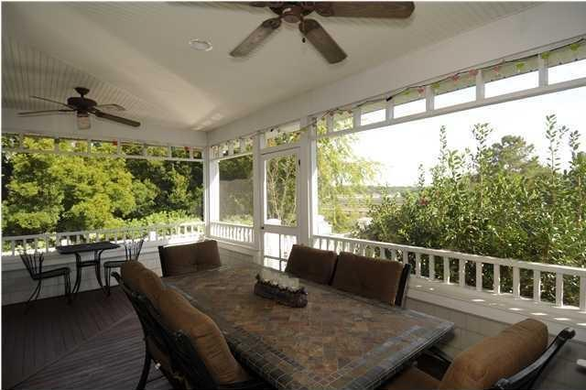
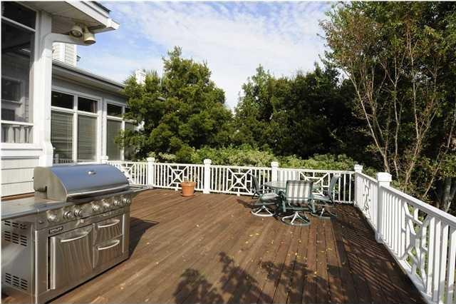
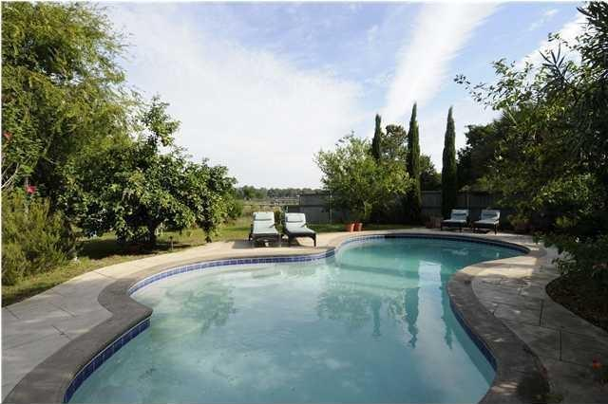

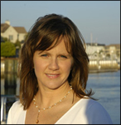
Price Reduced on Isle of Palms!
8 Seahorse Court, Isle of Palms, SC 29451 MLS# 15001433 | $1,292,500
One of the best buys on the island for a home of this size!
Spacious, light filled and inviting home with a view of the Intracoastal Waterway and only a short distance to the IOP Recreation Dept and the beach. Renovated in 2005, home features Brazilian cherry floors and tile throughout (no carpet). Two bedrooms downstairs, one with it's own entrance, and full bath with walk-in shower make a fabulous guest wing or in-law suite. Installation of elevator possible (shaft currently has closets). Master bedroom upstairs with sitting area, walk in closet, huge master bath with Jacuzzi tub and Finnleo dry sauna, dual shower. Three additional bedrooms upstairs. Saltwater pool, irrigation system, outdoor lighting, large screened porch and decks, intercom system. Call for an appointment! Wild Dunes club membership available, no HOA fees
Linda Gordon
843-324-3476 linda.gordon@agentownedrealty.com
www.agentownedrealty.com
AgentOwned Charleston Group
824 Johnnie Dodds Blvd
Mt Pleasant, SC 29464

