Slide 1
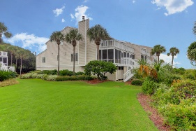
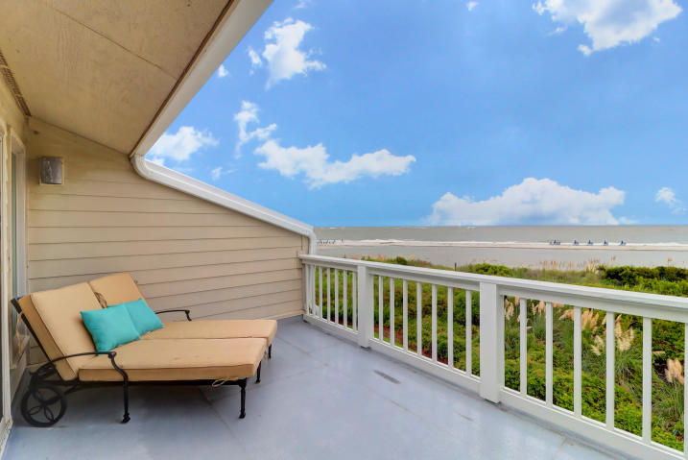
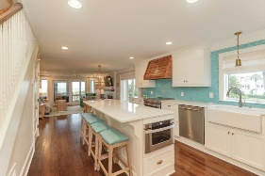
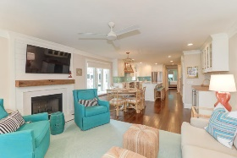
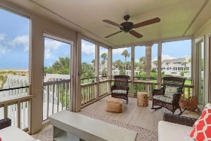
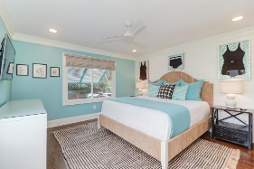
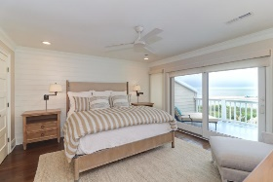
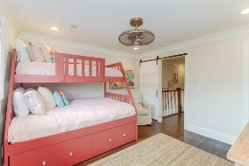
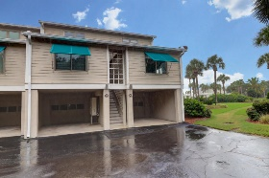
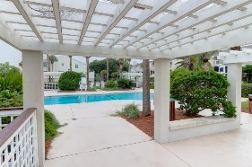
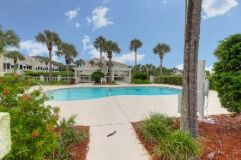


8 Beach Club Villas
Wild Dunes | Isle of Palms, SC 29451
MLS# 20025836 | $1,525,000
Just Listed
Oceanfront and Designer Renovation
Highly sought after oceanfront end unit Beach Club Villa with incredible views of the Atlantic Ocean! Located in the exclusive Wild Dunes Resort on the Isle of Palms, only minutes from downtown Charleston. With lots of natural light and very open, this property has been totally renovated with designer features, exquisite touches that exceed expectations. Enjoy your spacious upstairs master bedroom complete with an elegant bath. The downstairs master bedroom has a built-in Murphy bed in the closet. Stunning hardwood floors, coastal doors and accent shiplap throughout the property. Lots of great storage for your bikes and beach accessories. Living your best life and only steps away from the beach, complete with your hot / cold outdoor shower for your convenience. Enjoy quiet moments and ocean breezes on your screened porch, and star-gazing from your upper deck.
Darlene Smith
Office - (843) 886-8110
Mobile - (843) 696-7824
darlenesmith@carolinaone.com
DarleneSmithTeam.com
Carolina One Real Estate
1503 Palm Blvd Ste
Isle of Palms, SC 29451

