Slide 1
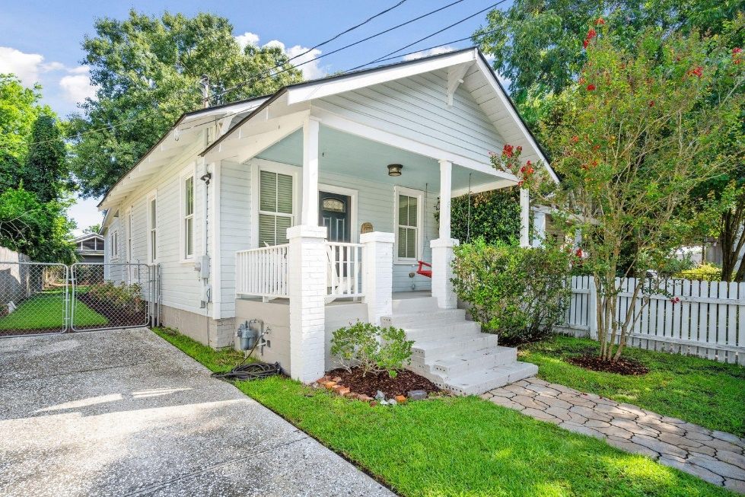
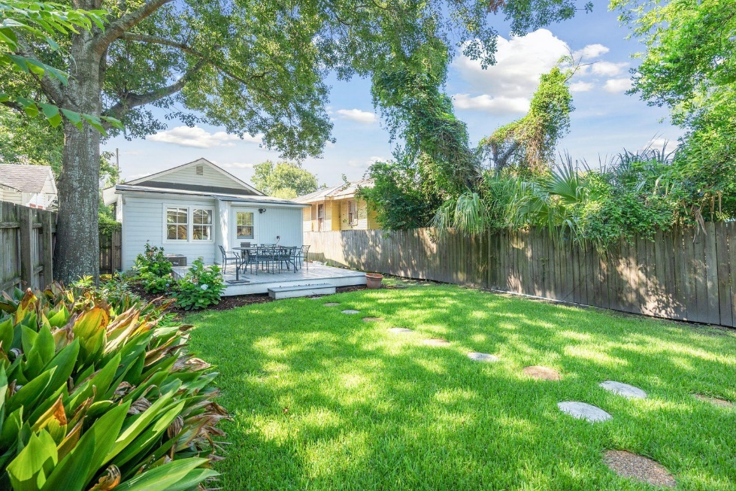








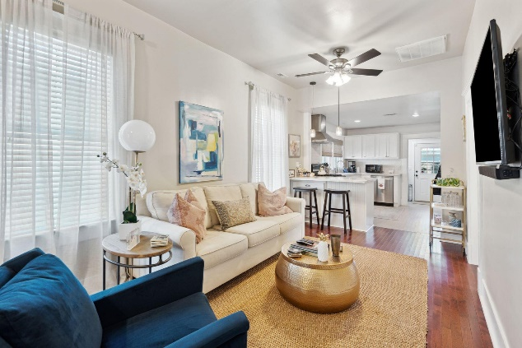
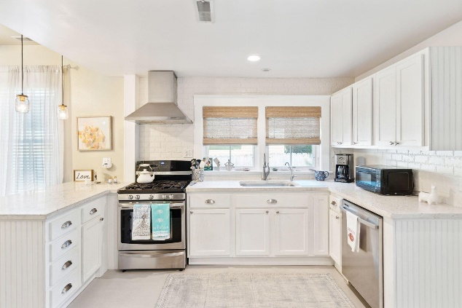
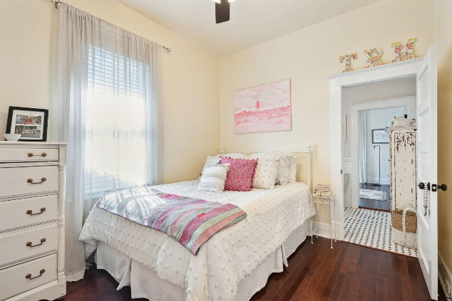
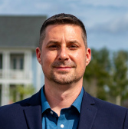
#23018703
8 Poplar Street
North Central
Charleston, SC 29403
Charming Gem
Open House
Sat 10-12 & Sun 10-12
2 BED
1 BATH
888 SF
$695,000
Beautifully renovated hidden gem in the popular North Central neighborhood just off of upper King Street. A short walk to local restaurants and convenient to Hampton Park, downtown, MUSC, West Ashley and Mt. Pleasant.
Hardwood floors in the living room and bedrooms. Updated kitchen with stainless appliances and plenty of counter space complete with a large pantry and built in banquette with more storage possibilities. Wonderfully tiled bathroom with a claw foot tub adds to the charm.
The large fenced backyard gives the option to create an outdoor living space or add on to the existing structure.
Enjoy a virtual walkthrough
Steve Auerbach
917-750-6965 | steve.auerbach@carolinaone.com
Carolina One Real Estate | 1503 Palm Blvd | Isle of Palms, SC 29451-2280
Matt Kimes
843-860-1669 | mattkimeshomes@gmail.com
www.mattkimeshomes.com

