Slide 1
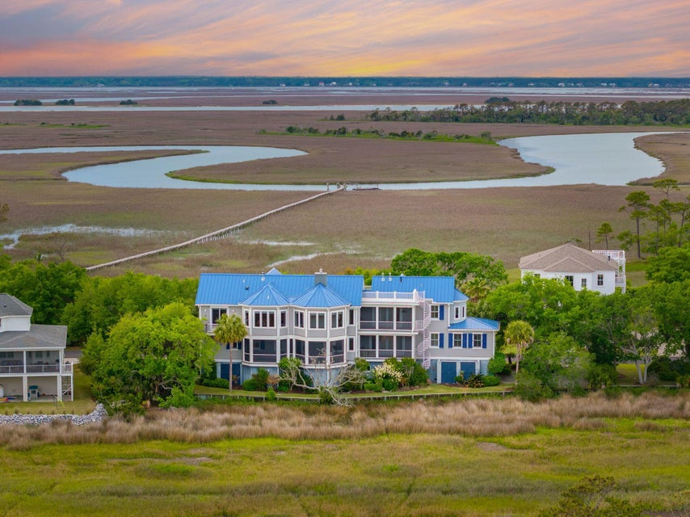
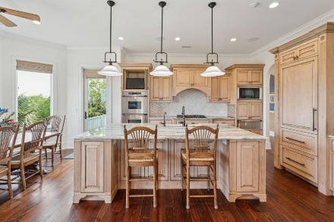
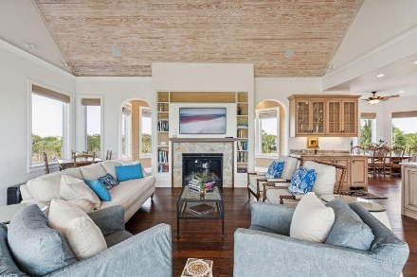
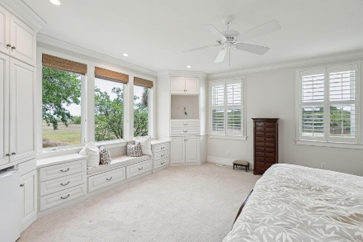
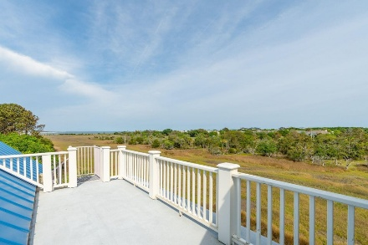


8 Seagrass Lane
Isle of Palms, SC 29451 | MLS# 24031177 | $3,999,000
Wild Dunes Swim & Social
Membership w/ Acceptable Offer
New Price
REDUCED $250,000

