Slide 1
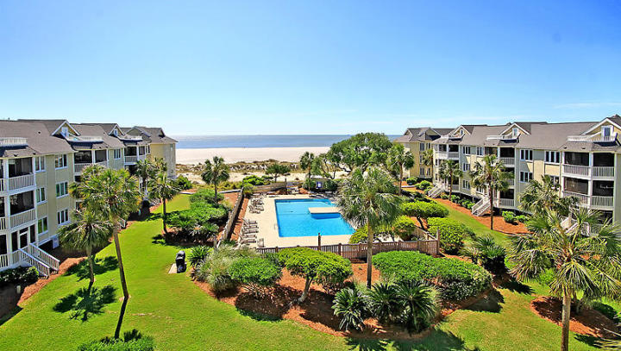
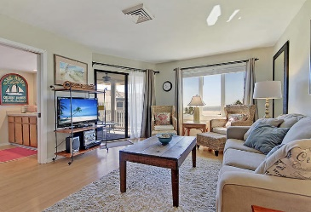
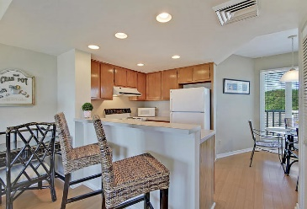
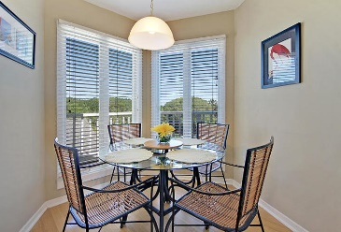
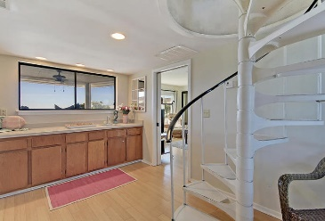
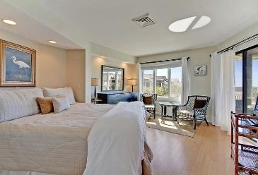
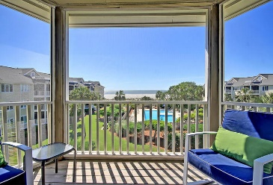
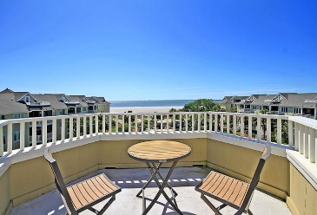
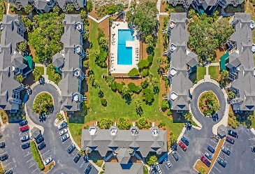
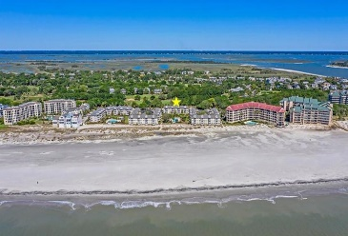
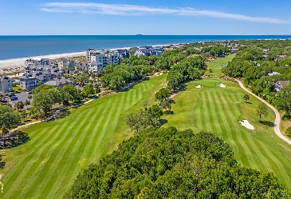



Direct Ocean & Pool Views
9000 Palmetto Drive 303-D Wild Dunes | Isle of Palms, SC 29451 | MLS# 20011605 | $475,000
Welcome to 303-D Port O'Call. This top floor unit offers unobstructed views of the ocean and community pool from every room. The layout is spacious and very functional. The family room can be closed off to offer a separate sleeping space. Enjoy the breeze and amazing views while sitting on your fully screened porch. Or, head up the spiral staircase to your private rooftop sundeck for dining al fresco! Beautiful bamboo floors throughout the main level and an updated bathroom with tile floors. Conveniently situated adjacent to the fitness facility, only steps from the elevator and closer to the parking area than other units...you can't beat its location! This condo looks and feels much larger in person. Being sold fully furnished.
Check out the full 3D tour: https://my.matterport.com/show/?m=uqVAY87QpMK
Whitley Boyd
(843) 324-4761
WBoyd@CarolinaOne.com
www.PropertiesofCHS.com
Carolina One Real Estate | 628 Long Point Rd. | Mt Pleasant, SC 29464-3032

