Slide 1
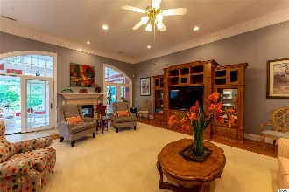
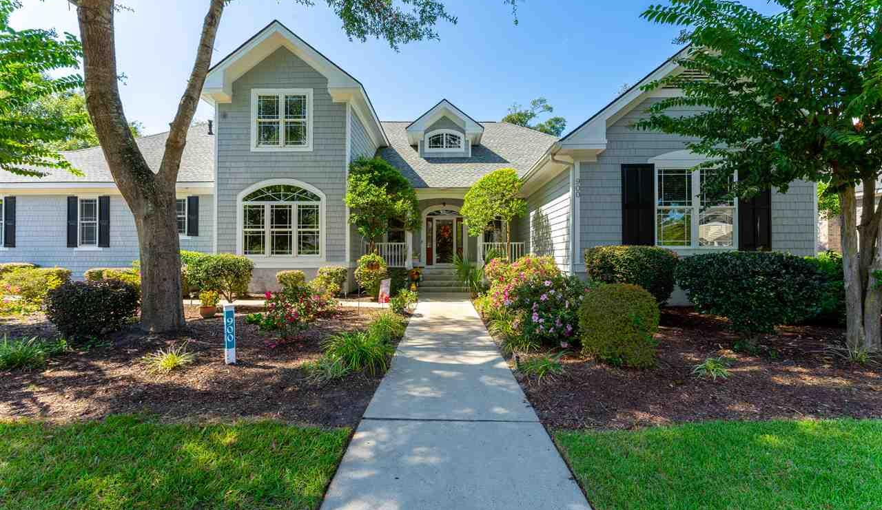
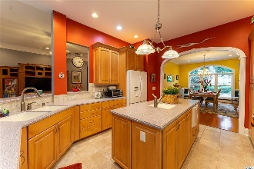
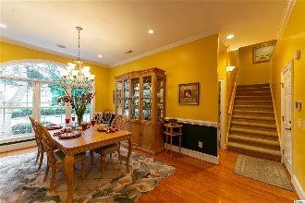
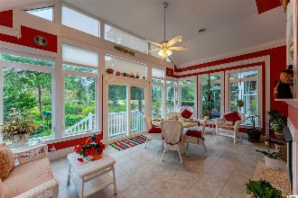
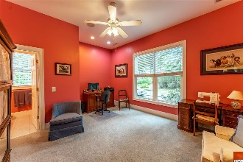
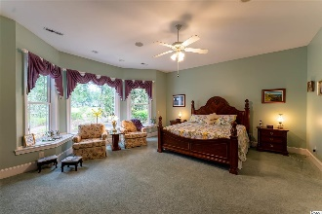
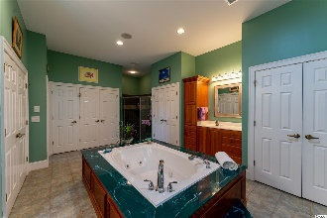
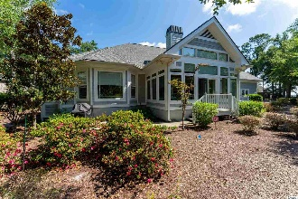
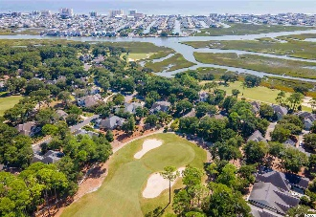


This rare, custom-built beauty has it ALL!
900 Heshbon Dr
Tidewater Plantation ~ North Myrtle Beach ~ MLS# 2020697
How many homes anywhere have a side-load, 3-car garage with planned storage and custom features, including workbench area, on a large corner lot! The driveway is likewise large and can park up to six cars off-street. This rare, custom-built beauty has it ALL, plus more: Its 1/3-acre lot has a singular, full tee-to-green view of the signature second hole of world-class Tidewater Golf Course, and the oversized master bedroom also looks out onto the green from its expansive wall of windows. Prepare for perfection inside, too! The lovely entry is a true Southern front porch, wide and welcoming. Enter into a spacious foyer providing a panorama of the open, flex floorplan of the heart of the house. The great/living area is straight ahead, has high ceilings, an inviting fireplace and is so spacious, much room for entertaining and family gatherings. To the right is the master and second-master bedrooms, left to the formal dining, kitchen and a whole other wing. The master bedroom, with window seats with hidden storage, and bath are enormous, featuring a sitting area, spa tub, walk-in and roll-in shower and lots and lots and lots of closets, a wonderful use of true en-suite space. Entrances and doors throughout are wide and preserve the stateliness of the home and offer ease of access. The second master with full en suite is in the front of the home and also functions as an office. Dining space is roomy, glorious, formal and elegant; the kitchen is well-planned with work areas, more cabinets, island, breakfast bar and nook, plus extras, such as 2 sinks and 2 dishwashers...and pleasing Corian countertops. Off of the kitchen and living room is the fabulous, comfortable Carolina Room, with see-through fireplace, tall windows offering much natural outdoor light and a nice private backyard nature enclave. The entire yard is, in fact, magnificently landscaped. There is a separate half bath and utility room on the main level, along with a sink and stand-up shower, well planned to wash a puppy or a sandy grand child returning from the beach. The first floor is wired for surround sound. The garage ingress is to the kitchen and utility room, the preferred entry pattern. The upstairs guest quarters are thoughtfully designed, and the u-shaped, floored-storage is everybody's dream. It is on the second level that seems to go on forever, then a short stairway up to two huge bedrooms and the best jack-n-jill baths ever, two sinks, two toilets and a central tub/shower...the rooms themselves have great light from big windows, are cherry, cozy & self-contained. Guests may never want to leave! Real pride of ownership is evident with a new roof in 2020, dual HVAC system with transferable warranty, 2 Rinnai tankless water heaters, upgraded CPI Security System and termite protection with the Lanes' Sentricon Termite Protection System. This home is a best of the Bluffs of Tidewater! Tidewater boasts many other upscale amenities, including owners' beach cabana on the Cherry Grove Beach named the 11th best in the nation, pools & spas, clay- & hard-surface tennis courts, pickle ball, bocce, horseshoes, amenities center, fitness center, driving range and putting green, 24-hour gated & manned security and clubhouse with bar & restaurants. There is even a complimentary gated storage yard for boats, campers, recreational vehicles and the like. The convenient HOA building has rooms for business and other meetings and events and a lending library. Tidewater itself is on a tree-lined road to oceanfront Anne Tilghman Boyce Coastal Reserve, a nature conservancy. It is minutes to the beach, shopping, entertainment, medical services, outstanding schools and parks and access to major highways. It represents a lifestyle, to do as much as you desire or just to relax in the beauty of the pristine surroundings. The jewel in the crown of the development is that private owners' beach cabana on the wide, pristine sand of Cherry Grove Beach in popular, safe North Myrtle Beach.
Deborah Collins
843-424-9013
dctidewater@yahoo.com
Connie Ross-Karl
702-306-2643
conniesross@aol.com
NEW WAY PROPERTIES MYRTLE BEACH

