Slide 1
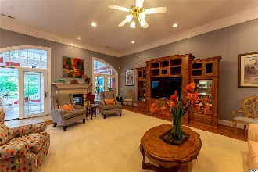
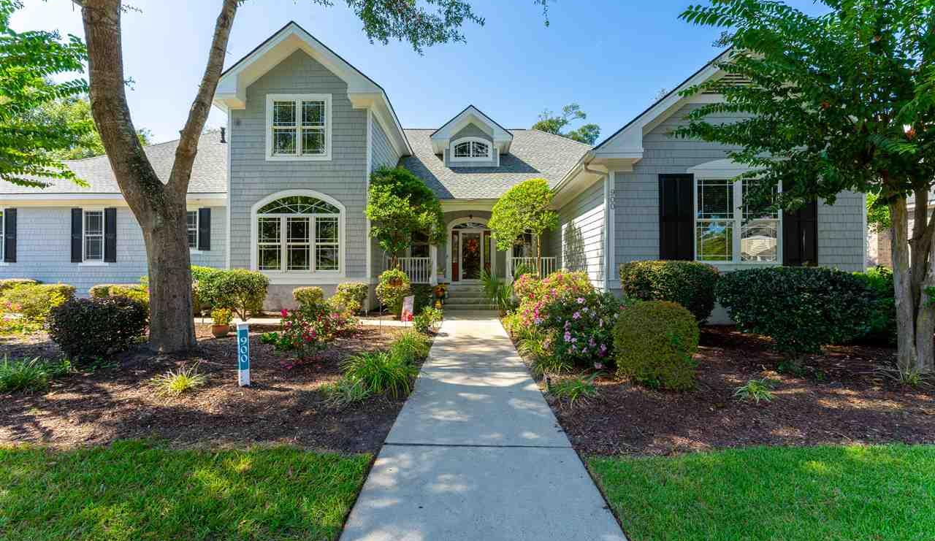
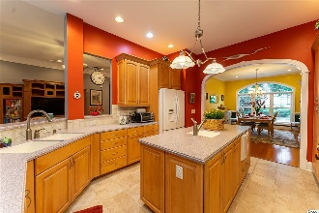
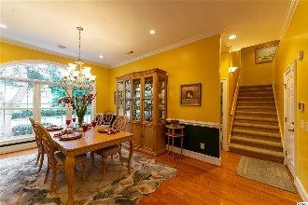
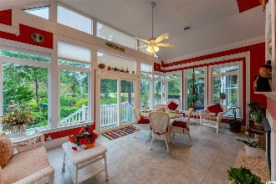
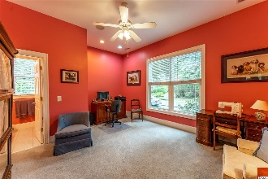
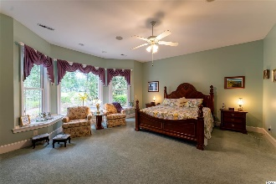
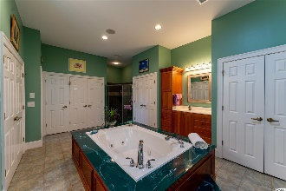
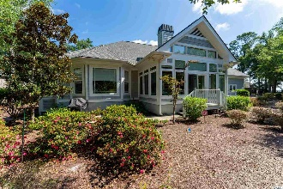
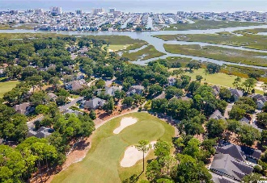


Features & Upgrades
900 Heshbon Dr
Tidewater Plantation ~ North Myrtle Beach ~ MLS# 2020697
3-CAR GARAGE! 3 Full 2 Half baths in unique, highly workable configuration –
Beautiful, Immaculate Home on Large Corner Lot in Upscale Bluffs of Tidewater Plantation
Highlights – roll in shower, wide bathroom doors, full tee to green view of the golf course but not on golf course for flexibility of outdoor uses, thoughtful design, custom-build, tons of storage!
Sun room: See-through fireplace, tile floor, large windows, ceiling fan, Tidewater Golf Course view
Kitchen: Pantry with pull-out shelves, plenty of cabinet (pull out shelves) & drawer storage, island with second sink & second disposal, warming drawer, lots of counter space
Large formal dining room: Distinctive chair rail. Dining Room Set negotiable
Large great/family room: See-through gas fireplace, ceiling fan, large entertainment center stays
First floor wired for surround sound
Large master bedroom: Ceiling fan, bay window, overlooks second green, window seats with storage
Master Bath: On first floor, large Jacuzzi tub, 2 sink areas with cherry wood cabinets, great closet space with built in shelves & drawers, 2 linen closets
Second Master Bedroom: On 1st floor, ceiling fan, full bath
Laundry room: First floor, large, lots of cabinets & sink, shower
Powder room on 1st floor
3 car garage, built in closets for all, plus 1 more closet, water line for second refrigerator-
2 bedrooms upstairs, each has ceiling fan, one with bay window, 2 full baths with 1 shared shower
Shelved storage closet on 2nd floor. Huge floored walk-up and walk-in storage area
SPECIAL NOTE: New roof 2020, transferable warranty
Dual HVAC system, transferable warranty
2 Rinnai tankless water heaters
Upgraded CPI Security system
Termite protection plan with Lanes, Sentricon Termite Protection System
Deborah Collins
843-424-9013
dctidewater@yahoo.com
Connie Ross-Karl
702-306-2643
conniesross@aol.com
NEW WAY PROPERTIES MYRTLE BEACH

