Slide 1
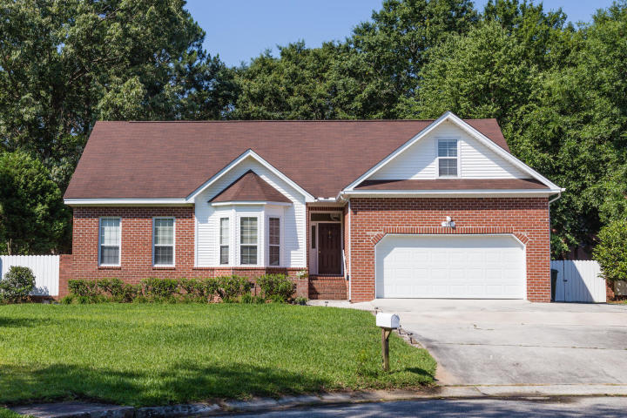
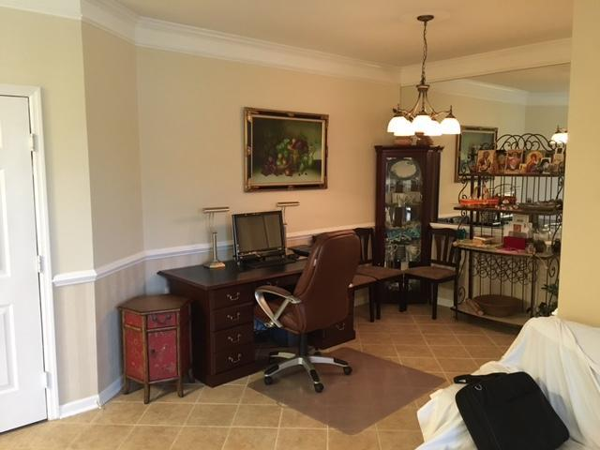
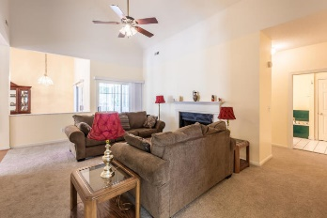
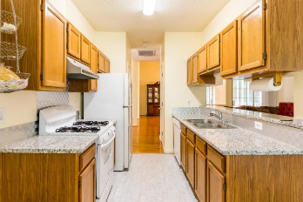
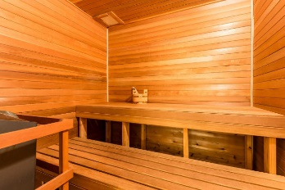
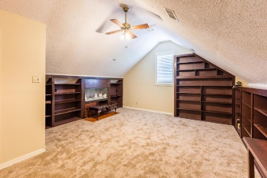
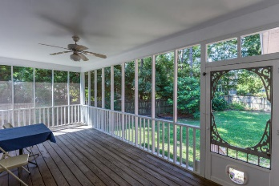


REDUCED PRICE! Open House Saturday
901 Watermelon
Stiles Point Plantation
Charleston, SC 29412
MLS# 19014675 | $529,900
4 Bedrooms | 3 Baths | 3,178 sf
Renovated and ready to move in!
Open Floor Plan! Freshly painted interior, brand new carpet. Kitchen has new granite countertops and new flooring! New Whirlpool dishwasher! Custom built sauna! Hardwood flooring in foyer, living room and formal dining room! Attached two room apartment above the garage that is perfect for a renter, teenager or college student! Well maintained fenced in back yard and a large screened in porch provide the perfect atmosphere for BBQ's and family fun! Only 12 minutes from MUSC and downtown Charleston!
Erik Fender
C 843-830-7346
O 843-856-8800
erik.fender@cbcarolinas.com
Coldwell Banker Residential Brokerage
1127 Queensborough Blvd. 103
Mt Pleasant, SC 29464

