Slide 1
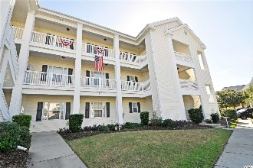
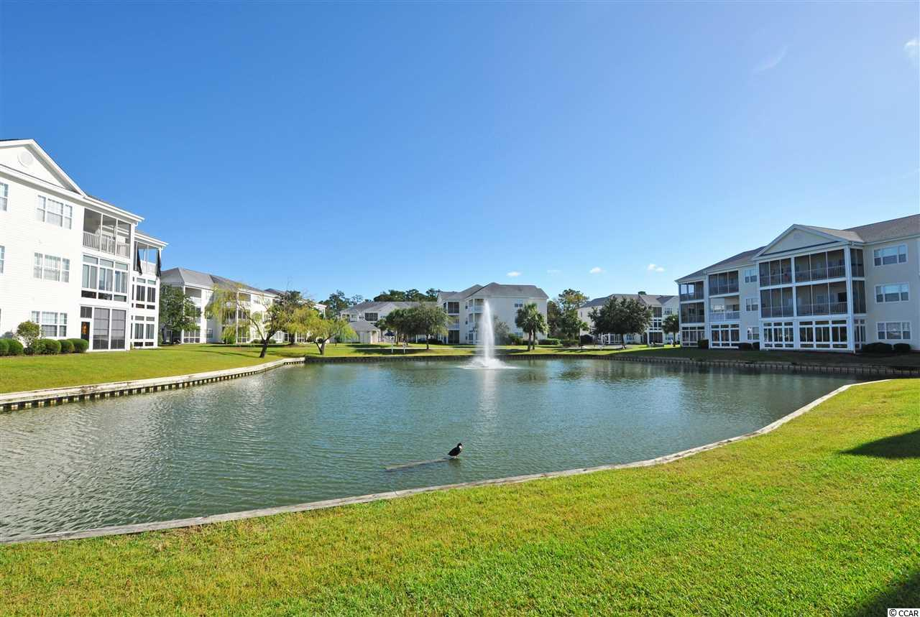
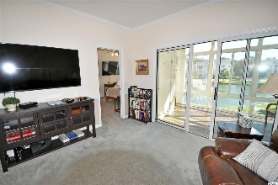
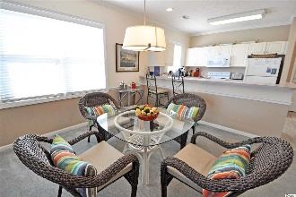
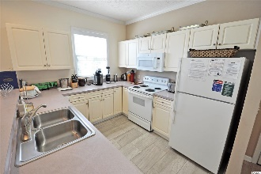
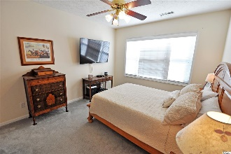
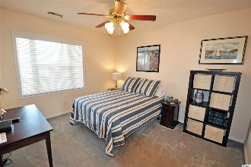
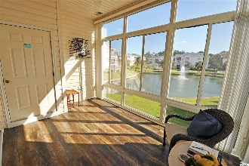
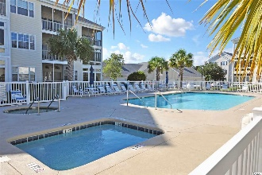
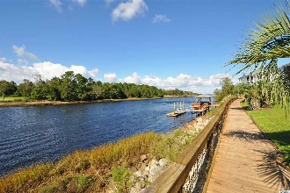
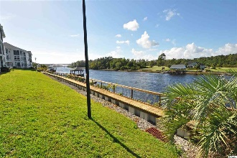


901 West Port Dr #908
Carolina Keyes ~ North Myrtle Beach, SC 29582
MLS# 2004077 ~ $169,900
Carolina Keyes is an upscale, popular North Myrtle Beach condominium community located on West Port Drive in the famous Ocean Drive section of North Myrtle Beach, South Carolina. This perfectly situated neighborhood is off Highway 17 South along the Intracoastal Waterway and near shopping dining, entertainment, attractions and major highways. This wonderful Carolina Keyes second story end/corner unit offers 2 bedrooms/ 2 full baths with a great kitchen, dining area, cable TV, and a washer and dryer. As a preferred corner unit, this condo is larger and has side windows for much cheerful natural light. Watch the boats across the street as they sail down the waterway at this desirable North Myrtle Beach signature residential, rental and investment accommodation. Carolina Keyes also has outdoor pools and Jacuzzi. There is a grilling area with picnic tables if you wish to enjoy a meal outside. As you get back onto Highway 17, you will be able to see a variety of restaurants and places to shop. Turn onto Main Street in the heart of North Myrtle Beach and ride down to the oceanfront. Shaggers, particularly, enjoy your time on Ocean Drive. Truly, look no further than Carolina Keyes unit 908 for one of the best North Myrtle Beach condos in the area. Nothing has been left out, so you can purchase a beautifully furnished home to relax or for fun, for a family or for a foursome! The kitchen is completely stocked with everything you need to prepare anything from simple meals or to try your hand at gourmet cooking; upgraded kitchen supplies are in abundance. Enjoy your morning coffee brewed fresh or use the Keurig coffee pot while enjoying the lake view from the Carolina Room, equipped with a wonderful solar shade for additional climate control and flexibility of use seasonally; this is a wonderful retreat for happy hour as well. In each living area you will find the perfect touches to make you feel right at home. The living room includes a new, larger designer couch in stylish beige fabric, a perfect match for the pleasing neutral decor so you can easily relax after a day at the beach or shopping while watching your favorite TV show on the extra large flat screen smart TV. Both bedrooms have a queen bed and a flat-screen TV. A full-size washer and dryer, ceiling fans and WIFI are included for your convenience. This spacious unit is sold furnished! Carolina Keyes is nestled along the Intracoastal Waterway, providing that hometown feeling while being just minutes away from anything you may want to do. There are two pools on the property, a nice dock area to enjoy watching the boats and grills for cooking out. The beach is only 1.2 miles from Carolina Keyes with easy-access parking. Golf carts and motorcycles are permitted, rules apply. Carolina Keyes is a sought-after development with low HOAs and which boasts luxury and convenience. The complex is well run and excellently maintained. It is close to the shore, yet still just a few minutes away from all that Myrtle Beach has to offer. This community really has it all, and the amenities are rich yet affordable -- two large pools with pool houses and sun decks; 2 hot tubs and a childrens' pool; along the waterway, there is a boardwalk that is lit up at night; multiple piers with floating docks; onsite parking for boats, etc., as well as free daytime docking; professional landscaping that includes a sprinkler system and ponds with fountains; and there are BBQ's for residents' usage.
This is a rare opportunity for purchase.
Deborah Collins
843-424-9013
dctidewater@yahoo.com
Connie Ross-Karl
702-306-2643
conniesross@aol.com
NEW WAY PROPERTIES MYRTLE BEACH

