Slide 1
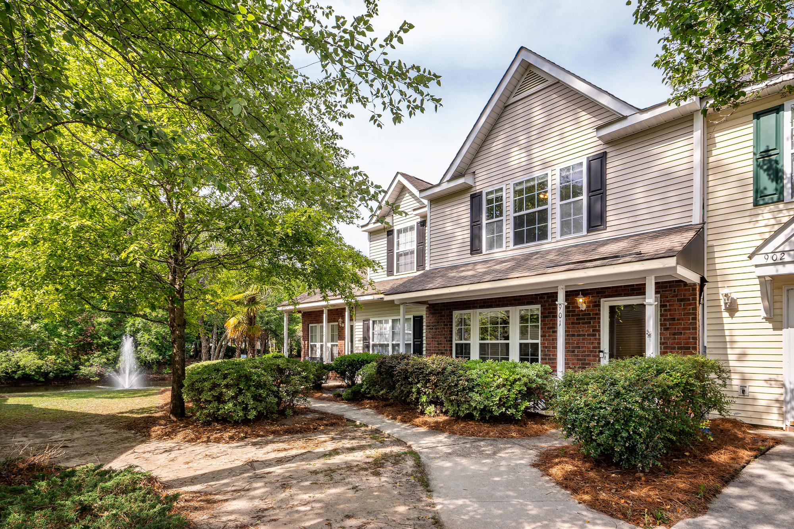
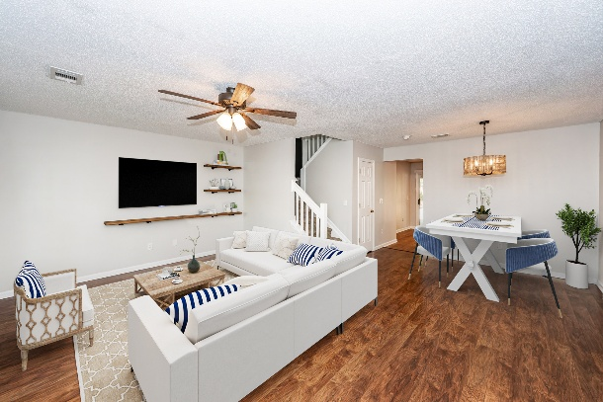
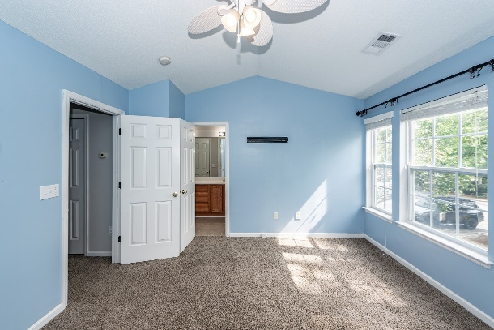


Open House Saturday May 31st from 1-3pm
901 Elm Hall Circle
Summer Wood | Summerville, SC 29483 | MLS# 25005224 | $247500
Welcome to this beautifully maintained 2BR/2.5BA townhome in the highly desirable Summer Wood community!
Features:
Open-concept living/dining with laminate floors
Bright kitchen with stylish painted cabinets and a pantry
Dual en-suite bedrooms with walk-in closets & linen storage
Fresh interior paint + upgraded lighting fixtures
Full front porch with pond/fountain views
Screened back porch with storage
Summer Wood offers lush landscaping and beautiful ponds
2 community pools!
Minutes from Historic Downtown Summerville, I-26, Volvo and more.
Don’t miss your chance—schedule your tour today or stop by the open house!
Libby Hearn
843-478-6652
libbyhearnrealty@gmail.com
www.sweetcarolinarealty.com
Sweet Carolina Realty
1810 Trolley Road, Suite B
Summerville, SC 29485

