Slide 1

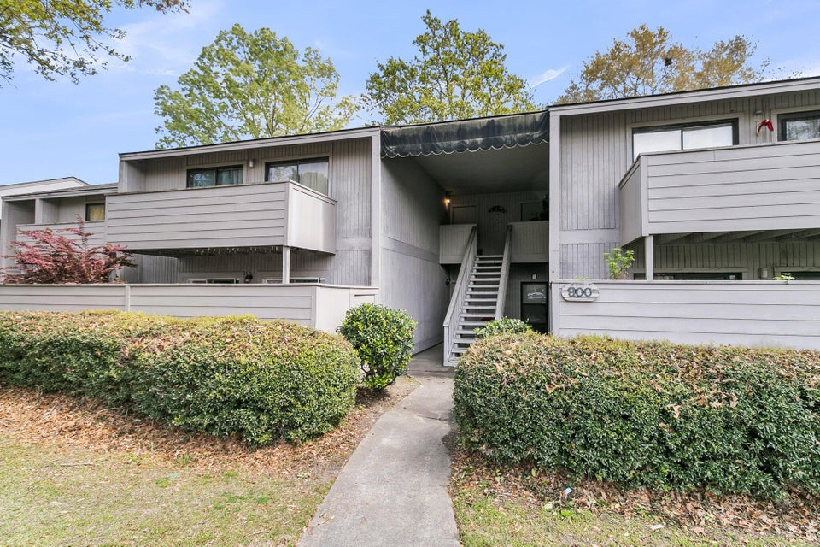
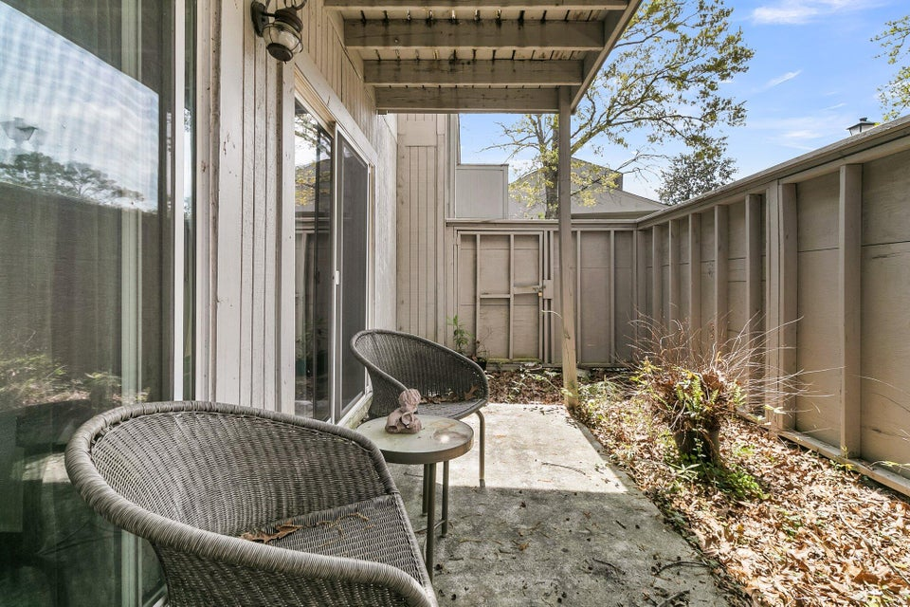
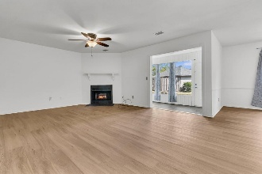
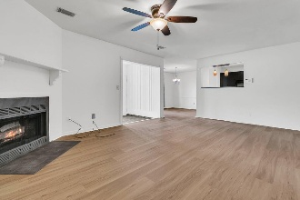
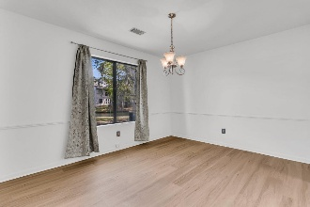
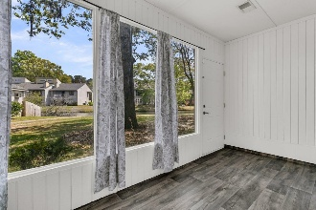
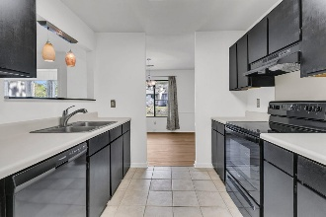

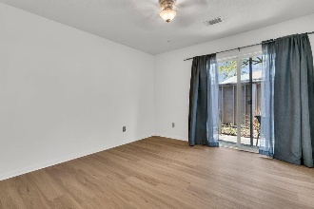
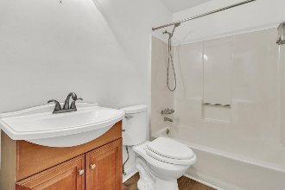
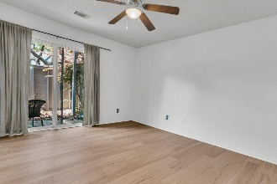
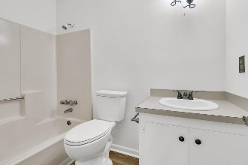
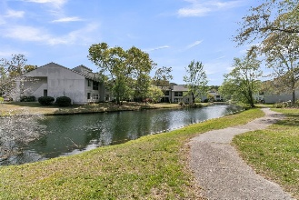
Debbie Cromer
ABR, RSPS, REALTOR, CRS
(843) 437-6342
debbie@debbiecromer.com
www.debbiecromer.com
Just Reduced + 2.5% BA Offered!
902 Greenmeadow Drive
Greenslake Condominiums | Goose Creek, SC 29445 | MLS# 25017074 | $156,500
This easy-living ground-floor condo has a great open layout and nice updates throughout. The bright sunroom is perfect for working from home or just relaxing, with pretty lagoon views and easy access to the community pool and walking trails.
The floor plan flows from the foyer into the family room, sunroom, dining area, and kitchen. The kitchen has black appliances, a pantry, refinished cabinets, and ceramic tile flooring. Both bedrooms open to a private enclosed patio and have ceiling fans and closets. The owner's bedroom has its own bathroom. The wood-look vinyl plank flooring is great for busy lives.
Don't miss your chance to make this inviting home yours—schedule your tour today!
Century 21 Properties Plus | 1090 Park West Blvd; Ste 103 | Mount Pleasant, SC 29466

