Slide 1
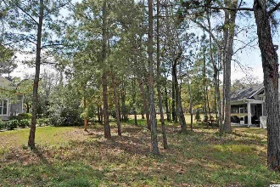

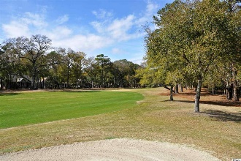
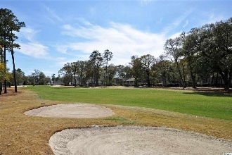
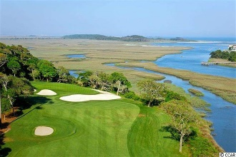
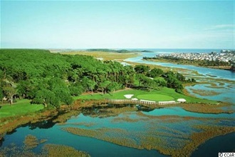
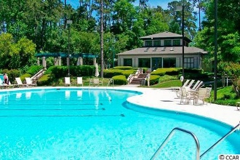
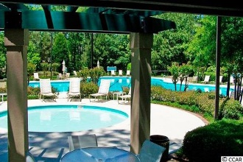
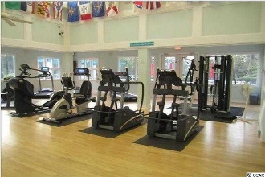
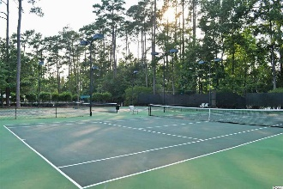
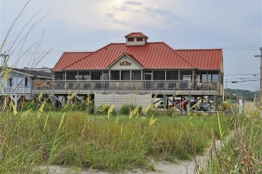


904 Morrall Drive
Tidewater Plantation Resort ~ North Myrtle Beach
MLS# 1806171 ~ $69,900
One of the few golf course lots left in the prestigious Bluffs of world-class Tidewater Plantation Resort! This wonderful golf course property has outstanding views of the fairway on the expansive 11th hole. The lightly wooded lot itself is also well located near the scenic Cherry Grove Marsh-front. Listen for the ocean from the front yard! The Bluffs of Tidewater borders the Cherry Grove Inlet where the Atlantic Ocean rolls into the marsh. The Bluffs are rapidly being built out as well; so this property is highly sought after for the builder, investor or soon-to-be home-owner who desire to acquire a luxury property at today's market prices to be built later. There is no deadline to build in Tidewater. Lot 664 has 84 feet of road frontage and is approximately 13,046.67 sq ft. Amenity-rich Tidewater is a 24-hour, manned gated community on a tree-lined road to oceanfront Anne Tilghman Boyce Coastal Reserve, a nature conservancy, including Waties Island, with access for managed recreational use. Tidewater itself is on an elevated peninsula of live oaks and southern pines between the Intracoatal Waterway and the Cherry Grove Inlet to the Atlantic Ocean. The plantation also preserves the unique look of its own historic origins. It is minutes from the beach, shopping, entertainment and access to major highways. The development has a private owners' beach cabana on the wide, white sands of the Cherry Grove Beach, just a few minutes drive. This lot enjoys that lovely, peaceful environment, along with the excellent reputation of the Tidewater Golf Course, the Pebble Beach of the East. Tidewater amenities at low HOA fees include that oceanfront beach cabana. Bluffs residents enjoy the use of 3 pools/hot tubs. The pool in the Bluffs is, however, exclusive to its residents. Other amenities include driving range, putting green, golf shop, clubhouse with bar and dining overlooking the 18th hole, clay & hard-surface tennis courts, pickle ball, fitness center, bocce courts, amenity center/more. There is even a gated storage yard for boats, campers, recreational vehicles and the like. The HOA building is conveniently on site with library and event, meeting space. Tidewater Plantation in popular North Myrtle Beach truly reflects a "way of life." Do not let this great lot at such a great price get away. Welcome to the the best of the beach on the golf course in the Bluffs of Tidewater Resort.
Deborah Collins
843-424-9013
dctidewater@yahoo.com
Connie Ross-Karl
702-306-2643
conniesross@aol.com
NEW WAY PROPERTIES MYRTLE BEACH

