Slide 1
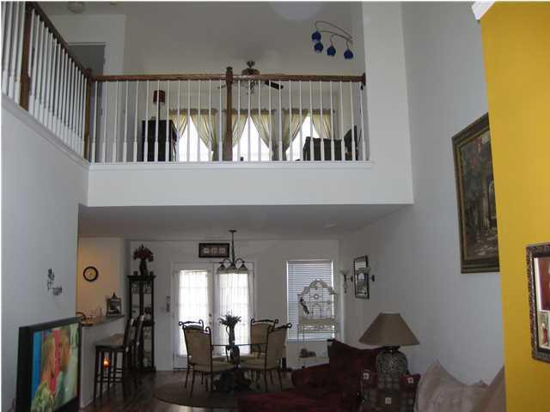
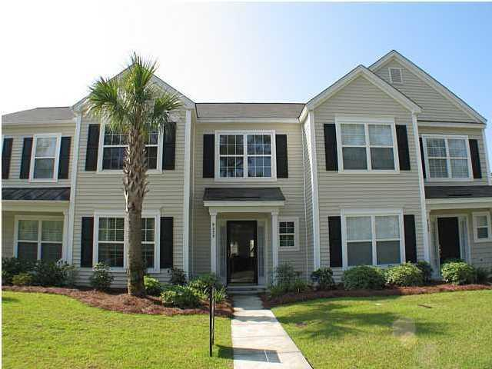
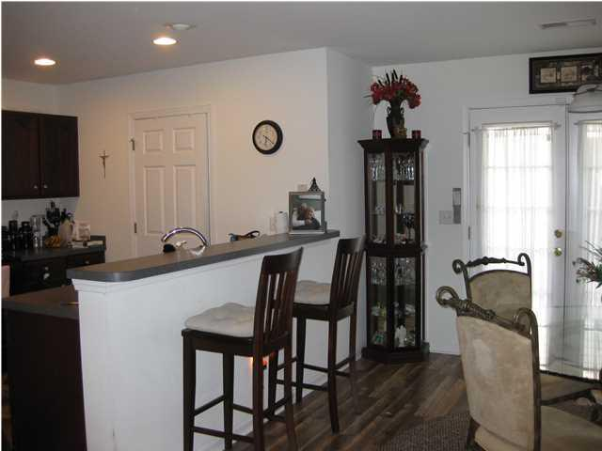
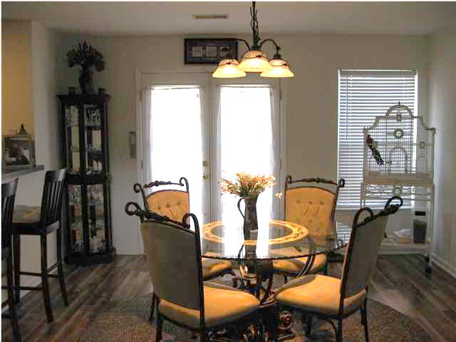
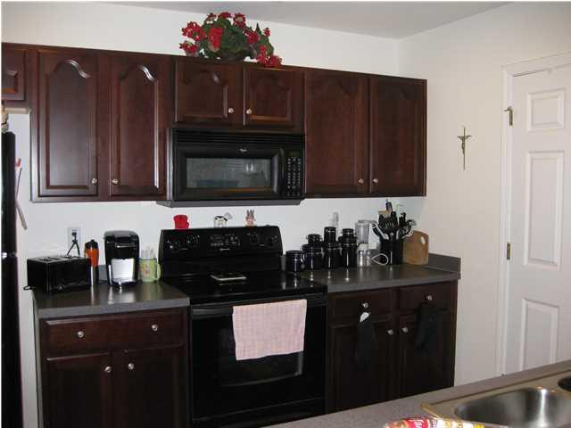
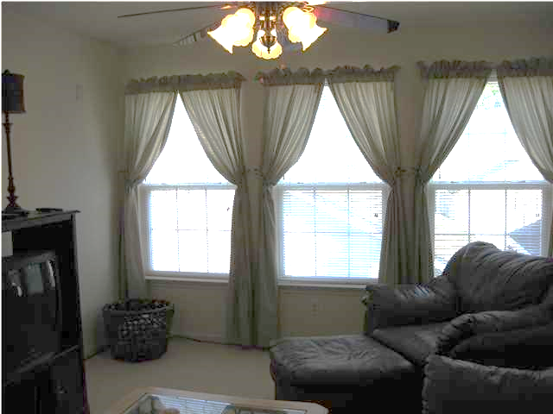
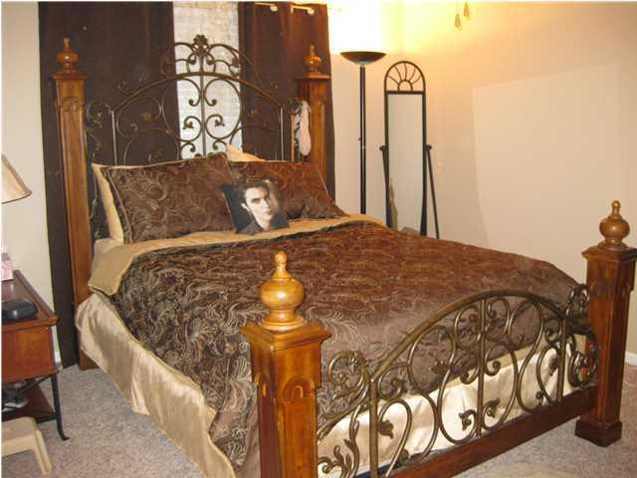
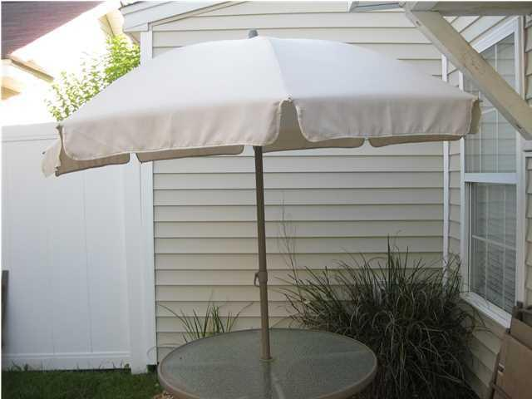
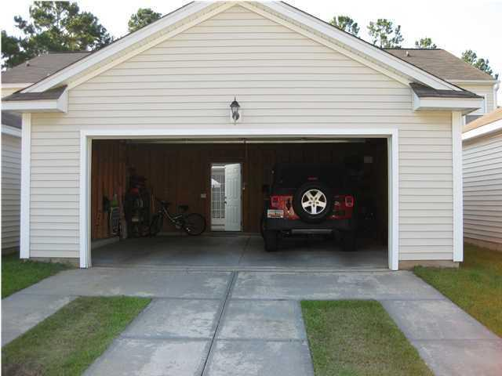


APPROVED SHORT SALE Ready to close in 30 DAYS!!!
9053 Maple Grove Drive
Wescott Plantation | Summerville | MLS# 1422647 | $149,000
I can give you 10 Reasons why you should buy this home!!!
Motivated seller.
Move in ready.
Already upgraded with black appliances and hardwood floors.
Very open floor plan with high ceilings.
Master downstairs with a full bathroom and walk in closet.
A powder room for guest downstairs so they do not have to use the master bathroom.
2 bedrooms upstairs with a full bathroom and a loft to make an office, playroom or a sitting room, whatever you prefer.
Private quaint back yard.
2 Car garage with opener. Priced to sell.
Don't miss this opportunity. Its not going to wait for you.
Carmilla Brown, REALTOR
Mobile - (843) 926-2007
crbrownrealestate@gmail.com
www.yourcharlestonnewhome.com
Keller Williams Realty 496 Bramson Ct Ste 200
Mt. Pleasant, SC 29464

