Slide 1
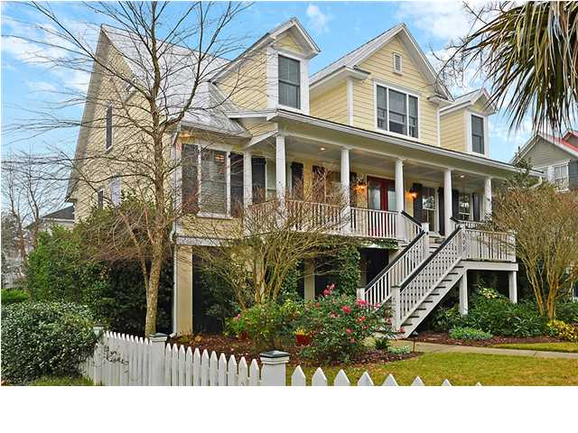
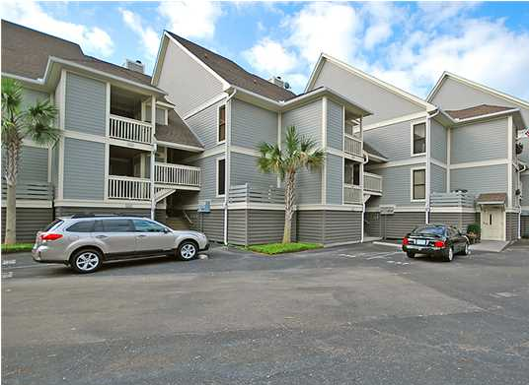
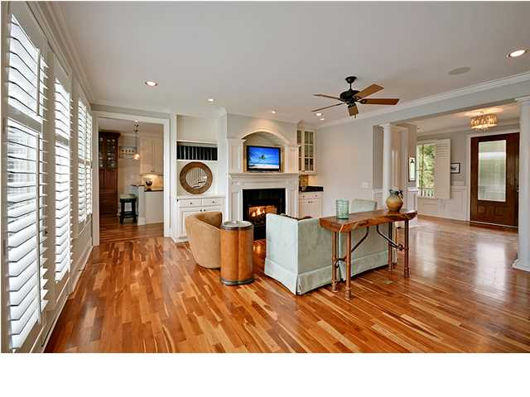
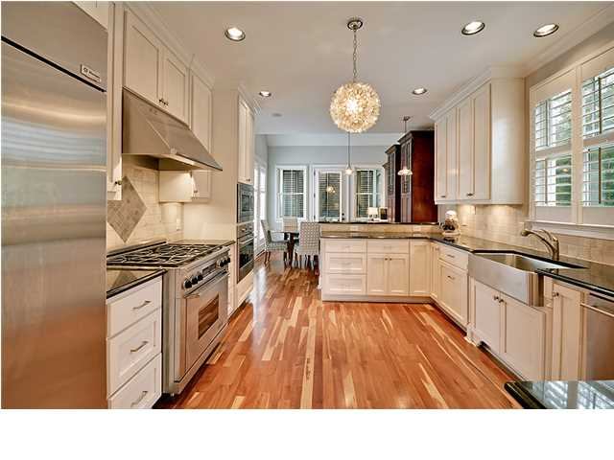
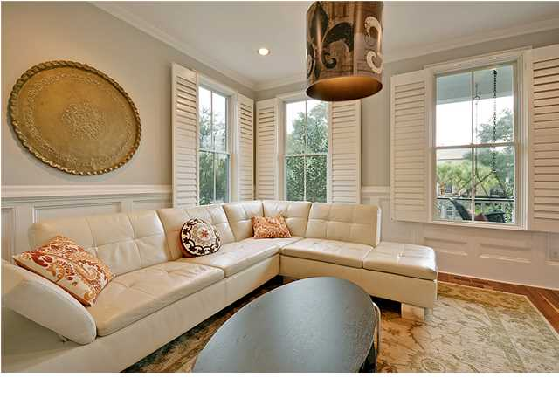
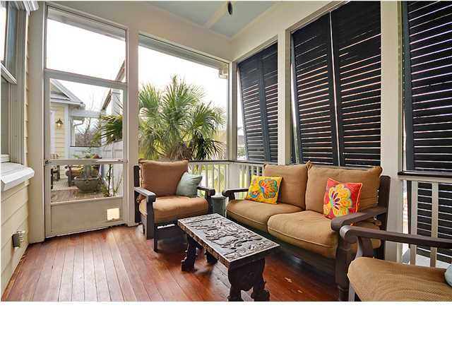
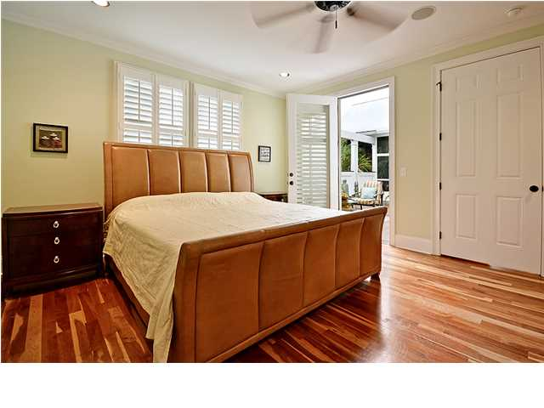
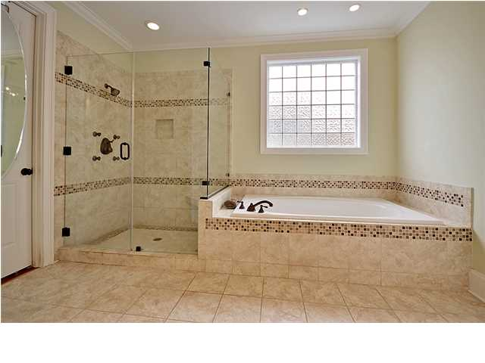
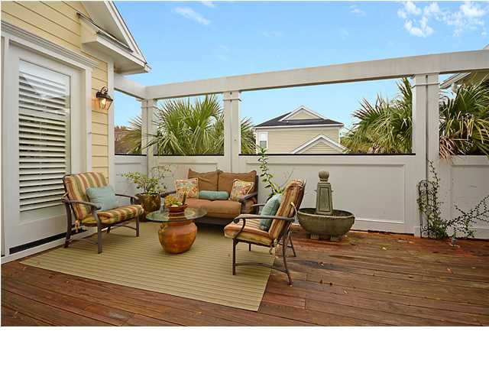
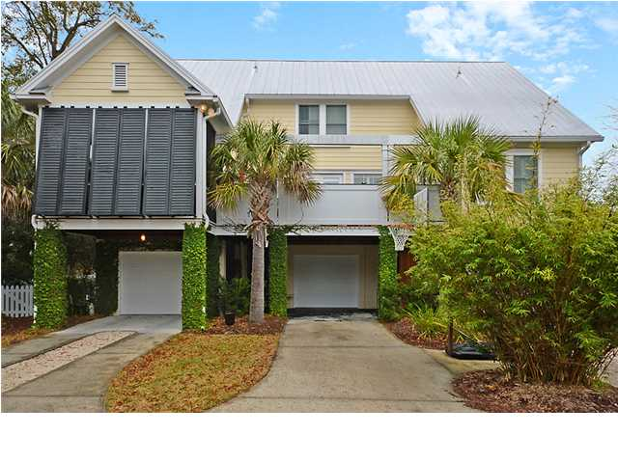

Open House
Sunday 1-4
905 McIver St ~ Old Mt Pleasant ~ MLS# 1331060 ~ $919,000
Some people dream of having the perfect home with a white picket fence, now's the time to make that dream a reality! With five bedrooms, four and a half baths, a three car garage and 3,200 square feet of living area, this custom low country home is located in Mt Pleasant's highly sought after Saltgrass Pointe. This gorgeous home has an unbelievable location. The sandy beaches of Sullivan’s Island are just a short bike ride away, you can walk to all the great shopping and restaurants found in Old Village, and you can rest assured knowing that this home is in a great school district with an award winning school within walking distance. The attention to detail and quality of construction is apparent from the moment you set foot on the full front porch with its swing and enter through the elegant, mahogany front doors. Inside you'll notice high ceilings, wainscoting, chair rail molding, crown molding, plantation shutters and simply stunning Australian cypress hardwood floors. Two columns in the foyer lead to the great room where there's recessed lighting, surround sound and built-ins are on either side of the fireplace. Around the corner is the chef's kitchen which boasts a Dacor gas range, granite counters, recessed lighting, stainless steel appliances and a breakfast bar in the eat-in area. This culinary playground allows plenty of room to work and space for guests to visit and eat. A door in the eat-in area leads to the screened-in porch where you can also access the deck, a perfect outdoor living area! One of the two master bedrooms is located on the first floor and has access to the deck, a walk-in closet and a giant master bath with dual vanity and a seamless glass walk-in shower. This home is simply spectacular from top to bottom while being conveniently located in the heart of Old Mount Pleasant. Come on by before its too late!
*Seller offering a $2,000 credit for paint and flooring updates with an acceptable offer
Angel French Angel@MattONeillTeam.com (843) 367-5333
Jordan Elleby Jordan@MattONeillTeam.com (843) 819-9229

