Slide 1
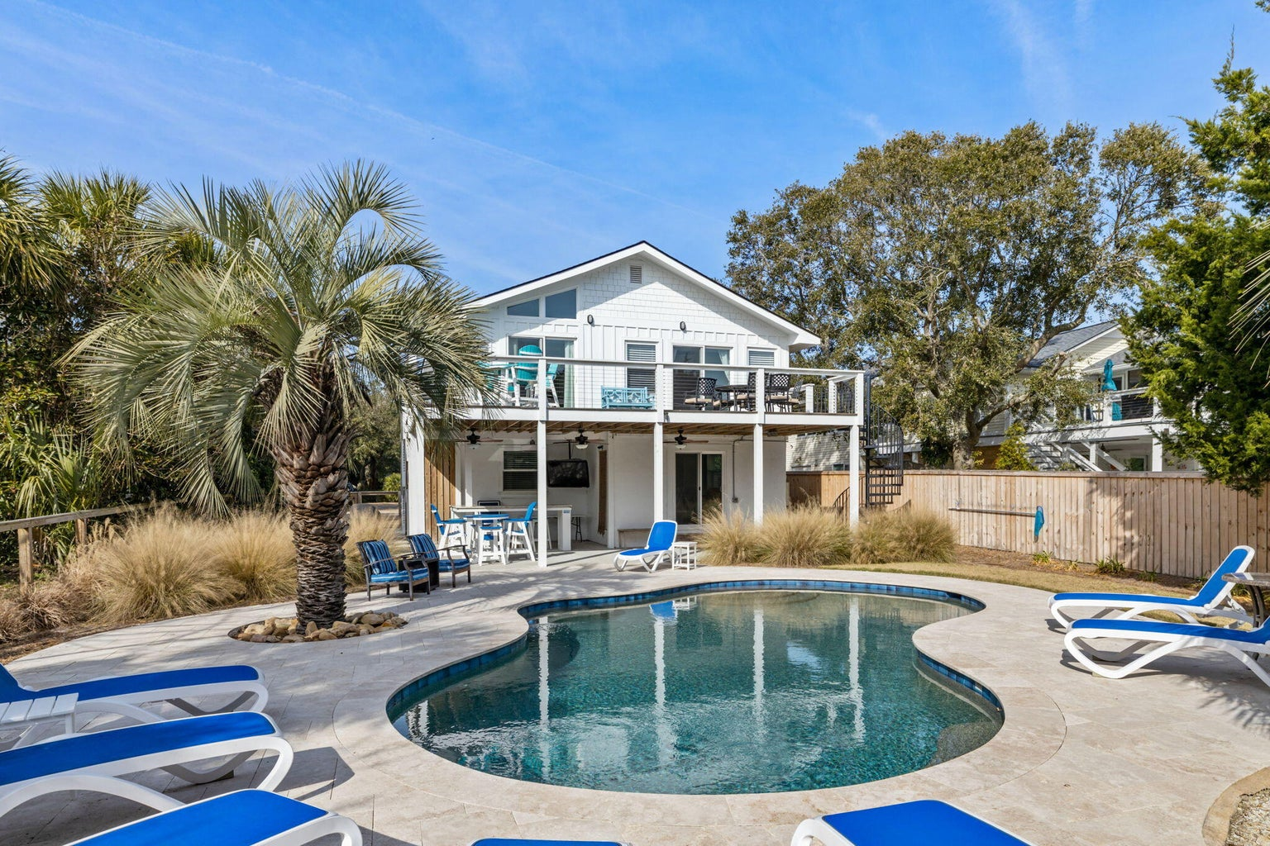
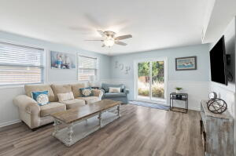
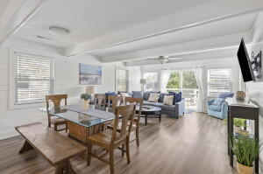
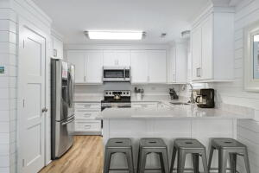
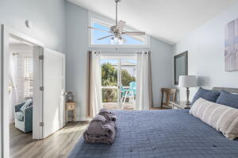
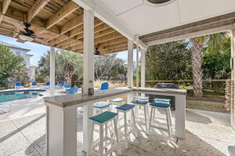
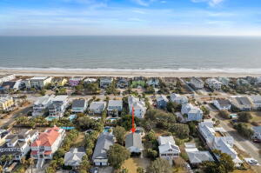
906 Carolina Boulevard Isle of Palms, SC 29451 MLS# 23005019 | $2,650,000
Darrell Creek Elevated Home With Elevator & Salt Pool
IOP - Great Investment Opportunity!
Vacation rental with an outstanding rental history and CAP rate. It would also make a great primary home! Classic, updated, 1970s IOP beach house on the South side of the island. Great location one block to the beach and one block to Front Beach shops and restaurants. This is a .24 acre lot with a spacious backyard and a ton of outdoor living space. Full renovation and added pool in 2018-2019. Home will be sold fully furnished with an outstanding vacation rental record; however, it would also make a wonderful primary or secondary home! The ground level includes the foyer; recreation room with bar, beverage refrigerator, and microwave; primary bedroom with king size bed and en suite bath; a secondary bedroom with twin beds; a hall bath; and laundry closet. Upstairs you'll find the kitchen with Shaker-style cabinets, stainless steel appliances, stone countertops, and breakfast bar dining area with table for 8; family room with queen sleeper sofa; a second primary suite with king bed; two secondary bedrooms (one with a queen bed and one with two double beds); and a hall bath. Home is beautifully finished with custom lighting and plumbing fixtures, custom cabinetry, and floor-to-ceiling shiplap in the main areas on the second floor as well as shiplap wainscoting in the main areas on the first floor. Morning coffee and evening cocktails simply taste better when you're on the island, sitting on your second-floor deck overlooking the beautifully landscaped back yard with heated saltwater pool and Travertine patio surround. On the ground level you can choose the sun (poolside) or the shade (covered patio with L-shaped bar and 50" TV). This turn-key property has been completely renovated from top to bottom, inside and out, and is ready to start producing income with its new owner or ready for move in!
Andrea Rogers
(843) 532-3010 | andrearogers1@gmail.com | www.andrearogersrealtor.com
AgentOwned Preferred Group | 1400-G Palm Blvd | Isle Of Palms, SC 29451

