Slide 1
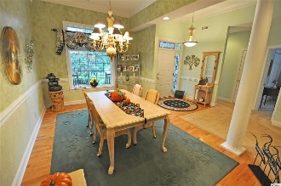
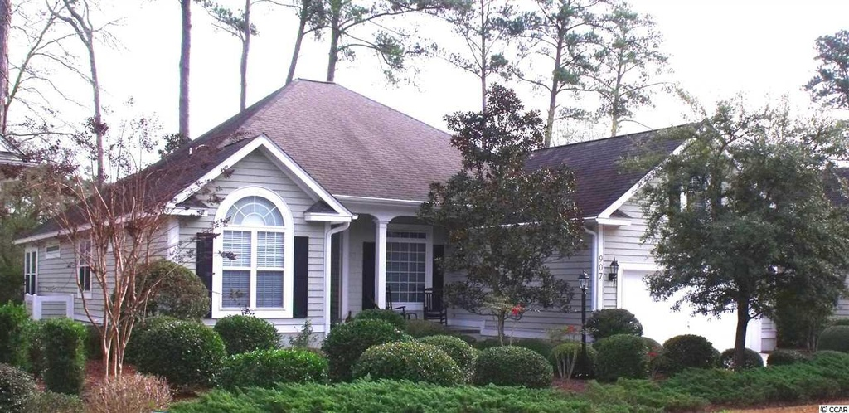
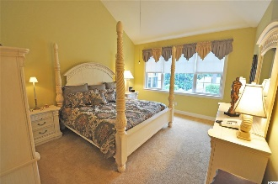
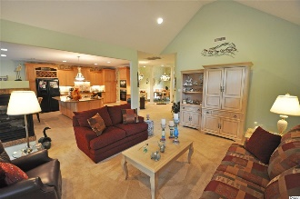
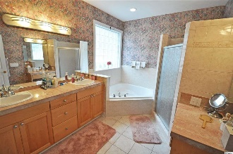
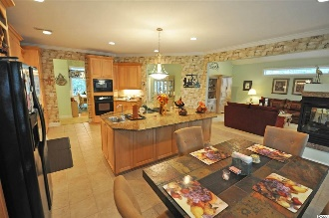
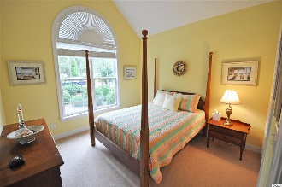
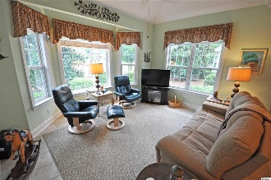
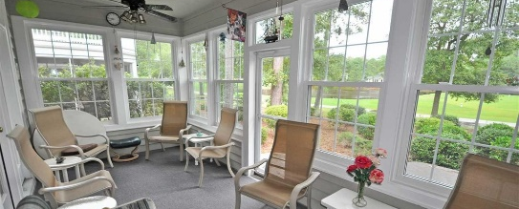
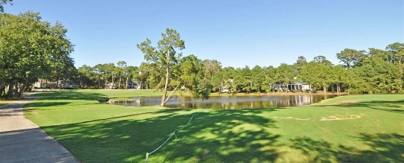
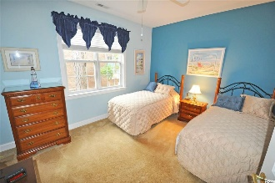
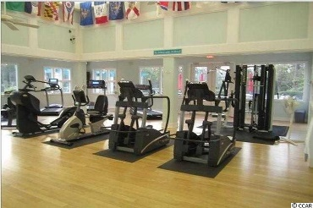
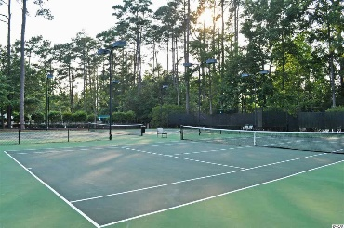
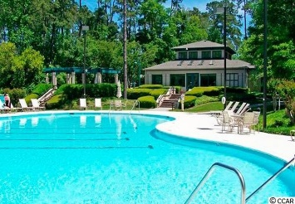
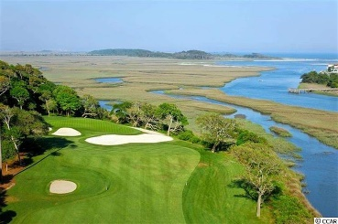
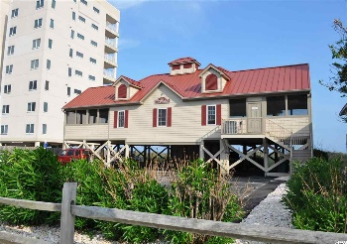


Lots Of Upgrades - Overlooks Tidewater Resort Golf Course
$1,000 selling agent bonus paid by seller if sold by 3/31/16
907 Morrall Dr
Tidewater Plantation - North Myrtle Beach, SC 29582
MLS# 1519831- $418,000
Fall in love first with the home, then with the singular golf/beach community lifestyle. It has everything, and this is a BIG! house, 3 bedrooms in a split-bedroom floor plan on first floor, with another bedroom with full bath, bonus room and floored attic storage on the second level. 3 and one-half baths! Lots of closets and more storage on each level and in the over-sized 2-car garage. Nice traffic pattern from garage to kitchen features large laundry with sink and more along convenient entry hall. Magnificent view of 14th hole of Tidewater Golf Course and one of its most amazing panoramas of the lake and the indigenous wildlife. Sun room, patio and new spa (conveys), all embellish this beautiful indoor/outdoor environment for maximum enjoyment, scenic serenity and relaxation year round. Kitchen has marvelous marble counter tops, grand island and warm maple cabinets. And there is a cozy double fireplace between the kitchen and living room. Appliances convey. Family room and formal living areas open to the kitchen, creating an enormous great-room area, perfect for families and entertaining. There's even a separate formal dining room. Window treatments convey; some furniture, like commanding master bedroom four-poster bedroom set, upscale dining room suite and many other items are negotiable. (All furnishings in the home are negotiable.) Spacious, spacious, spacious, for BIG families, BIG beach home fun and BIG value throughout more than 4,000 square feet! Singular offering at a compelling reduced price. Located in prestigious Tidewater Plantation - one of the top-rated golf courses in the Grand Strand - with 24 hour gated, manned security. Tidewater amenities include an oceanfront beach cabana for owners' use with open/screened porches, bathrooms, showers and kitchen. Other amenities include driving range, golf shop, clubhouse with bar and dining faculties overlooking the 18th hole, clay and hard surface tennis courts, fitness center overlooking pool, bocce courts, and amenity center for public/private/special events. Other group activities include outdoor summer concert series, group work out classes including water aerobics, artist group/classes, Happy Hours, dinner clubs, book clubs, bridge, mahjong and holiday events plus more! In addition, Tidewater boasts a gated storage lot for boats, jet skis, motorcycles and kayaks. Tidewater Plantation and its full range of amenities truly reflects a "way of life" where friendly neighbors will welcome you to your new home. This is an immaculately kept home, with scheduled maintenance, timely repairs and replacement of minor and major home systems. Tidewater is likewise a wonderful community, with regular beautification and planned maintenance and improvements. This combination of location and BIG opportunity is truly unmatched. Easy to see!
Deborah Collins
843-424-9013
dctidewater@yahoo.com
Connie Ross-Karl
702-306-2643
conniesross@aol.com
NEW WAY PROPERTIES MYRTLE BEACH

