Slide 1
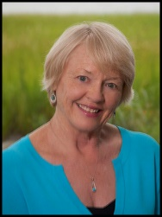
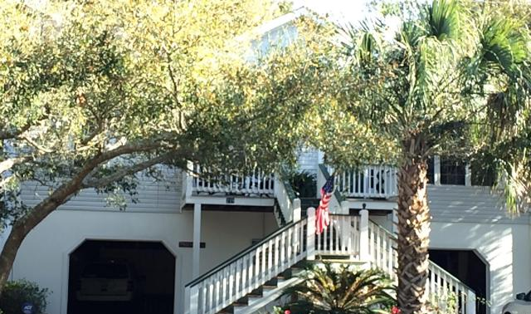
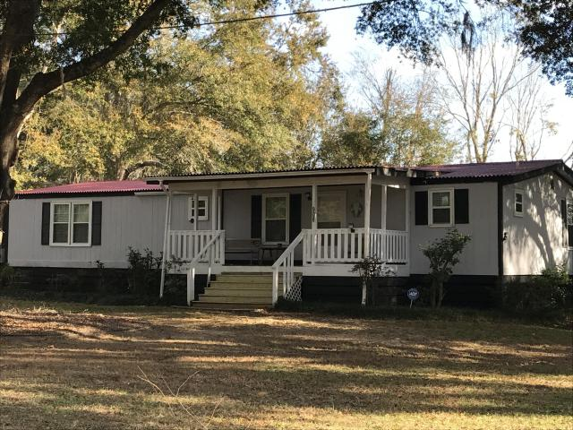
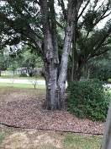
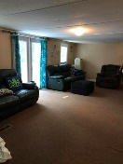
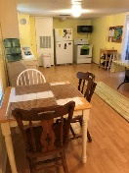
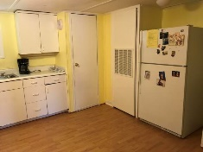
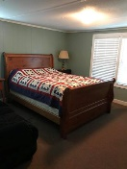
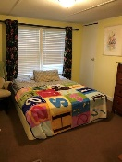
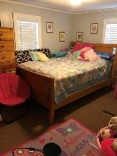
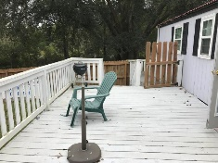
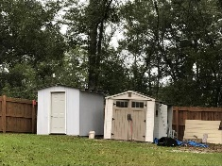
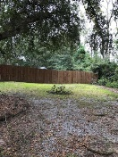
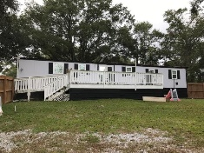
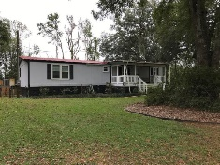

Open House
Sunday, March 25th 12-4pm
Jane Locke, Realtor
M (843) 819-3508
lockejaneb@aol.com
www.century21properties.com
908 Highway 174 | Edisto Island, SC 29438 | MLS# 17030133 | $145,000
DRAFT
Country island living at its best at this quiet and peaceful home. This is a double wide on a corner lot with a nice front porch for rocking and a large deck on the back for family cookouts and parties. This home is on a .92 acre of land and has a fenced backyard with a 6 foot privacy fence. There are two buildings in the back - a pump house and a building for storage of lawn equipment. The front yard has lovely mature live oaks creating a shady oasis. It is 3 miles from beach and minutes to nearby boat landings. This could be your home or maybe your weekend retreat. You are only minutes from jumping the waves or lounging in your beach chair with your toes pointing to the water. Come check this out as this will not stay on the market long. Property near the beach goes quickly.
Century 21 Properties Plus | 3301 Salterbeck St Suite 100 | Mt. Pleasant, SC 29466

