Slide 1
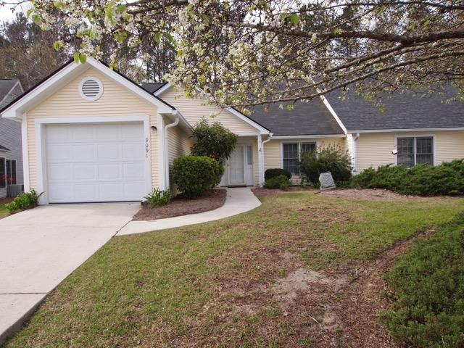
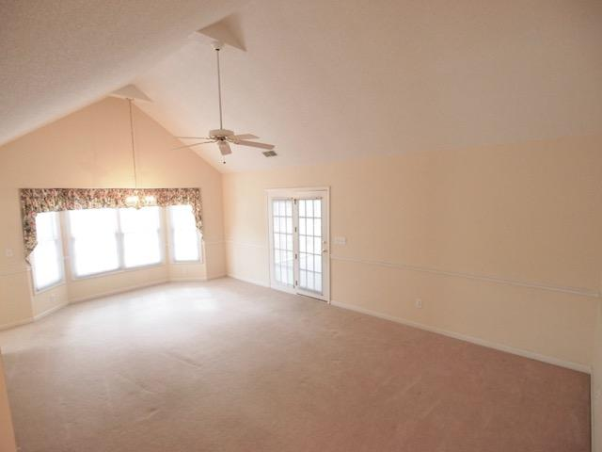
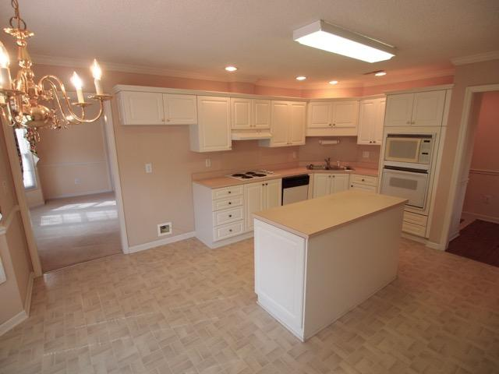
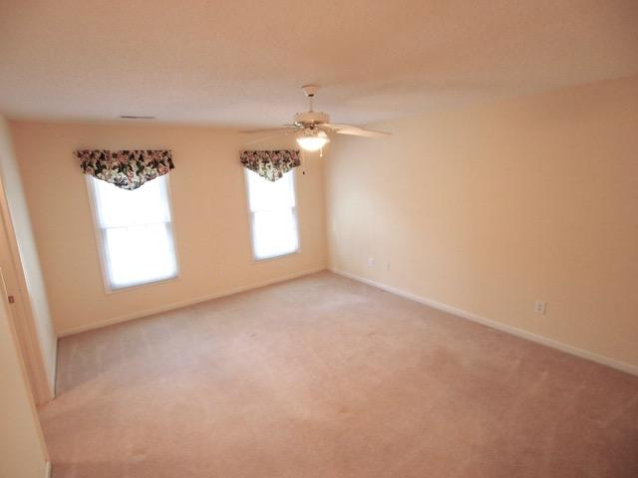
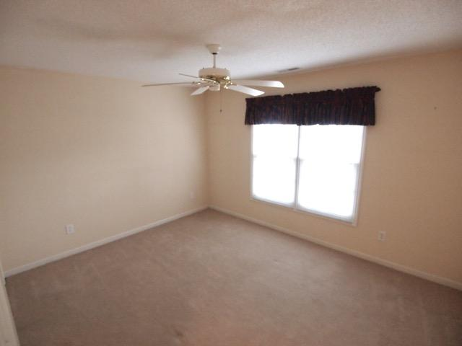
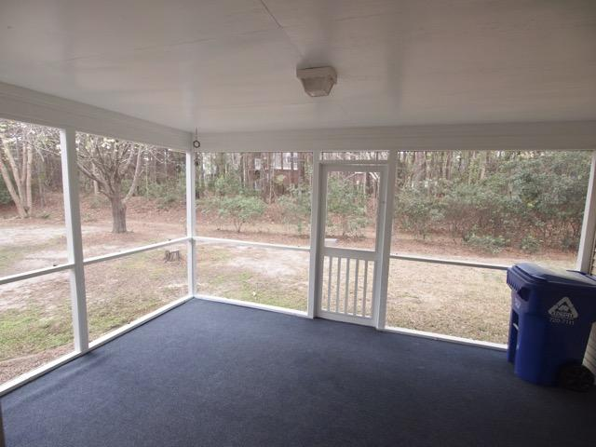
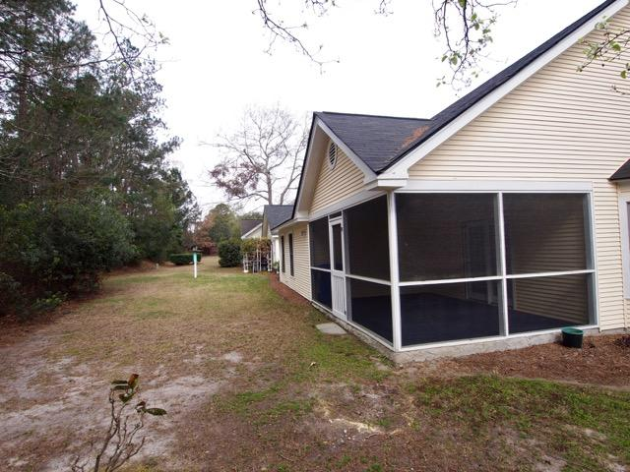

9091 Delancey Cir Elms of Charleston North Charleston, SC 29406 MLS# 17006374 $180,000 1,370 Sq Ft - 2 Bedroom - 2 Bath
Priced to Sell!
An immaculate 2 bedroom, 2 bath duplex in the beautiful over 55 gated community of The Elms of Charleston is ready for a new owner. As you enter, notice the hardwood in the foyer. The eat-in kitchen is bright and sunny with recessed lighting and plenty of cabinet and counter space as well as an island. The oven and microwave are built-in for added convenience. The family/dining area is large enough to hold many a family gathering. Off the family room is a large screened-in porch. There are two spacious bedrooms that round out this pretty home. This home is bright and cheerful: large enough to entertain family and friends but small enough to be manageable and comfortable. HOA fees include care of lawns, annual power washing and painting of exterior trim. There are many activities available. The club house has been renovated and boasts of gathering rooms, exercise areas, and lockers rooms. A swimming pool and tennis courts are available too.
CMGCharleston.com is the website address.
Liz & Bob Simonds
843-261-7138 O | 843-437-9696 M lizandbob@agentownedrealty.com
AgentOwned Realty Co. Premier Group, Inc. | 141 A N. Main St | Summerville, SC 29483

