Slide 1
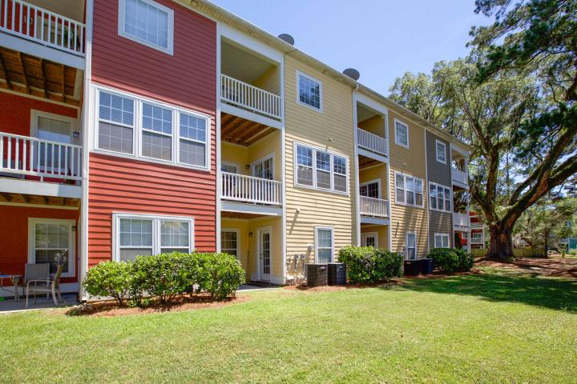
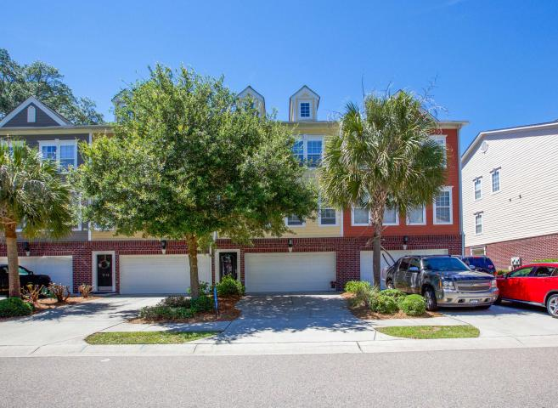
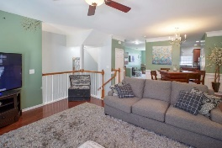
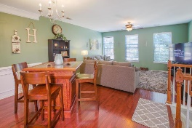
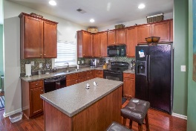
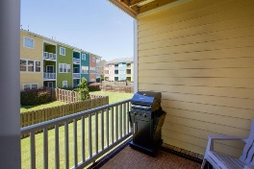
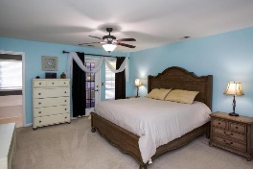
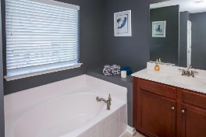
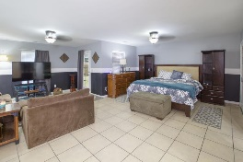
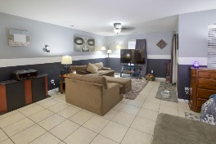
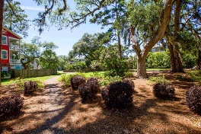
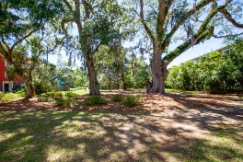
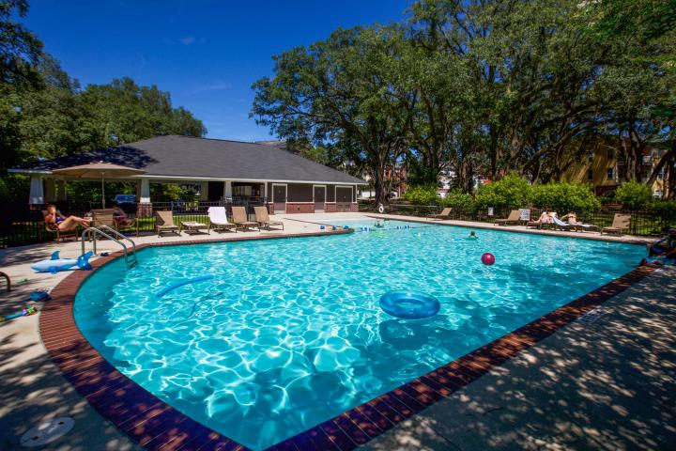

Must See To Believe
9108 Parlor Drive
Tranquil Hill Plantation ~ Ladson, SC 29456
MLS# 17013932 ~ $199,000
Beautiful Large Townhome. Over 2600 square feet. Excellent condition with new carpet in entry way. Bonus Room on the lower level may be used as Mother-in-law suite, theatre or play room, man/woman cave, or addition living area. Main living area on second level has kitchen with black appliances, dining area, and formal living area. Third level has a large master bedroom and bathroom with large tub and separate shower and two vanity areas. The third level also has the laundry area and two additional bedrooms with shared bath. Must see to believe the size and layout of this beautiful town home. Perfect for couples or families. Community Pool, Dog Park, and play area are included in this neighborhood. Pictures cannot convey the beauty!
Deborah Meuli
(843) 822-0133
dmeuli@comcast.net
Wendy Deitsch
(843) 270-0433
wendy@lifetreeliving.com
LifeTree Real Estate, LLC | 3094 Hwy 17 North | Mt. Pleasant, SC 29466 | www.lifetreerealestate.com

