Slide 1
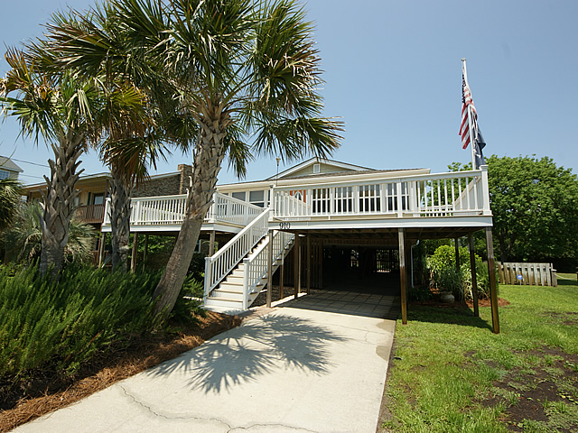
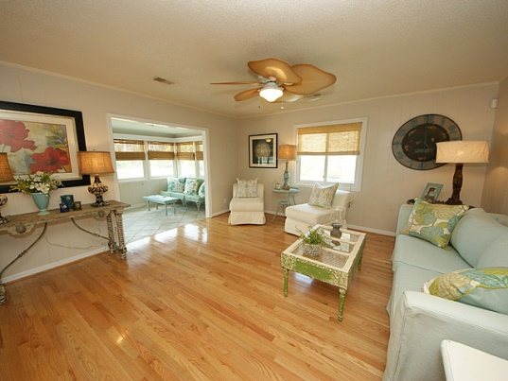
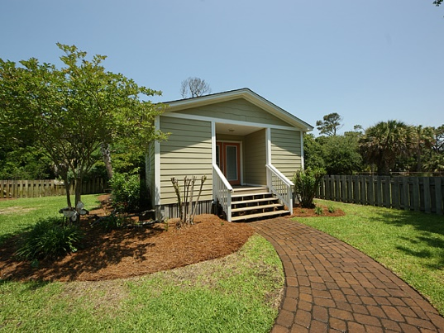
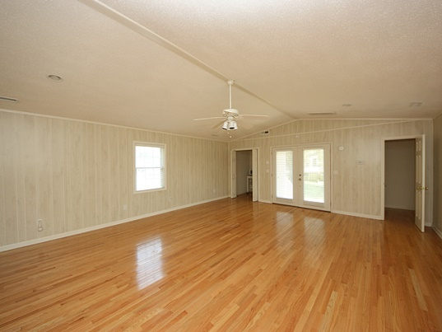

Second Row Cottage Steps from the Beach
910 West Ashley Ave – Folly Beach, SC
MLS# 1323694 - $615,000
Breezy Folly Island living with double front porches where you can hear the ocean from your hammock from this 2nd row home. Open the door into the front sun room and large dining area that overlooks the kitchen and great room. Large enough to entertain but cozy for a family as well. Lots of light , new windows and hardwood floors throughout. Down the hall are three large bedrooms and newly renovated baths with tile and granite. Past the bedroom a door leads you to an enclosed porch converted to a airy and bright laundry room connected to a large deck. As you look from the deck, you see another building ! Yes, a man cave/ billiards / ping pong / retreat complete with a half bath ! Hardwood floors as well ! A must see ! Well maintained and easy to breeze in for the weekend or stay for weeks.
Angela Black Drake Broker Associate
angela@limehouseproperties.com
O: (843) 577-6242 | C: (843) 991-0337 | F: (843) 577-0504
Limehouse Properties • 8 Cumberland Street • Charleston, SC 29401

